Slide 1



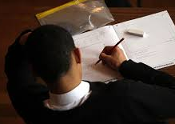
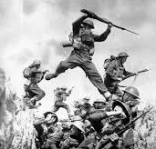


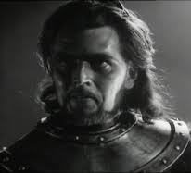


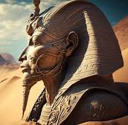
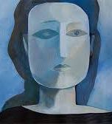


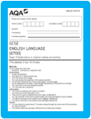
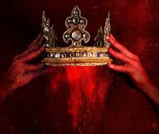
English Learning Journey Year 11
Level 3 qualifications-
Further Education
GCSE exams
Power and Conflict Poetry –London, Ozymandias, Prelude, My Last Duchesss, Charge of the Light Brigade, Exposure, Bayonet Charge, Storm on the Island Remains, Poppies, War Photographer, Emigree, Checkin Out My History, Kamikaze, Tissue You will develop your academic writing skills – comparing poems
Revision and exam practice
Revision and exam practice
Develop your wellbeing and relaxation techniques ready for the examination period
Play: An Inspector Calls - The format of a modern play, exploring stage directions, Social class, the themes of social responsibility, social class,
Complete taught curriculum and revision
Ap3
Exams – Literature and Language
AQA language paper 1 & 2 section B READINGs - The format of the paper. How to respond to the writing section of the exam
Spring Term
Power and Conflict Poetry – poems about identity – Emigree, Checkin Out My History, Kamikaze, Tissue You will develop your academic writing skills – comparing poems
Exams – Literature and Language
Ap2
You will develop your academic writing skills – unseen poems
Ap1
YEAR
START
Autumn
Term
11
AQA language paper 1 & 2 section A & B READINGs - The format of the paper. How to respond to each question.
Shakespeare: Macbeth You will learn about the Jacobean era, Divine Right of Kings, Great Chain of Being Patriarchal society, Shakespearean context, play format, dramatic irony and develop your academic writing skills.

