Slide 1


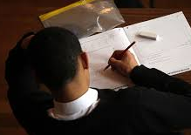


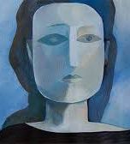
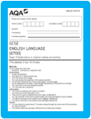


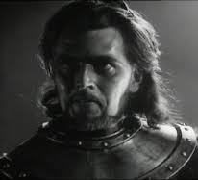
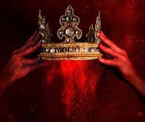
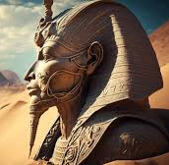
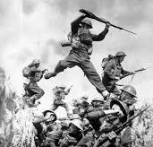
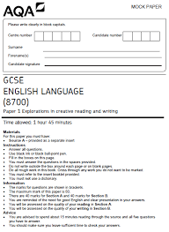
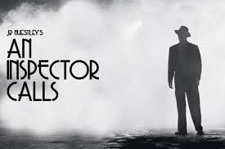
English Learning Journey Years 10-11
Level 3 qualifications-
Further Education
Revision and exam practice
Exams – Literature and Language
Complete taught curriculum and revision
GCSE exams
Spring Term
Ap2
Power and Conflict Poetry – poems about war in the present and identity– Remains, Poppies, War Photographer, Emigree, Checkin Out My History, Kamikaze, Tissue You will develop your academic writing skills – comparing poems
Exams – Literature and Language
YEAR
Ap1
11
Autumn
Term
Develop your wellbeing and relaxation techniques ready for the examination period
Shakespeare: Macbeth You will learn about the Jacobean era, Divine Right of Kings, Great Chain of Being Patriarchal society, Shakespearean context, play format, dramatic irony and develop your academic writing skills.
Exams – Literature An Inspector Calls / PC poetry and Language Paper 1
Ap3
AQA language paper 1 & 2 section B READINGs - The format of the paper. How to respond to the writing section of the exam
Power and Conflict Poetry – poems about war in the past– Charge of the Light Brigade, Exposure, Bayonet Charge, Storm on the Island You will develop your academic writing skills – comparing poems
Ap2
Spring Term
Exams – An Inspector Calls and Language Paper 1
Power and Conflict Poetry – conflict poems – London, Ozymandias, Prelude, My Last Duchesss You will develop your academic writing skills – comparing poems
Ap1
YEAR
START
Autumn
Term
10
AQA language paper 1 & 2 section A READINGs - The format of the paper. How to respond to each question.
Play: An Inspector Calls - The format of a modern play, exploring stage directions, Social class, the themes of social responsibility, social class,

