Slide 1




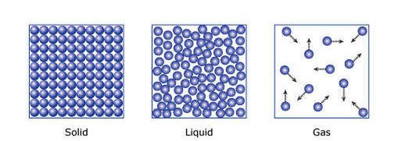






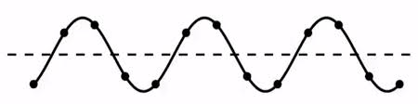


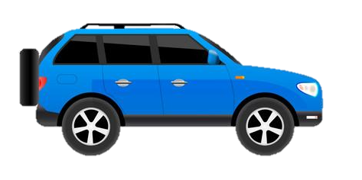




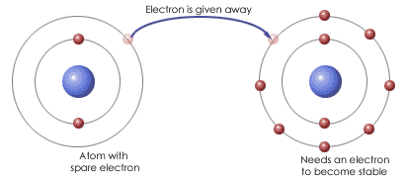

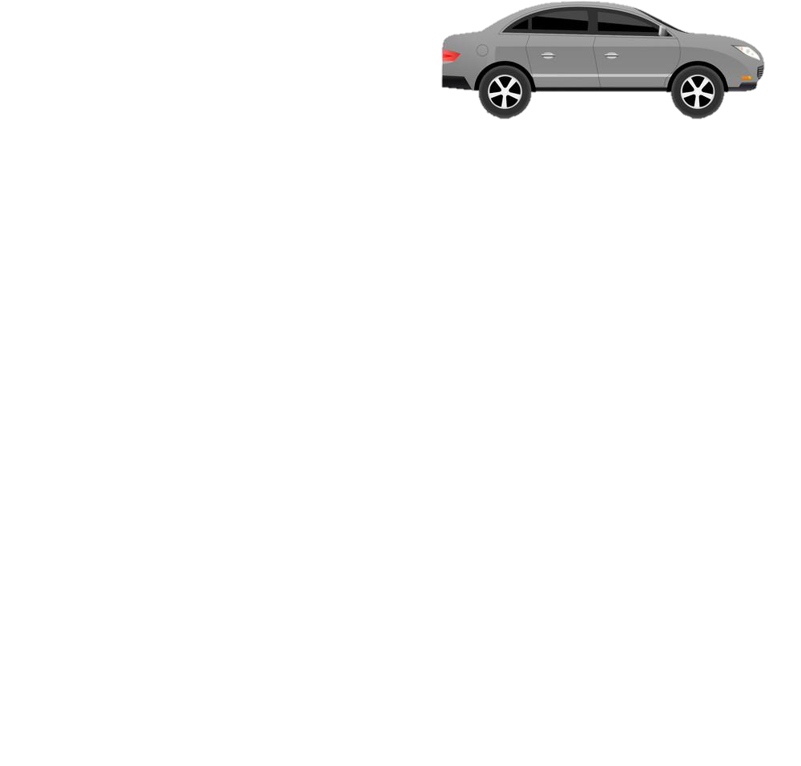
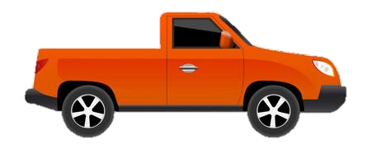

YEAR 9 SCIENCE 2024 – 25
PIN BANK
Simply drag a pin to add it to your journey
Destination Two: Possible Career in Biology e.g Dental technician, trainee lab technician, health care profession and apprenticeship schemes
C5 Chemical change
B2 Cells division
Destination One
You can go on to study A levels in Biology, Physics and chemistry or Level 3 BTEC Applied Science
HALF TERM
3
The red box:
These road work boxes can be used to highlight a particular task, or link parts of the journey to the national curriculum.
Just copy and paste when needed and drag to map position, editing position of pin if necessary. Type over this text.
P11 Wave properties
END OF TERM
2
END OF TERM
HALF TERM
B7 Non communicable disease
B6 Preventing and treating disease
C2 Periodic table
HEADING
HEADING
HALF TERM
2
The red box:
These road work boxes can be used to highlight a particular task, or link parts of the journey to the national curriculum.
Just copy and paste when needed and drag to map position, editing position of pin if necessary. Type over this text.
B1 Cell strcuture and transport
C1 Atomic structure
END OF TERM
1
HALF TERM
1
P8 Forces in balance
CAR PARK
Why not
START
Introduction to Core Practical
Working Scientifically
LEARNING JOURNEY

Slide 2


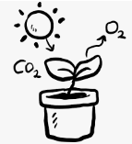

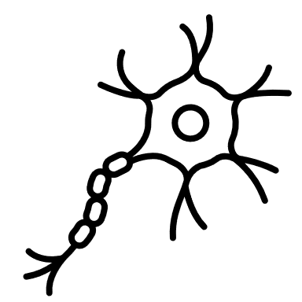
The red box:
These road work boxes can be used to highlight a particular task, or link parts of the journey to the national curriculum.
Just copy and paste when needed and drag to map position, editing position of pin if necessary. Type over this text.
YEAR 10 Biology 2024-25
PIN BANK
Simply drag a pin to add it to your journey
Destination Two: Possible Career in Biology e.g Dental technician, trainee lab technician, health care profession and apprenticeship schemes
Review and catch up time.
C10-12 Electrolytic Processes; Metals; Reversible Reactions
Destination One
You can go on to study A levels in Biology, Physics and chemistry or Level 3 BTEC Applied Science
HALF TERM
3
The red box:
These road work boxes can be used to highlight a particular task, or link parts of the journey to the national curriculum.
Just copy and paste when needed and drag to map position, editing position of pin if necessary. Type over this text.
END OF TERM
2
END OF TERM
HALF TERM
B12 Reproduction
HEADING
HEADING
Assessment 5:
Full paper1’s for Biology, Physics and Chemistry
HALF TERM
2
B12 Reproduction
B9 Respiration
B8 Photosynthesis
END OF TERM
2
HALF TERM
1
CAR PARK
Assessment 4:
Chemistry Paper 1
Why not
Baseline Assessment
Recover
START
Assessment 1: Science Skills
Assessment 2:
Full Mock Exam: EDEXCEL Biology Paper 1
Assessment 3:
Full Mock Exam: EDEXCEL Chemistry Paper 1
B4 Organisation in plants and animals
LEARNING JOURNEY
Notes:
Do not print

Slide 3
The red box:
These road work boxes can be used to highlight a particular task, or link parts of the journey to the national curriculum.
Just copy and paste when needed and drag to map position, editing position of pin if necessary. Type over this text.
YEAR 10 Chemistry 2024-25
PIN BANK
Simply drag a pin to add it to your journey
Destination Two: Possible Career in Biology e.g Dental technician, trainee lab technician, health care profession and apprenticeship schemes
Review and catch up time.
C10-12 Electrolytic Processes; Metals; Reversible Reactions
Destination One
You can go on to study A levels in Biology, Physics and chemistry or Level 3 BTEC Applied Science
HALF TERM
3
The red box:
These road work boxes can be used to highlight a particular task, or link parts of the journey to the national curriculum.
Just copy and paste when needed and drag to map position, editing position of pin if necessary. Type over this text.
END OF TERM
2
END OF TERM
HALF TERM
C6 Electrolysis
HEADING
HEADING
Assessment 5:
Full paper1’s for Biology, Physics and Chemistry
HALF TERM
2
C5 Chemical change
C5 Chemical change
C3 Structure and bonding
END OF TERM
2
HALF TERM
1
CAR PARK
Assessment 4:
Chemistry Paper 1
Why not
Baseline Assessment
Recover
START
Assessment 1: Science Skills
Assessment 2:
Full Mock Exam: EDEXCEL Biology Paper 1
Assessment 3:
Full Mock Exam: EDEXCEL Chemistry Paper 1
C3 Structure and bonding
LEARNING JOURNEY
Notes:
Do not print

Slide 4






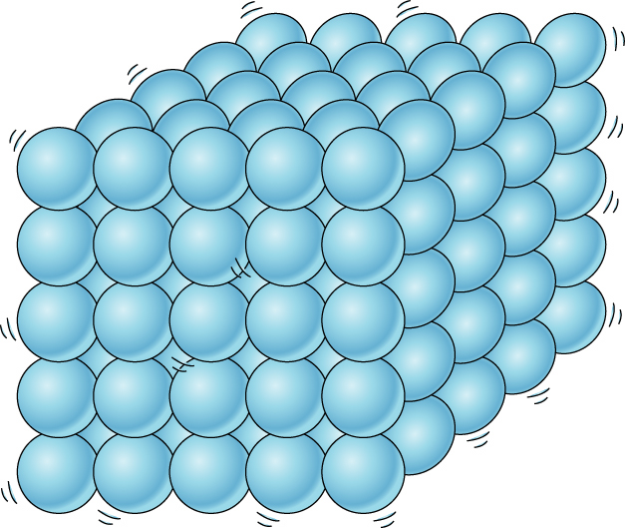
The red box:
These road work boxes can be used to highlight a particular task, or link parts of the journey to the national curriculum.
Just copy and paste when needed and drag to map position, editing position of pin if necessary. Type over this text.
YEAR 10 Physics 2024-25
PIN BANK
Simply drag a pin to add it to your journey
Destination Two: Possible Career in Biology e.g Dental technician, trainee lab technician, health care profession and apprenticeship schemes
Review and catch up time.
C10-12 Electrolytic Processes; Metals; Reversible Reactions
Destination One
You can go on to study A levels in Biology, Physics and chemistry or Level 3 BTEC Applied Science
HALF TERM
3
The red box:
These road work boxes can be used to highlight a particular task, or link parts of the journey to the national curriculum.
Just copy and paste when needed and drag to map position, editing position of pin if necessary. Type over this text.
END OF TERM
2
END OF TERM
HALF TERM
P13 Electromagnetism
HEADING
HEADING
Assessment 5:
Full paper1’s for Biology, Physics and Chemistry
HALF TERM
2
P7 Radioactivity
P6 Molecules and matter
P10 Force and motion
END OF TERM
2
HALF TERM
1
CAR PARK
Assessment 4:
Chemistry Paper 1
Why not
Baseline Assessment
Recover
START
Assessment 1: Science Skills
Assessment 2:
Full Mock Exam: EDEXCEL Biology Paper 1
Assessment 3:
Full Mock Exam: EDEXCEL Chemistry Paper 1
P9 Motion
LEARNING JOURNEY
Notes:
Do not print

Slide 5





The red box:
These road work boxes can be used to highlight a particular task, or link parts of the journey to the national curriculum.
Just copy and paste when needed and drag to map position, editing position of pin if necessary. Type over this text.
YEAR 11 SCIENCE 2024-25
PIN BANK
Simply drag a pin to add it to your journey
Destination Two: Possible Career in Biology e.g Dental technician, trainee lab technician, health care profession and apprenticeship schemes
Destination One
You can go on to study A levels in Biology, Physics and chemistry or Level 3 BTEC Applied Science
Half term 3
B7 Animal Coordination & Control
The red box:
These road work boxes can be used to highlight a particular task, or link parts of the journey to the national curriculum.
Just copy and paste when needed and drag to map position, editing position of pin if necessary. Type over this text.
Prepare for exams
Assessment 2:
Paper 12
B10 Nervous system
Catch up and revision
End of term 2
END OF TERM
HALF TERM
C10 Chemistry analysis
P9 motion
C11 Earths atmosphere
HEADING
HALF TERM
2
HEADING
C12 Earths resources
P10 Forces and motion
B17 Biodiversity and ecosystems
P11 Wave properties
P12 Electromagnetic waves
C9 Crude oil and Fuels
End of term 1
C9 Crude oil and fuels
Assessment 1:
Paper 1
HALF TERM
1
B16 Adaptation and competition
CAR PARK
Why not
START
P8 Forces in balance
C8 Rates and equilibrium
Skills
LEARNING JOURNEY

