Slide 1



























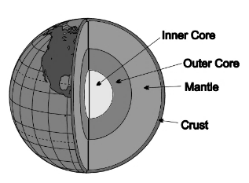
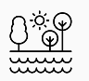
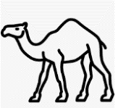
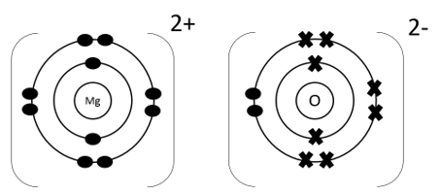





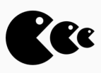







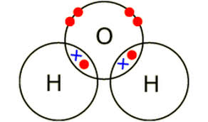
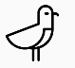



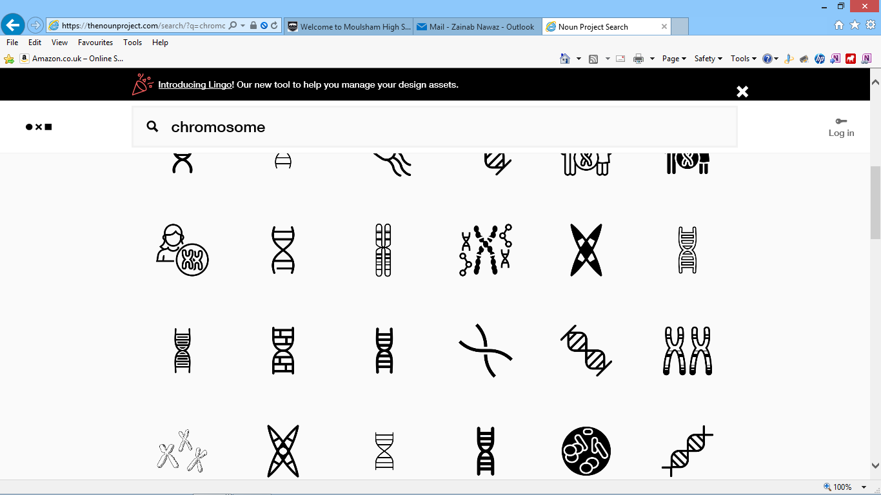
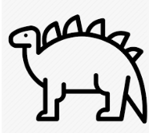






Year 8 Learning Journey
Year 8
Understanding and Applying Scientific Skills
Year 9
Writing methods
Assessing impact of scientific concepts
Understanding relationships between science and society
IDEAL
Identify, describe, explain, apply, link
Risk Assessment
Understanding variables
Drawing graphs and analysing graphical data
Analysis of secondary data
Modelling scientific concepts
Drawing conclusions
Applying maths to the scientific concepts
Describe patters
Abiotic and Biotic factors
Universe
Moon Phases
Plant Minerals
Astronomer
Year 9
Solar System
Seasons
Eclipses
Photosynthesis
Biochemist
Resistance
Potential Difference
Static
Chromatography
Electrician
Solubility
Aerobic Respiration
Amps and Voltage
Circuits
Purity
Solutions
Anaerobic Respiration
Magnets and Electromagnets
Predator Prey
Types of rocks
Fossils
Fossil Fuels
Conservation of mass
Moles
Geologist
Pharmacist
Sampling Techniques
Structure of the Earth
Weathering
Air pollution
Relative formula mass
Communities
Water Cycle
O=C=O
Chemical bonds, ionic, covalent and metallic
Transpiration
Ecosystems
Food Webs
Distributions of Organisms
Relative atomic mass
Plant tissues
Ecologist
Periodic Table Scientist
Adaptations
Food Chains
Decomposition
Periodic table
Structure and bonding of carbon
What is gravity?
Calculating and describing how we use speed?
How do we See?
Properties of Sound
Light & Sound Engineer
Motor Sport Scientist
How bonding and structure are related to properties
Reflection Refraction
Sound in Space
Colour
What is the difference between weight and mass?
Calculating and investigate pressure
Variation
Inheritance
Conduction, Convection, Radiation
investigate how to change gas pressure
Competition and Adaptation
Natural selection
Extinction
YEAR
8
Evolution Scientist
Heating Engineer
Adapting to change
Continuous and discontinuous variation
Specific heat capacity
Temperature and Heat

