Slide 1










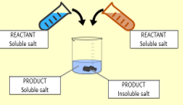


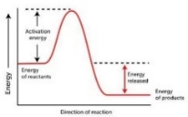


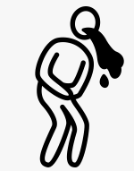






















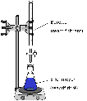


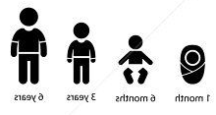




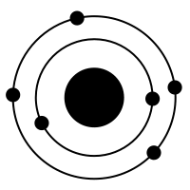


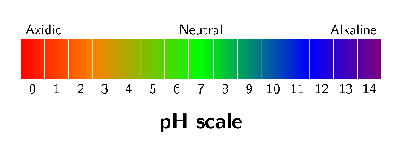




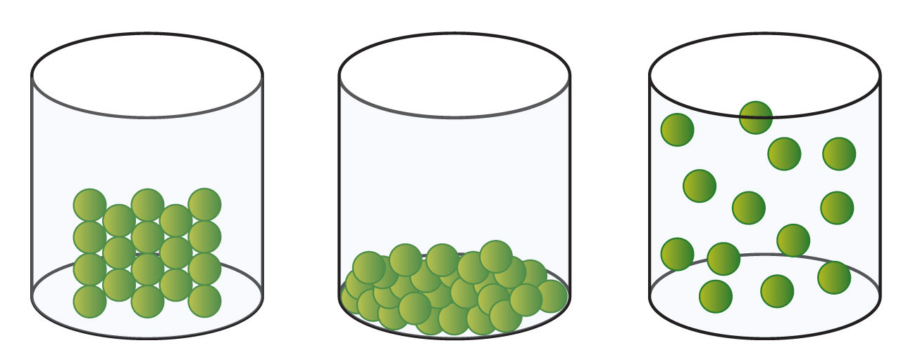
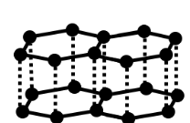


Year 7 Learning Journey
Year 7
Understanding and Applying Scientific Skills
Year 8
Writing methods
Assessing impact of scientific concepts
Understanding relationships between science and society
IDEAL
Identify, describe, explain, apply, link
Risk Assessment
Understanding variables
Drawing graphs and analysing graphical data
Analysis of secondary data
Modelling scientific concepts
Drawing conclusions
Applying maths to the scientific concepts
Describe patters
Skeleton
Physio
Year 8
Breathing
Gas exchange
Muscle Movement
Physical and Chemical Change
Precipitates
Newton meters
Analytical Chemist
Hooke’s Law
Endo/Exothermic Reaction
Combustion
Thermal Decomposition
Friction
Force Scientist
Types of Force
Disease
Unhealthy diet
Antibiotics
Food tests
Alcohol
Health Scientist
Air Resistance
Gene Expression
Nutrients
Microbes
Drugs Smoking
Balanced Forces
DNA
Flowers and pollination
The menstrual cycle?
Fertilisation and implantation
Seed dispersal
Geneticist
Insoluble Salts
Fertilisation and germination
Development of a fetus
Reproductive systems
Adolescence
Titration
Acid Scientist
Cost of Energy
Acids and Bases
Particle Model
Stores of Energy
Sankey Diagrams
pH Scale
Atoms Elements and Compounds
Energy Scientist
Indicators
Renewable and Non Renewable
Neutralisation
Molecular Chemist
Chemical Formula
Particles in Solution
Cell division
Levels of organisation
Movement of substances
Specialised cells
Observing cells
YEAR
7
Cell Biologist
Solids, Liquids, Gases
Breathing
Gas exchange
Unicellular organisms
Plant and animal cells
Polymers

