Slide 1



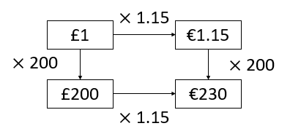
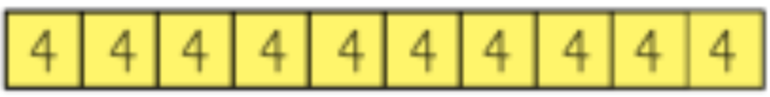
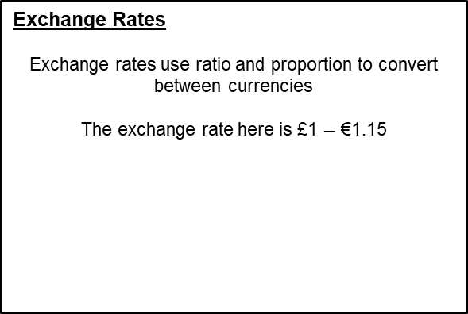
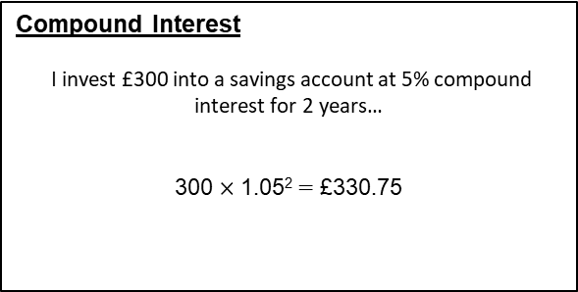
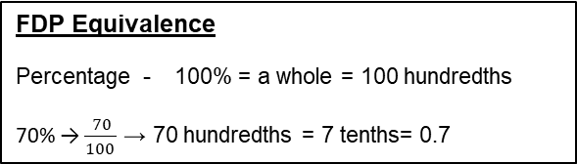
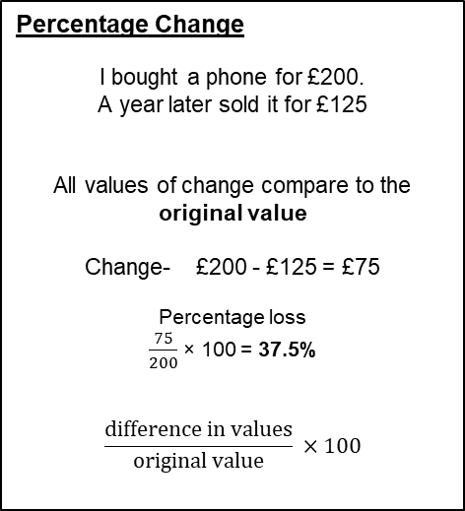
Year 11 – Reasoning with Number
Percentages and Money
Calculate percentage increase and decrease
Calculate percentage change
Calculate reverse percentages
Calculate interest and solve money problems
Percent: parts per 100 – written using the % symbol.
Fraction: a fraction represents how many parts of a whole value you have.
Equivalent: of equal value.
Reduce: to make smaller in value.
Growth: to increase/ to grow.
Integer: whole number, can be positive, negative or zero.
Multiplier: the number you are multiplying by.
Profit: the income take away any expenses/ costs.
FDP Equivalence
hope
Percentage - 100% = a whole = 100 hundredths
70% → $\frac{70}{100 }$ → 70 hundredths = 7 tenths= 0.7
Year 7- Fractions and percentages of
amounts
Year 8- Fractions and Percentages
Percentage Increase and Decrease
1.00 – 0.58 = 0.42
Percentage Change
I bought a phone for £200.
A year later sold it for £125
All values of change compare to the original value
Change- £200 - £125 = £75
.
Percentage loss
$\frac{75}{200}$ × 100 = 37.5%
$$\frac{difference in values}{original value} ×100$$
Decrease
Increase
100%
100%
42%
decrease by 58%
increase by 12%
1.00 + 0.12 = 1.12
Compound Interest
I invest £300 into a savings account at 5% compound interest for 2 years…
300 $×$ 1.05²$=$ £330.75
capital
years
multiplier
Reverse Percentages
40% of my number is 16.
What am I thinking of?
40% = 16
10% = 4
100% = 40
Exchange Rates
Exchange rates use ratio and proportion to convert between currencies
The exchange rate here is £1 $=$ €1.15
Original number (100%)
16 (40%)
Try to scale down to 10% or 1% and then scale back up
to 100%

Slide 2
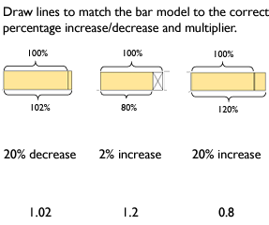
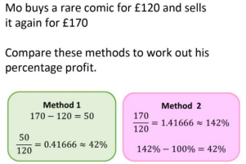
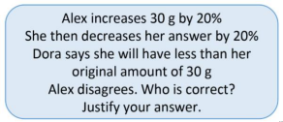
Year 11 – Reasoning with Number
Percentages and Money
Define the words:
Percent-
Fraction-
Equivalent-
Reduce-
Integer-
Multiplier-
Profit-
Reverse Percentages
a) In a sale, a shop reduces all its prices by 10%. On the last day of the sale, the shop reduces the sale prices by 20% On the last day of the sale, a mobile phone costs £432 How much was the mobile phone
before the sale?
b) Evie is given a 22% pay rise. Her new salary is £21,960 What was Evie’s salary before the pay rise?
c) Trevor is a car salesman. He bought a car for £5000 Currently he is holding a sale with 35% off the price of all cars. Trevor wants to sell the car so that he makes a
10% profit on the price he paid. How much should Trevor advertise the car for?
FDP Equivalence
Express as a decimal
3⁄4 b) 72% c) 125%
Express as a fraction
0.25 b) 65% c) 0.4
Express as a percentage
3⁄4 b) 0.125 c) 1.5
Percentage Increase and Decrease
Increase 120 by 5%
Increase £1.50 by 20%
Decrease £66 by 10%
Decrease £2.20 by 5%
Percentage Change
In January, a puppy weighed 4kg. Three months later, the same puppy weighed 5kg. What was the percentage increase in the puppy’s weight?
Daisy bought a car for £20,000. She sold the car for £15,000. Work out the percentage loss.

