Slide 1

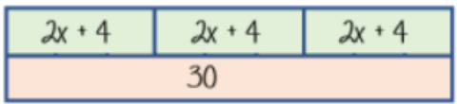
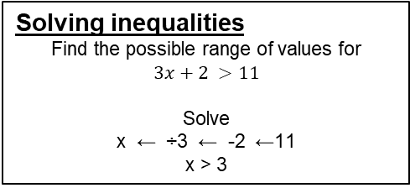
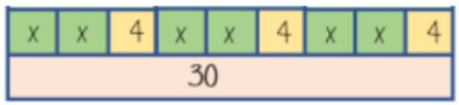







Year 11- Reasoning with Algebra- Forming and Solving Equations
-Solve two-step equations and inequalities, including with brackets and with unknowns on both sides
-Form and solve equations and inequalities
-Rearrange formulae, both one and two step
Inequality: an inequality compares who values showing if one is greater than, less than or equal to another
Variable: a quantity that may change within the context of the problem
Rearrange: Change the order
Inverse operation: the operation that reverses the action
Substitute: replace a variable with a numerical value
Solve: find a numerical value that satisfies an equation
Solving equations with brackets
Year 7- Equality and Equivalence
Year 8- Brackets, Equations and Inequalities
3(2x + 4) = 30
Expand the brackets
6x + 12 = 30
-12
-12
6x = 18
Equations with unknowns on both sides
4x + 5 = 3x + 24
x + 5 = 24
x = 19
Solving inequalities has the same
method as equations
x = 3
Formulae and Equations
Formulae – all expressed in symbols
Equations – include numbers and can be solved
Inequalities with negatives
Make x positive first
2 – 3x > 17
2 > 17 + 3x
-15 > 3x
-5 > x
-3x
-3x
+3x
+3x
-5
-5
-17
-17
÷ 3
÷ 3
Rearranging formulae (one step)
x = y + z
Rearrange to make y the subject.
y = x – z
y →+z → x
y ← –z ← x
Rearranging formulae (two step)
The steps are the same for solving and rearranging
In an equation (find x)
In a formula (make x the subject)
Using inverse operations or fact
families will guide you through
rearranging formulae
xy – s = a
+ s + s
xy = a + s
÷ y ÷ y
x = a + s
y
4x – 3 = 9
+3 +3
4x = 12
÷ 4 ÷ 4
x = 3

Slide 2
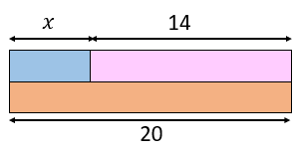
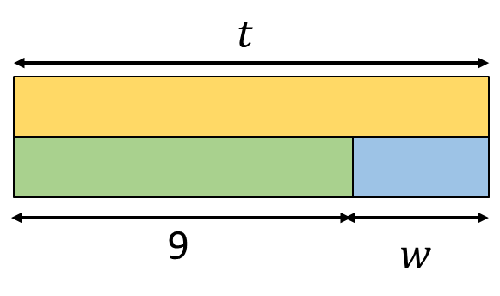
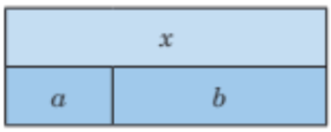
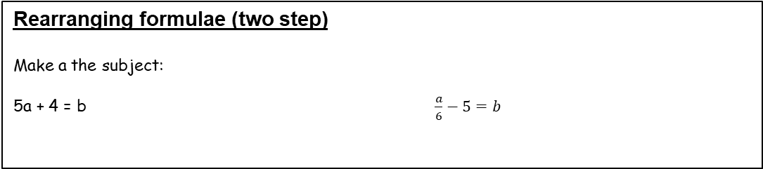
Year 11- Reasoning with Algebra- Forming and Solving Equations
Write the fact families for these bar models.
Use cover, look, write, check to write the definitions
Inequality:
Variable:
Rearrange:
Inverse operation:
Substitute:
Solve:
Inequalities with negatives
Solve
-5x + 24 > 54
Solve equations with brackets
Solve
3(x + 5) = 27
Equations and inequalities with unknowns on both sides
Solve
3x + 1 = 2x + 5
Solve
4 + 5g < 3g − 8
Rearranging formulae (one step)
Use the bar model to write b in terms of x and a.
Make y the subject:
c = y + z

