Slide 1

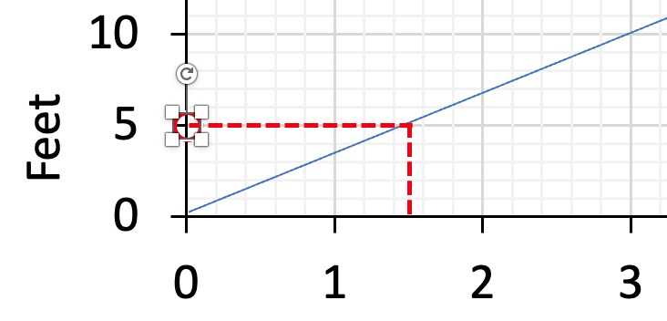
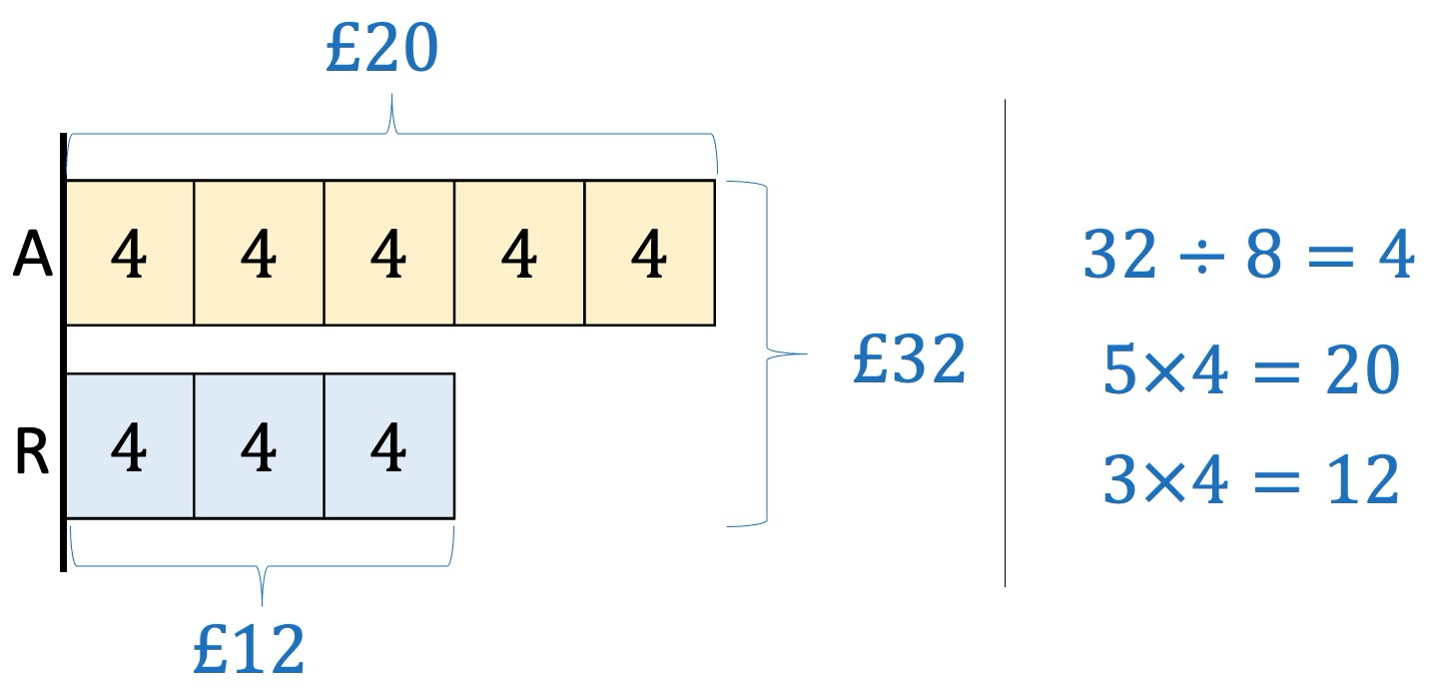
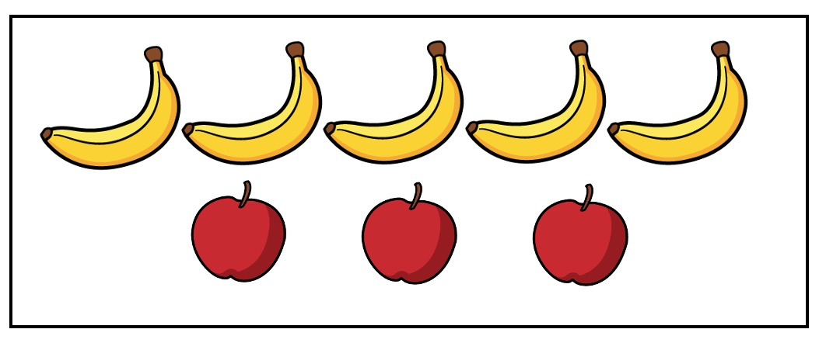
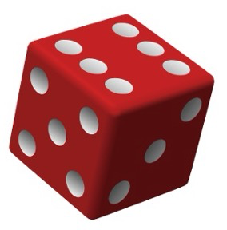
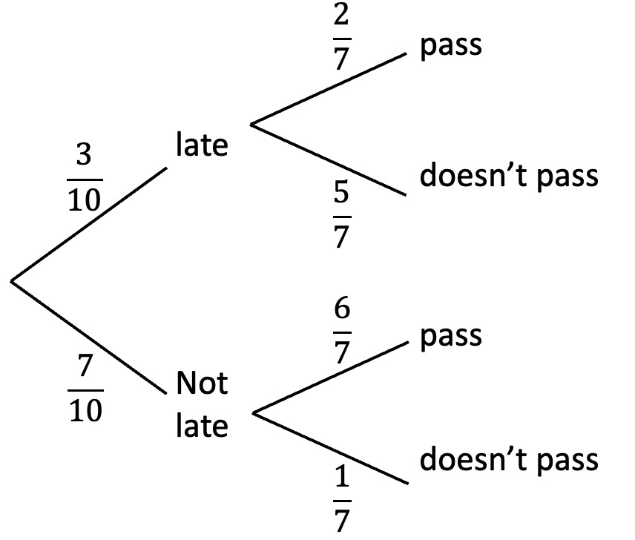
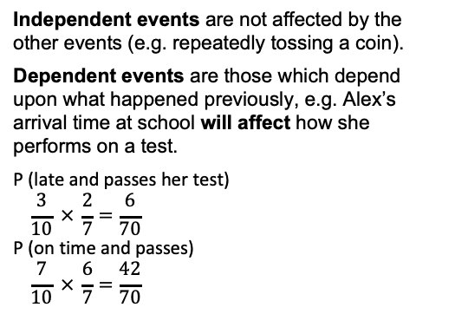
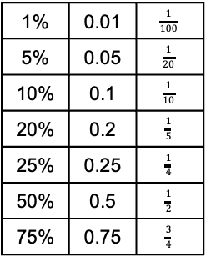
Year 11 – Proportional change & Probability
Understand direct proportion
How to share into a ratio
Convert between common fractions, decimals and %
Calculate simple & compound interest
Calculate probability
Understand dependent and independent events
Direct proportion: two values are in direction proportion when one is a multiple of the other.
Ratio: shows how much of one thing there is compared to another.
Theoretical probability: number of times we expect something to happen.
Relative frequency: the number of times an event happens divided by the number of outcomes that took place.
Dependent events: in probability theory, the probability of a dependent event is affected by previous events.
Direct Proportion
Ratio & scale (Y8)
Fractions & percentages (Y8)
Probability (Y9)
Solving ratio & proportion problems (Y9)
Here is a conversion graph
between meters and feet.
These are directly proportional,
i.e. 5 feet ≈ 1.5m, 10 feet ≈ 3m, 15 feet ≈ 4.5m
Ratios (show how much of one thing there is compared to another).
The bar model illustrates how to share £32 in the ratio 5 : 3
The ratio of apples to bananas is 3 : 5
Percentages, decimals & fractions
Percentage and interest
1% | 0.01 | $$\frac{1}{100}$$
5% | 0.05 | $$\frac{1}{20}$$
10% | 0.1 | $$\frac{1}{10}$$
20% | 0.2 | $$\frac{1}{5}$$
25% | 0.25 | $$\frac{1}{4}$$
50% | 0.5 | $$\frac{1}{2}$$
75% | 0.75 | $$\frac{3}{4}$$
To find a percentage of an amount, multiply the amount by the decimal equivalent, e.g.
10% of 50 (0.1 × 50 = 5)
20% of 48 (0.2 × 48 = 9.6)
A percentage decrease reduces an amount, e.g. 10% off £90, is:
90 − 9 = 81
Simple interest is calculated by finding a % of an amount & multiplying by the time period.
£400 at 3% simple interest for 3 years
Interest = 400 × 0.03 × 3 = 36
Original amount + interest = 400 + 36 = 436
Compound interest means each time interest is paid onto an amount, the added interest also receives interest from then on.
£400 at 3% compound interest for 3 years
400 × 1.03 × 1.03 × 1.03 = 437.09
400 × 1.03³ = 437.09
Probability (1)
Probability (2)
Theoretical probability refers to the
number of times we expect something
to happen, e.g. if we roll a dice 60 times we would expect to get 10 ones, 10 twos etc.
Experimental probability refers to the times something actually happens, e.g. if we roll a dice 60 times we might get 8 ones, 12 twos etc.
Relative frequency is the number of times an event happens divided by the total number of outcomes that took place. The more times an experiment is carried out, the closer the relative frequency will be to the theoretical probability.
Independent events are not affected by the other events (e.g. repeatedly tossing a coin).
Dependent events are those which depend upon what happened previously, e.g. Alex’s arrival time at school will affect how she performs on a test.
P (late and passes her test)
$$\frac{3}{10} × \frac{2}{7}=\frac{6}{70}$$
P (on time and passes)
$$\frac{7}{10} × \frac{6}{7}=\frac{42}{70}$$

Slide 2
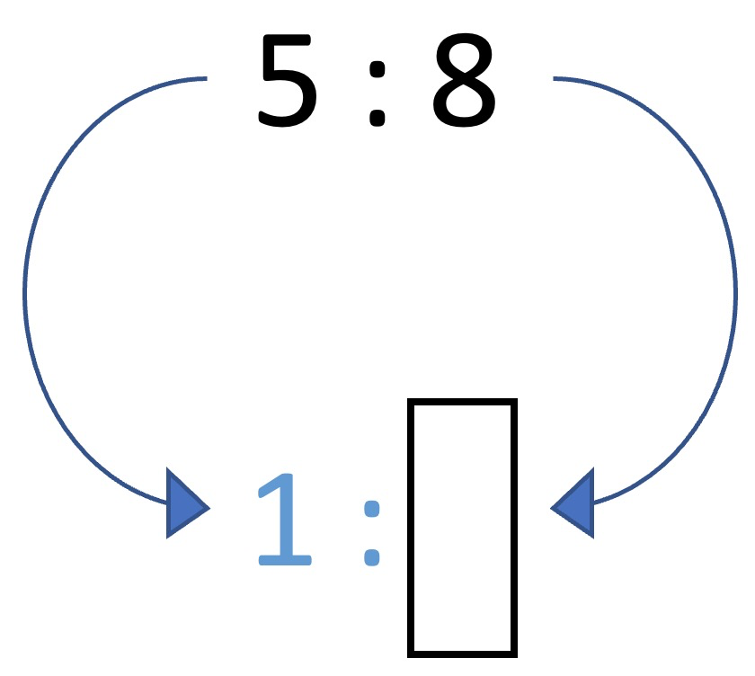
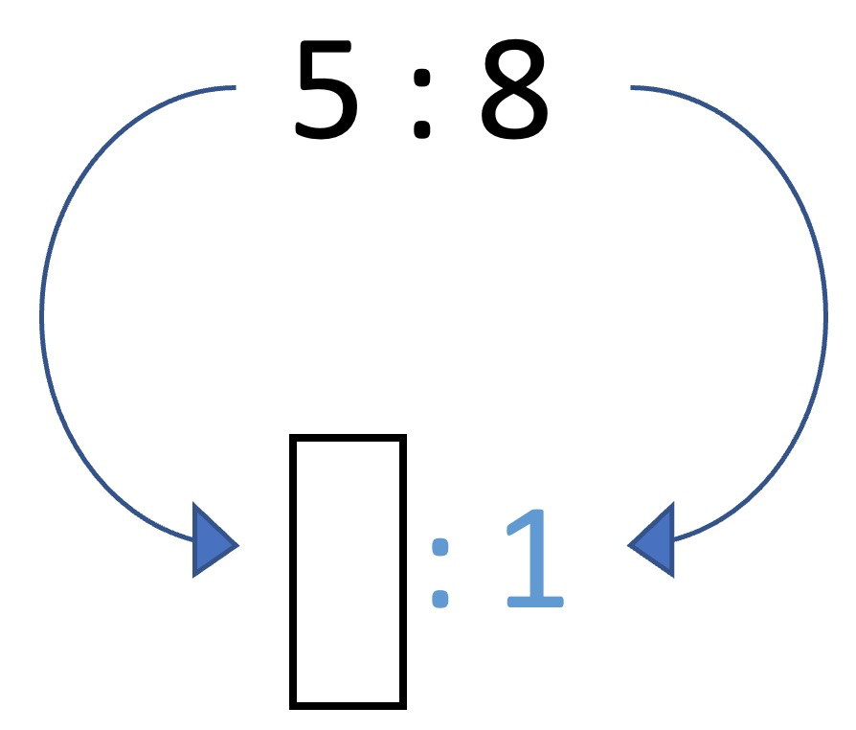
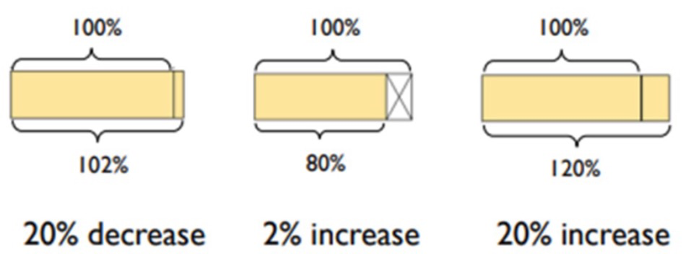
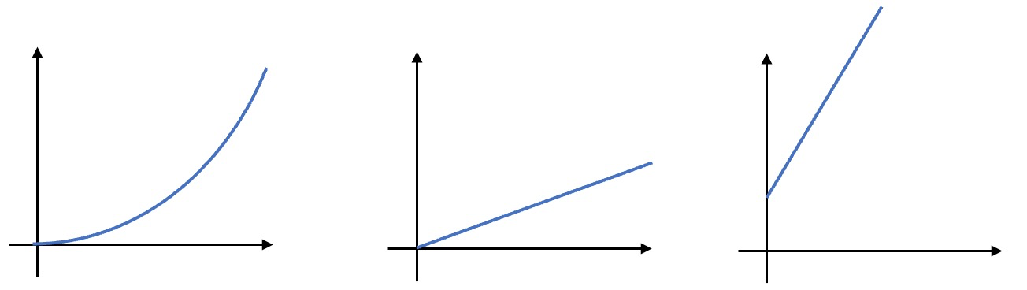
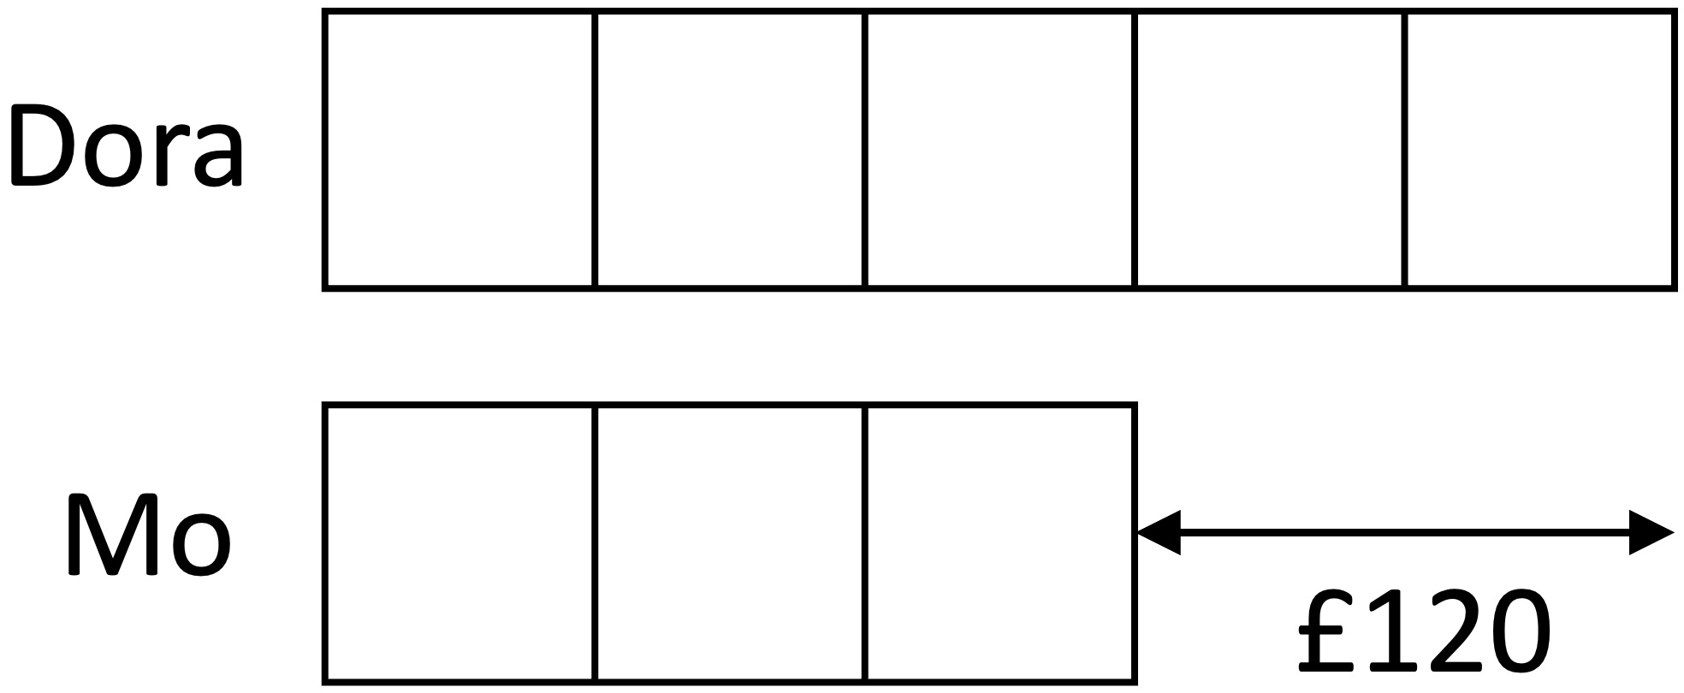
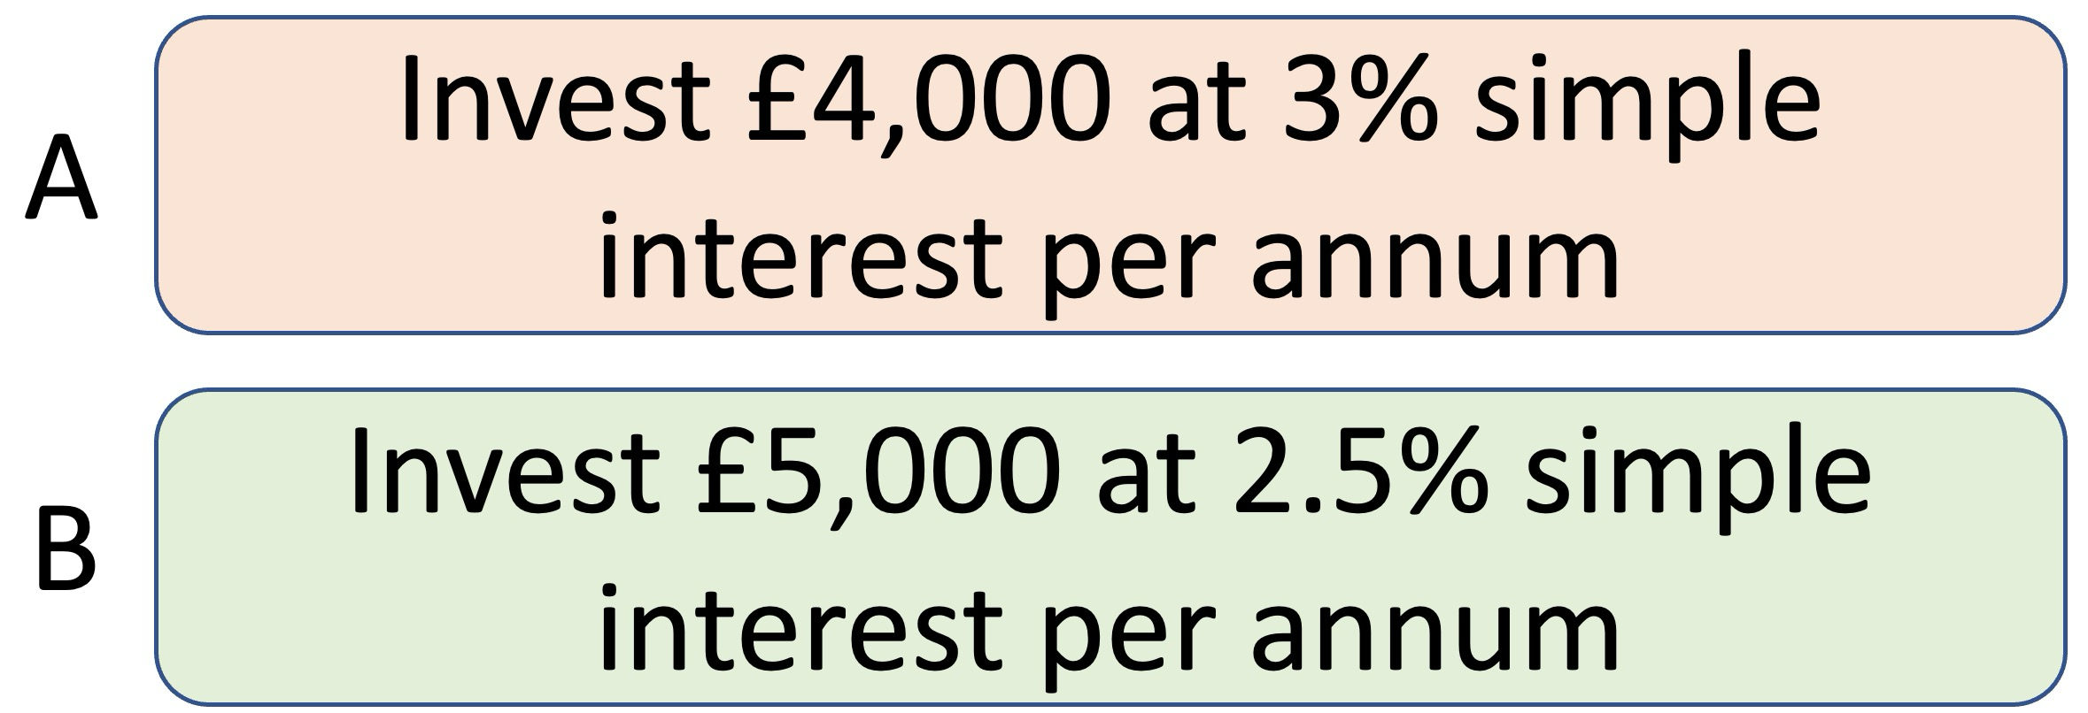
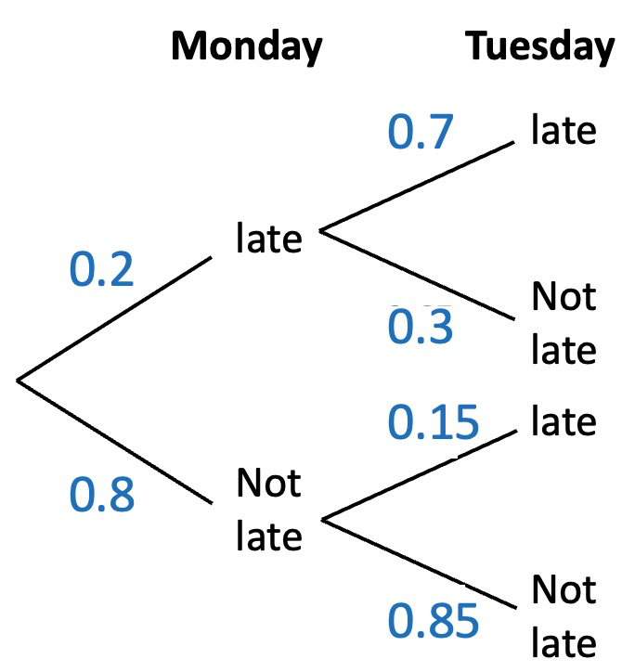
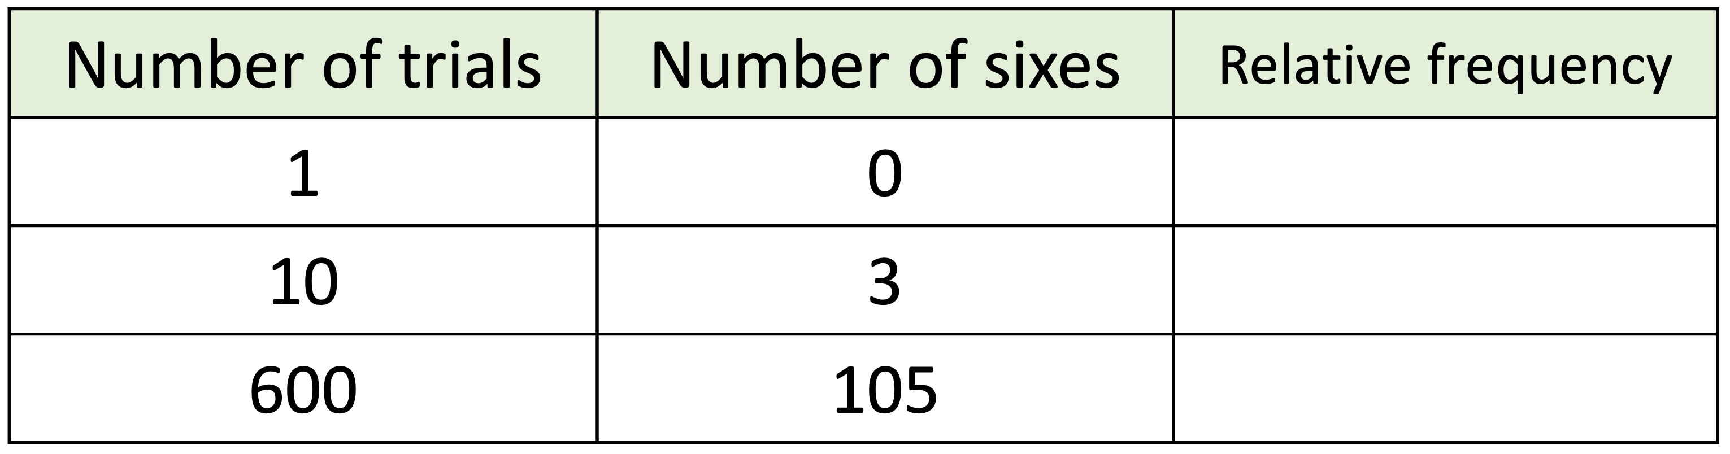
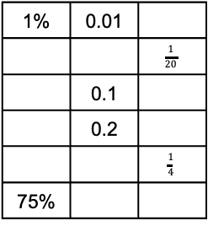
Year 11 − Proportional change
& probability
Write the ratios in the form 1 : 𝑛 and 𝑛 : 1
Use cover, look, write, check to write the definitions …
Direct proportion:.
Ratio:
Theoretical probability:
Relative frequency:
Dependent events:
Match the bar model to the percentage increase or decrease.
Direct proportion Which of these graphs shows direct proportion?
Explain
your
answer
Ratios
Use bar models to share the
numbers in the given ratios.
Share 150 in the ratio 3 : 2
Share 75 in the ratio 2 : 3
Share 96 in the ratio 7 : 1 : 4
Dora and Mo share some money
in the ratio 5 : 3
If Dora gets £120 more than Mo, how much money did they share?
Use the bar model to help you answer the question.
Percentages, decimals & fractions
Percentage and interest
Complete the table
Calculate:
10% of 48
36% of 780
Decrease 120 by:
10%
25%
State the % multiplier for:
40%
3%
A 25% increase
Dora invests £2,000 at 4% simple interest per annum. How much interest would she earn after 5 years?
Rosie invests £6,000 at 2.5% compound interest per annum. What is her investment worth after 7 years?
Which investment, A or B, will give the greater amount of
interest after:
a) 2 years?
b) 5 years?
1% | 0.01
 |  | $$\frac{1}{20}$$
 | 0.1
 | 0.2
 |  | $$\frac{1}{4}$$
75%
Probability (1)
Probability (2)
Complete the relative frequency table.
A dice is rolled 54 times. How many fives would you expect to roll?
What is the theoretical probability that you flip three heads in a row?
Two dice are rolled. What is the theoretical probability that the total of both dice is 12?
The probability of Amir
being late for work on
Monday and Tuesday
is shown in the tree
diagram.
Calculate:
The probability Amir is late
on both days.
The probability that he is late on at least one day.

