Slide 1

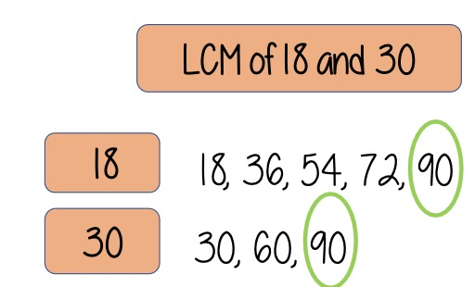
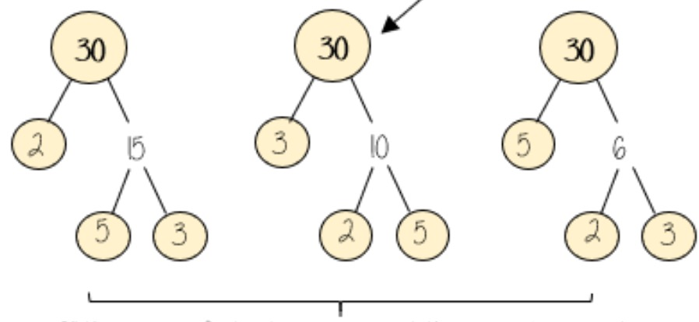
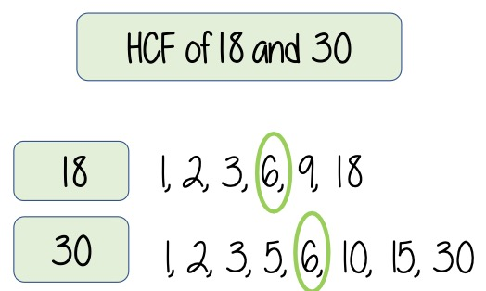
Year 10 − Using Number
Types of number and sequences
• Factors and multiples
• Express numbers as a
product of primes
• Find the HCF and LCM
• Describe, continue and
explore sequences
• Find the nth term of a linear
sequence
Factor: numbers we multiply together to make another number
Multiple: the result of multiplying a number by an integer.
HCF: highest common factor. The biggest factor that numbers share.
LCM: lowest common multiple. The first multiple numbers share.
Arithmetic: a sequence where the difference between the terms is constant.
Geometric: a sequence where each term is found by multiplying the previous term by a fixed, non-zero number.
Sequence: items or numbers put in a pre-determined order
Prime numbers
A prime number is an integer that has only two factors, itself and 1.
2 is the only even prime number.
Sequences (Y8)
Testing Conjectures (Y9)
Prime numbers and proofs (Y7)
2, 3, 5, 7, 11, 13, 17, 19, 23, 29 …
Multiples
Multiples are the ‘times table’ of a given number.
These are the first 5
multiples of 3.
Factors
A factor is one of two or more numbers that divides into a number without a remainder.
3, 6, 9, 12, 15, …
Factors of 10
1, 2, 5, 10
Factors of 24
1, 2, 3, 4, 6, 8, 12, 24
Arithmetic and Geometric sequences
LCM – Lowest Common Multiple
change by a common
The lowest common multiple is the lowest multiple shared by two or more numbers
Arithmetic Sequences
difference. This is found by addition or subtraction between terms (e.g. 3, 7, 11, 15 …).
change by a common
Geometric Sequences
ratio. This is found by multiplication or division between terms (e.g. 2, 4, 8, 16, 32 …).
Term to term rule – How you get from one term (number in the sequence) to the text term.
The LCM of 18 and 30 is 90.
Product of prime factors
HCF – Highest Common factor
The HCF of two numbers is the largest number which will divide exactly into both of them.
The HCF of 18 and 30 is 6.
All three prime factor trees represent the same decomposition, i.e. the prime factors that multiply together to make the original number, e.g. 30 = 2 × 3 × 5

Slide 2
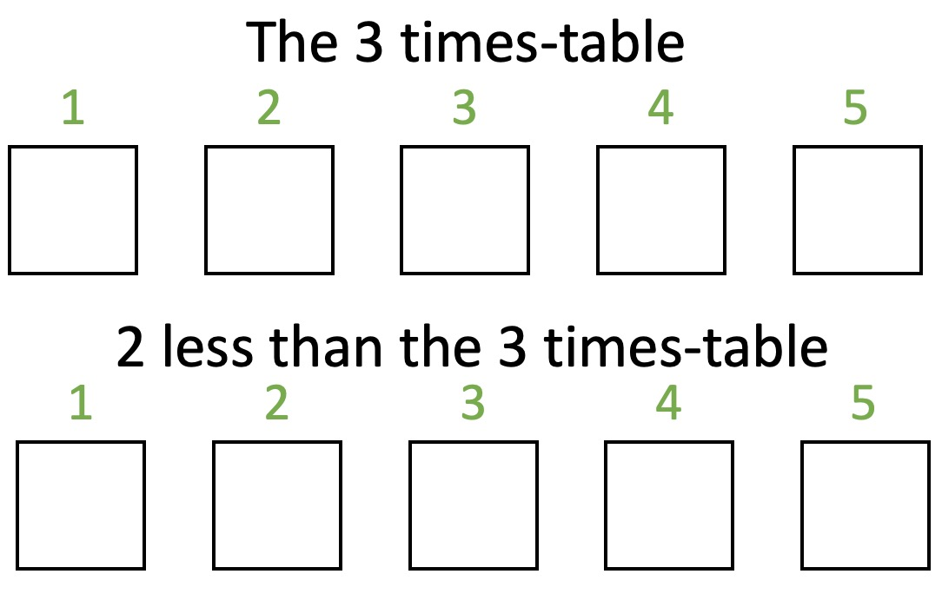
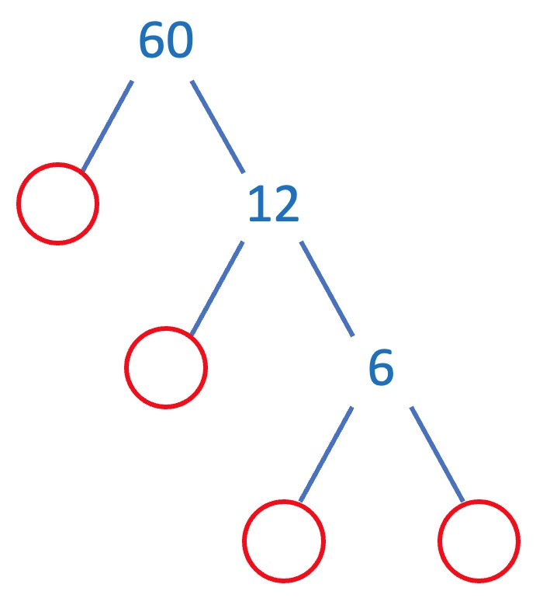

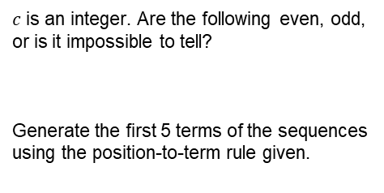



Year 10 − Using Number
Types of number and sequences
$c$ is an integer. Are the following even, odd, or is it impossible to tell?
Generate the first 5 terms of the sequences using the position-to-term rule given.
Use cover, look, write, check to write the definitions …
Factor:
Multiple:
Highest Common Factor:
Lowest Common Multiple:
Sequence:
Arithmetic Sequence:
Geometric Sequence:
$$\text{10}c$$
$$\text{2}c+\text{2}$$
$$c+\text{7}$$
$$\text{6}c+\text{3}$$
Prime Numbers
Which is the only even prime number?
List all the prime numbers less than 30.
How many factors does a prime number have?
What is the product of the first 3 prime numbers?
Multiples Factors
List the first five multiples of 6.
What is the 5th multiple of 5?
What is the 8th multiple of 3?
The 5th multiple of 4 is the same as which multiple of 10?
List the factors of 32.
List the factors of 64.
The factors of an odd number are all odd. True or false?
Arithmetic and Geometric sequences
LCM – Lowest Common Multiple
What are the term to term rules of the following sequences, and what are the next two terms in each sequence?
5, 12, 19, 26 …
69, 57, 45, 33 …
3, 9, 27, 81, 243 …
128, 64, 32, 16, 8 …
Create examples of arithmetic and geometric sequences of your own.
What is the LCM of 6 and 8?
What is the LCM of 15 and 45?
What is the LCM of 12, 20 and 44?
A toad croaks every 8 seconds. A frog croaks every 6 seconds. They both croak at the same time. After how many seconds will they next both croak at the same time?
The lowest common multiple of two numbers is 70. Both numbers are less than 20. Write down two possible numbers.
Product of prime factors
HCF – Highest Common Factor
Complete the prime factorisation tree to find the prime factors of 60.
What is the HCF of 18 and 32?
What is the HCF of 21 and 27?
What is the HCF of 17 and 23?
What is the HCF of 12, 24 and 30?
Alannah has two lengths of ribbon. One length of ribbon is 36cm long and the other length is 45cm long. Alannah wants to cut lengths of ribbon into shorter lengths that are of equal length. Alannah does not want any ribbon left over. What is the longest possible length for each of the shorter lengths of ribbon?
Use the same method to find the prime factors of:
20
64
120
180
420

