Slide 1

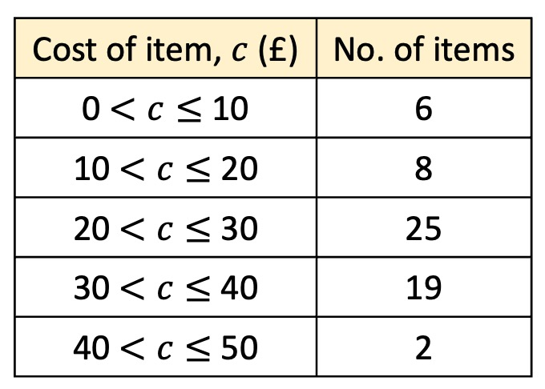
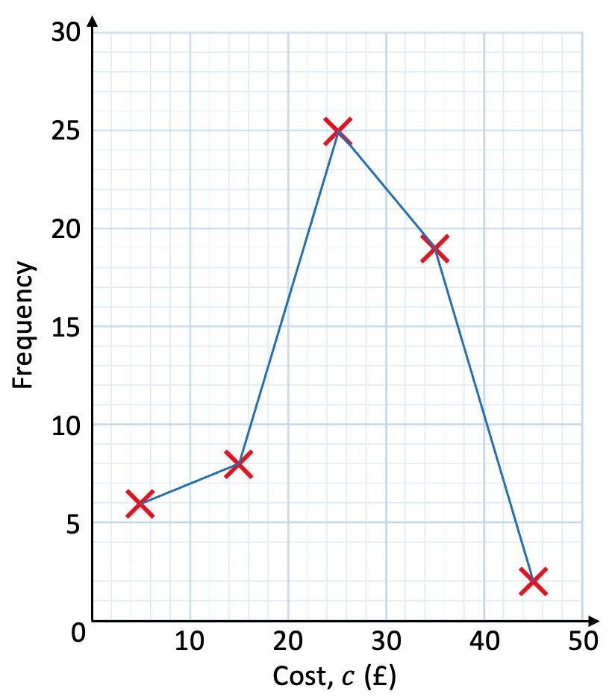
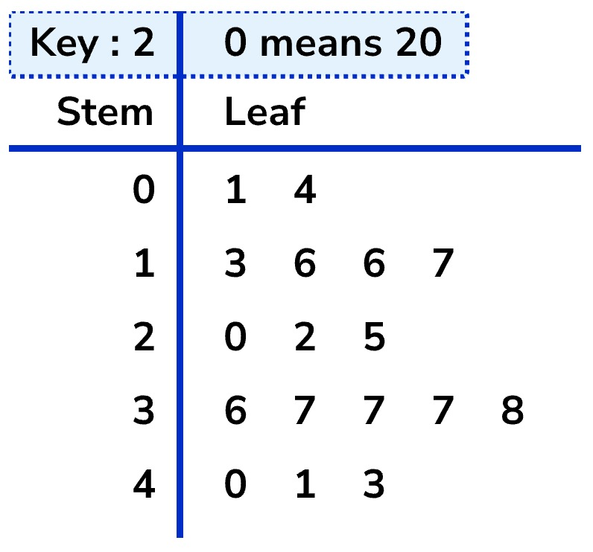
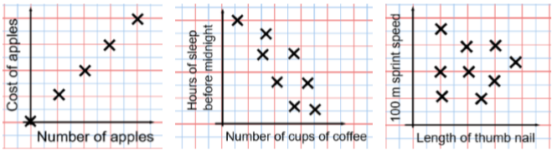

Year 10 − Delving into Data
Collecting, representing & interpreting data (1)
Construct & interpret freque-ncy tables & polygons, 2-way tables, line, bar, & pie charts
Find and interpret averages from a list and a table
Construct and interpret time series graphs, stem and leaf diagrams and scatter graphs
Population: the whole group that is being studied.
Sample: a selection taken from the population that will let you find out information about the larger group.
Representative: a sample group that accurately represents the population.
Random sample: a group completely chosen by change. No predictability to who it will include.
Stratifed sampling
A stratified sample divides a population into smaller groups known as strata. In stratified sampling, the strata are formed based on members' shared features
(e.g. year group, gender, etc.)
Representing data (Y8)
The data handling cycle (Y8)
Measures of location (Y8)
Frequency tables
A frequency table has two main columns. The first column has all the outcomes as individual values or in the form of class intervals. The second column tells us about the frequency of each outcome. For example, the frequency table to the right indicates that there were 6 items (second column) that cost more than £0 but less than £10 (first column).
Frequency Polygon
n
ns
Averages from lists
24, 8, 4, 11, 8,
A frequency polygon is a graph that shows the frequencies of grouped data. It is a type of frequency diagram that plots the midpoints of the class intervals against the frequencies and then joins up the points with straight lines.
The mean
To find the mead divide
the overall total by how
many pieces of data you have.
The mode
This is the number OR the item
that occurs the most (it does not
have to be numerical).
The median
The value in the centre (in the
middle) of the data. This can
be easier to calculate if it the data is ordered first. NOTE: If there is no single middle value find the mean of the two numbers left.
Mean (55 $÷$ 5) = 11
Mode = 8
Median = 8
Stem and leaf diagrams
A stem and leaf diagram is a method of organising numerical data based on place value.
Each number is split into two parts.
The first digit(s) form the stem,
The last digit forms the leaf (this should only contain one number).
A stem and leaf diagram must have a key.
Linear Correlation
Positive Correlation
Negative Correlation
No Correlation
A scatter graph illustrates the relationship between two variables.

Slide 2
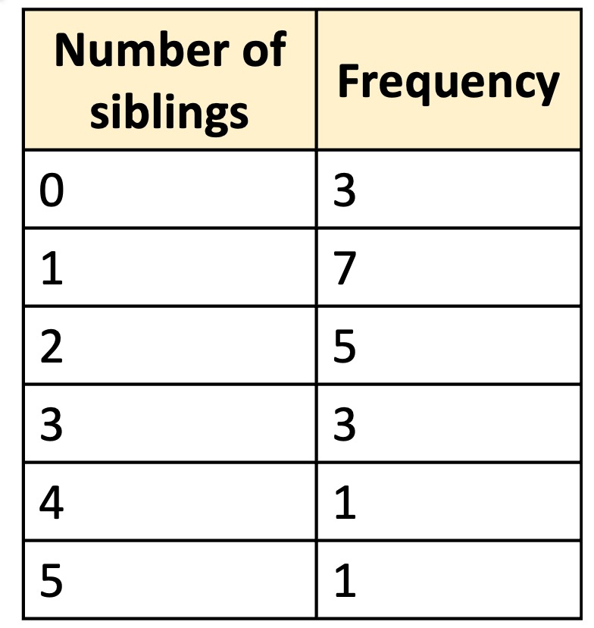
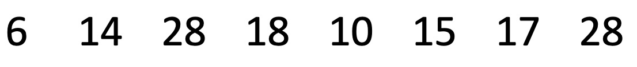
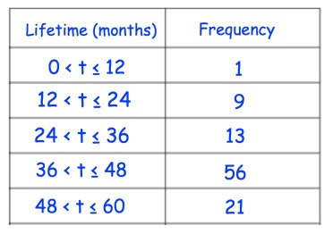
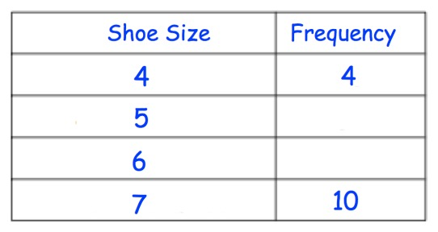
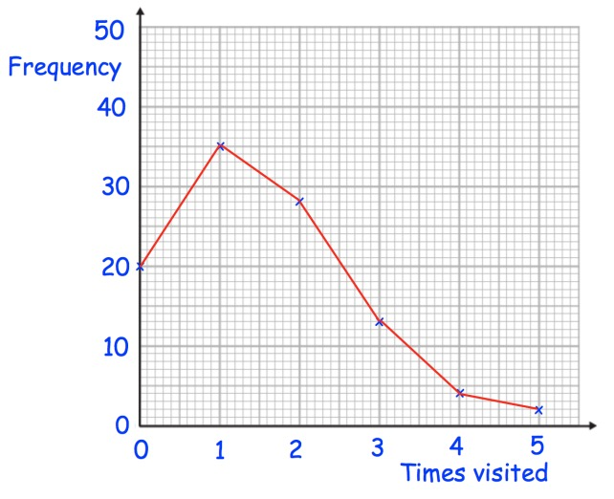
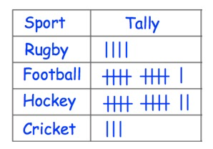
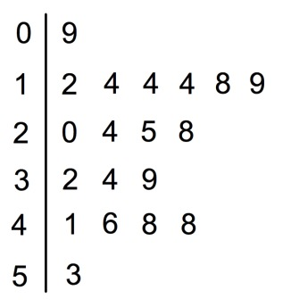
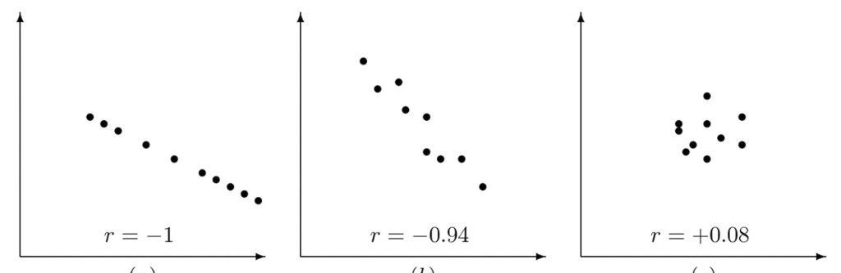
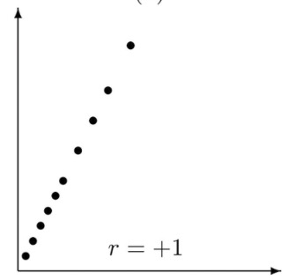
Year 10 − Delving into Data
Collecting, representing & interpreting data (1)
A group of 20 students were asked how many siblings they have. The results are shown in the table. How many siblings in total?
Use cover, look, write, check to write the definitions …
Population:
Sample:
Representative:
Random sample:
Here are the heights (in cm) of 8 towers.
Calculate the mean, median, mode, and range of the data.
Stratifed sampling
List three strata you could use to divide Unity’s population of pupils into different groups.
Would the same strata be applicable for the staff?
Frequency tables
Which class interval contains the median?
There are 30 students in a class. Miss Ash knows that the median shoe size is 5. Fill in the frequency table with two possible values.
Frequency Polygon
Averages from lists
Tia asked her friends how many times they visited the cinema last month.
Calculate the mean median and mode for the following sets of data:
5, 7, 3, 5, 8, 9, 10, 2
How many people visited twice?
What is most popular number of times that her friends visited the cinema?
How many people did Tia survey in total?
−2, −1, 5, 8, −2, 2, −1, 9, −1, 1, 2, −1
2.3, 2.6, 2.8, 2.7, 2.8, 2.7, 2.4, 2.3, 2.1, 2.3
The tally chart shows the favourite sport of the students in a class.
What is the modal sport?
How many students are in the class?
How many more students liked football than rugby?
Stem and leaf diagrams
The stem and leaf diagram below shows heights of Mr Bold’s flowers.
How many flowers does he have?
What is the height of the tallest flower?
How many flowers are taller than 40cm?
How many flowers are 14cm tall?
What fraction of the flowers are under 20cm?
Key: 0|9 means 9cm
Linear Correlation
What type of correlation does each scatter graph show?

Slide 3
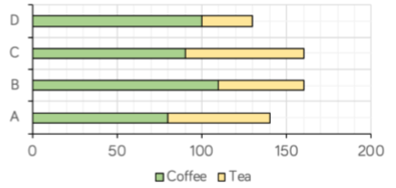
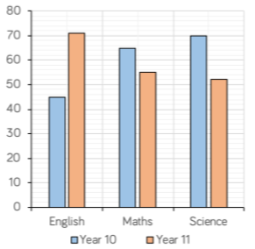
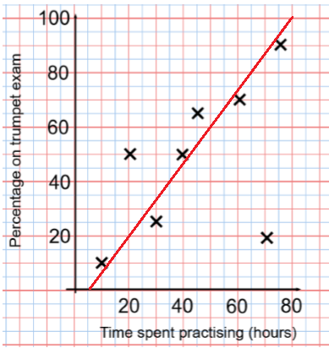
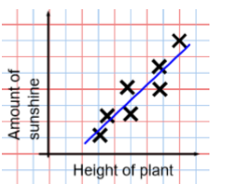

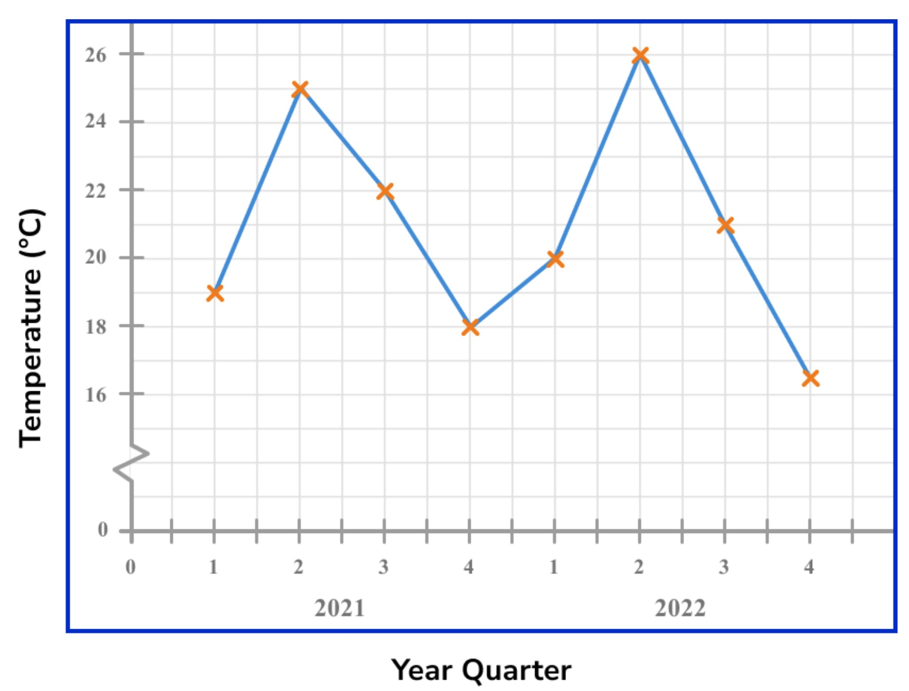
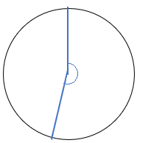
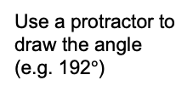

Year 10 − Delving into Data
Collecting, representing & interpreting data (2)
Types of data (e.g. discrete, continuous)
Population and sampling
Frequency tables and polygons
Two-way tables
Time series graphs
Stem and leaf diagrams
Use cover, look, write, check to write the definitions …
Bias:
Primary data:
Secondary data:
Outlier:
The Range
The range of a data set is the difference between the greatest value and lowest value within a collection of numbers. Subtract the smallest from the greatest value in the set to find the range of given data points.
Representing data (Y8)
The data handling cycle (Y8)
Measures of location (Y8)
Bar and line charts
Bars are compared side by side
Easier to compare subgroups
Dual bar charts
Composite bar charts
Compare the bars green compared to yellow. The size of each bar is the frequency.
Overall total easily comparable
Categories clearly indicated
The line of best fit
The line of best fit DOES NOT need to go through the origin (The point the axes cross)
There should be approximately the same number of points above and below the line. The line extends across the whole graph
Interpolation is using the line of best fit to estimate values inside our data point.
The Line of best fit is used to make estimates about the information in your scatter graph
It is only an
estimate
because the line
is designed to be an average representation of the data.
It is always a straight line.
Extrapolation is where we use our line of best fit to predict information outside of our data.
This point is an “outlier”. It doesn’t fit this model and stands apart from the data.
Draw and interpret Pie Charts
Time series graphs
There were 60 people asked in this survey
(Total frequency)
A time series graph is a line graph that shows data such as measurements (e.g. temperature), sales or frequencies over a given time period
“32 out of 60 people had a dog”
They can be used to show a pattern or trend in the data and are useful for making predictions about the future.
32
X 360 = 192$°$
60
Dogs
This fraction of the 360 degrees represents dogs
Use a protractor to draw the angle (e.g. 192$°$)

Slide 4
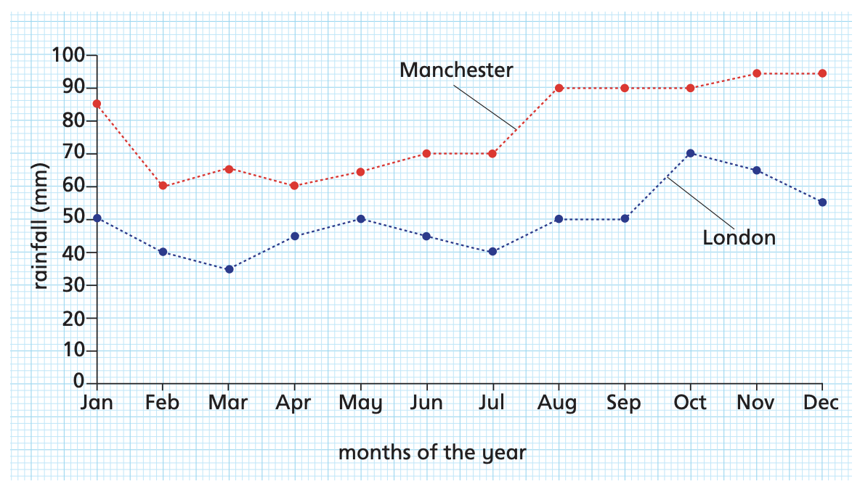
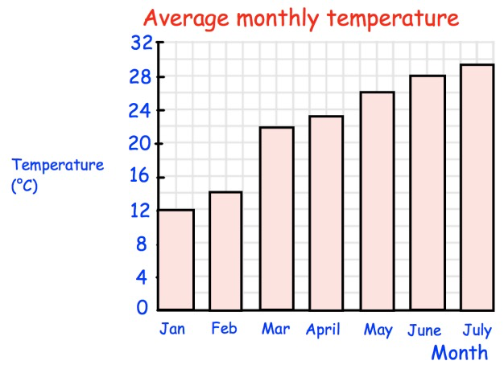
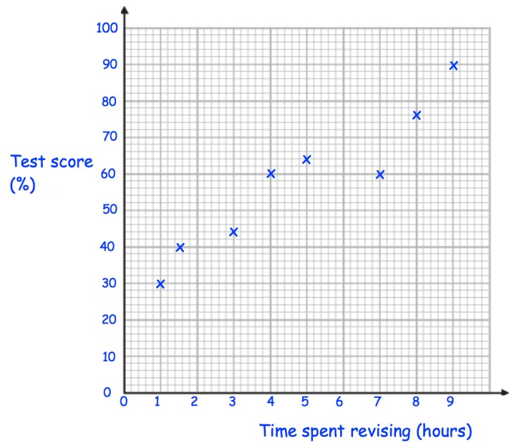
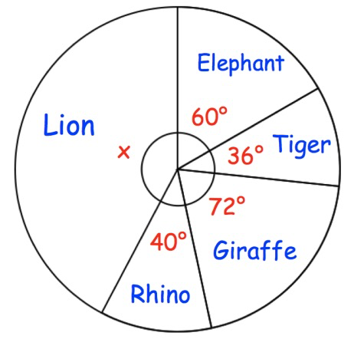
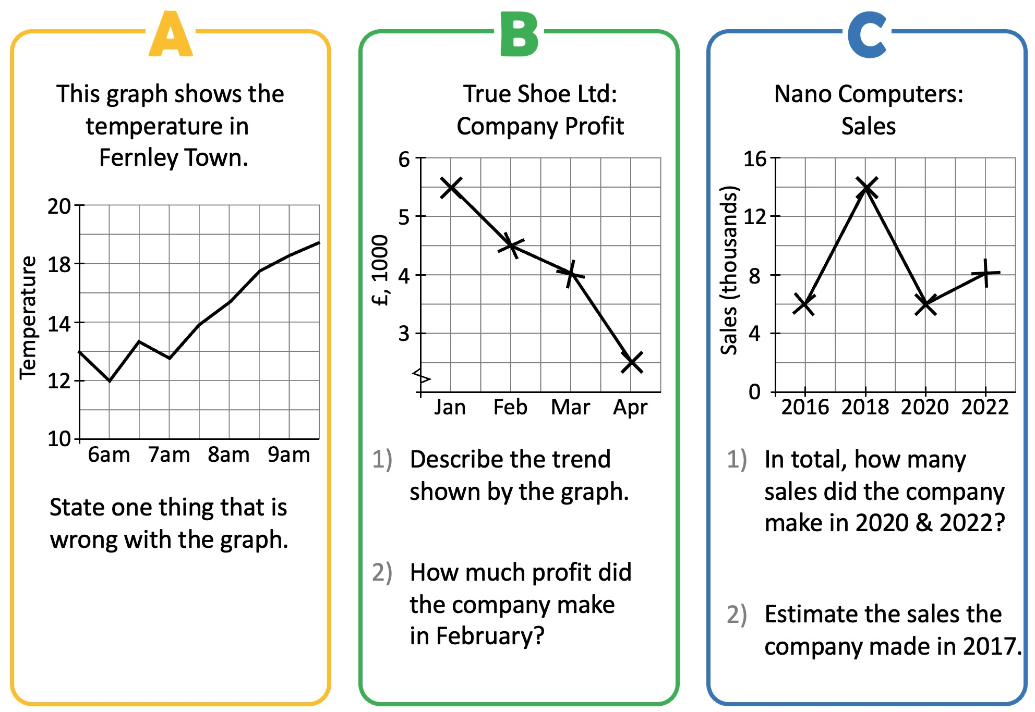
Year 10 − Delving into Data
Collecting, representing & interpreting data (2)
Is the data shown in the chart qualitative, discrete or continuous?
Use cover, look, write, check to write the definitions …
Population:
Sample:
Representative:
Random sample:
The Range
Find the range for each of the following:
5, 9, 1, 5, 7, 4, 3
6.2, 7.3, 8.8, 1.5, 4.1
7, 9, -2, 13, 9, 8, 20, -8, 1
Describe the difference between discrete and continuous data.
Describe the difference between qualitative and quantitative data.
Bar and line charts
What was the average temperature in March?
Which month had an average temperature of 26°C?
What is happening to the average temperatures between Jan and July?
Between which two months was there the greatest rise in temperature?
The bar chart shows information about the average temperature on an island.
The line of best fit
Daisy spent 7 hours revising for the test. What is Daisy's test score?
Harry's test score was 30%. How many hours did Harry spend revising?
Draw a line of best fit.
Another student spent 6 hours revising for the test.
Find an estimate of their test score.
Explain why it might not be sensible to use the scatter graph to estimate the score for a student that spent 15 hours revising.
The scatter graph (right) shows information about the number of
hours spent revising for a test and the test result for a group of 8 students.
Draw and interpret Pie Charts
Time series graphs
90 students went on a school
trip to Longleaf Safari Park.
They were asked their
favourite animals.
What fraction of the students
chose elephant?
What fraction of the students chose tiger?
What fraction of the students chose giraffe?
What fraction of the students chose rhino?
Find x
How many students chose elephant?

