Slide 1

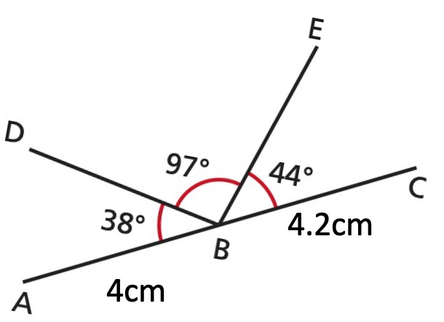
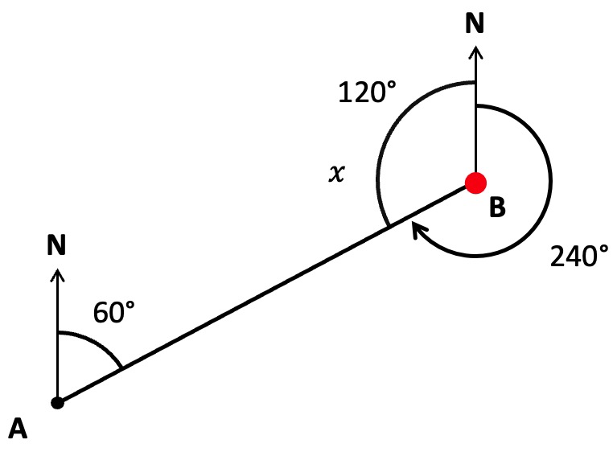
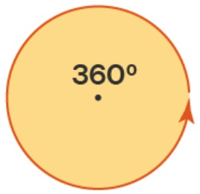
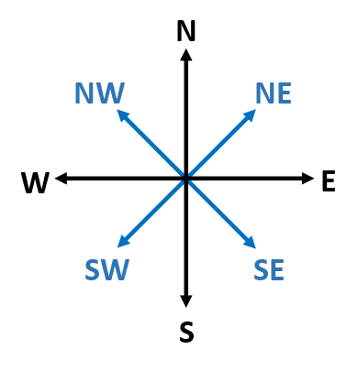
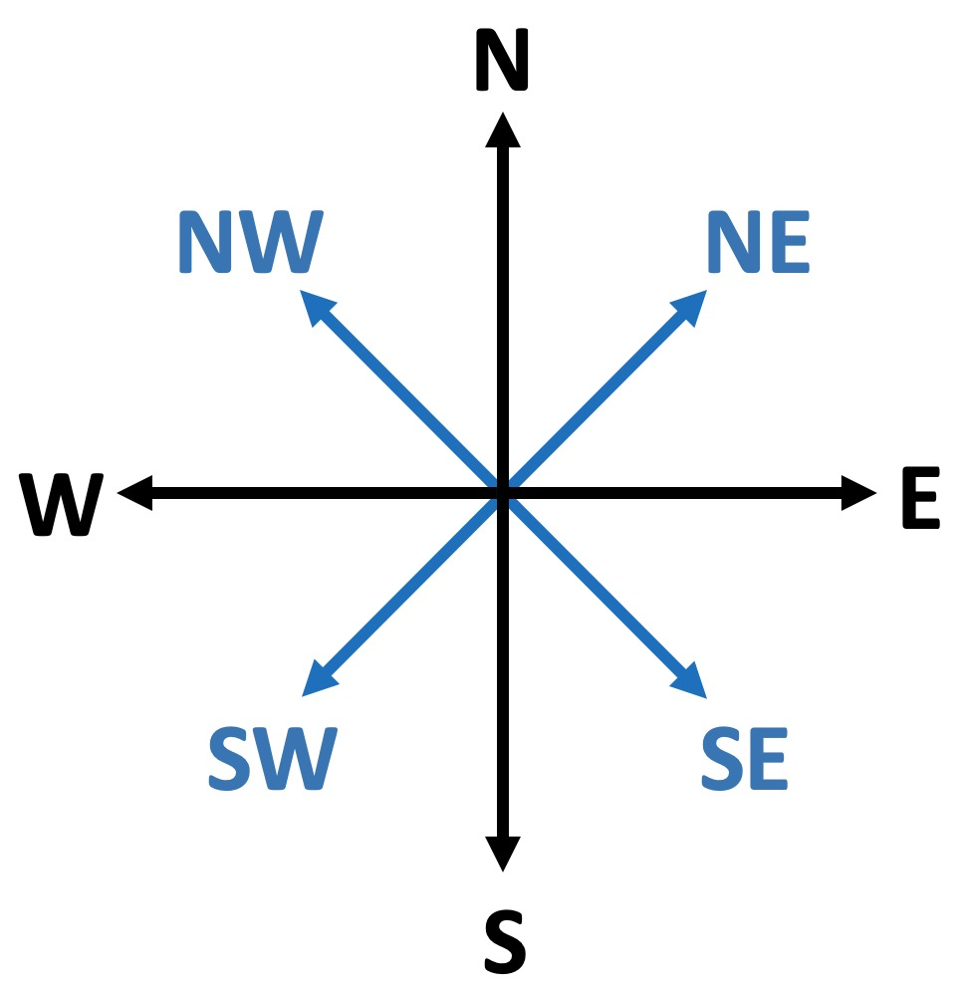
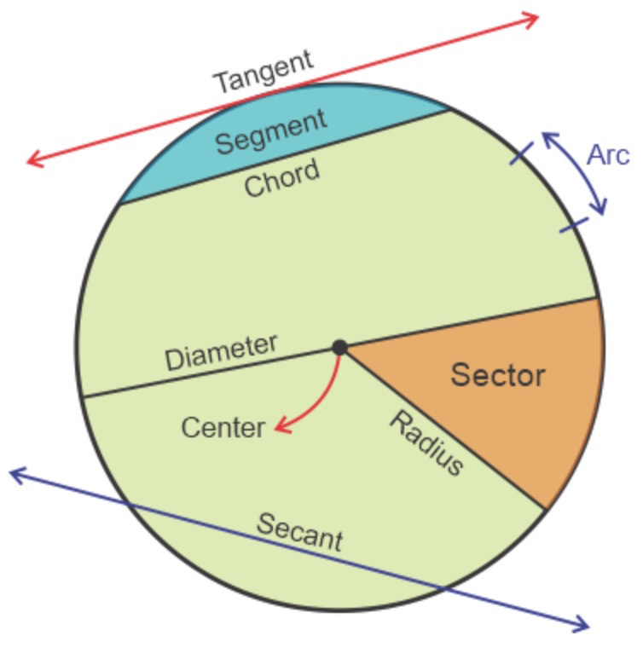
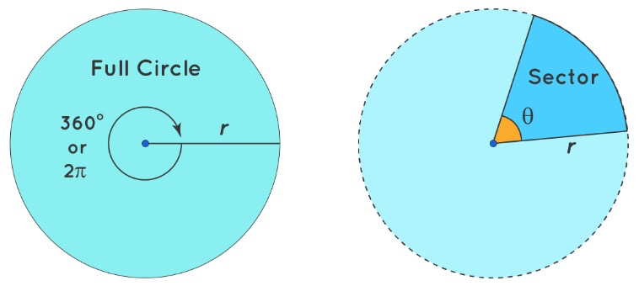
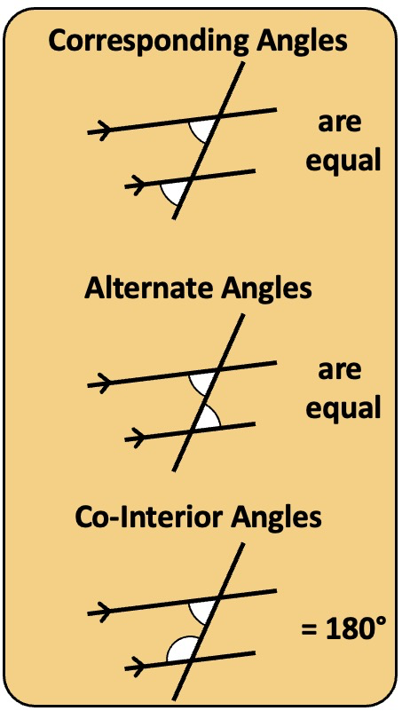
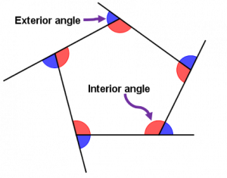
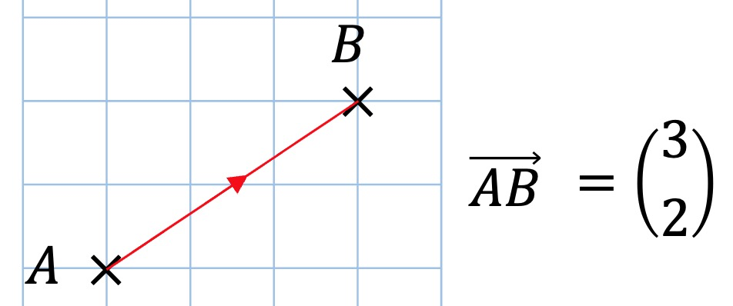
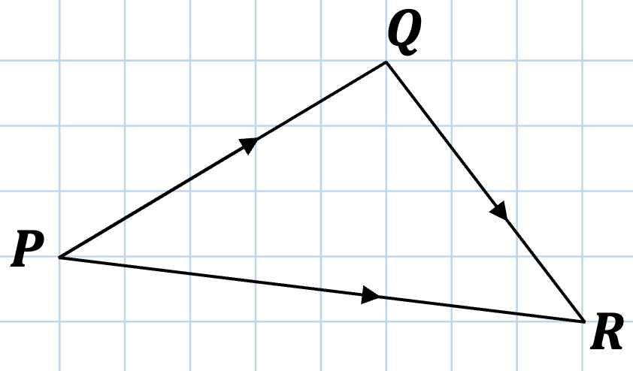
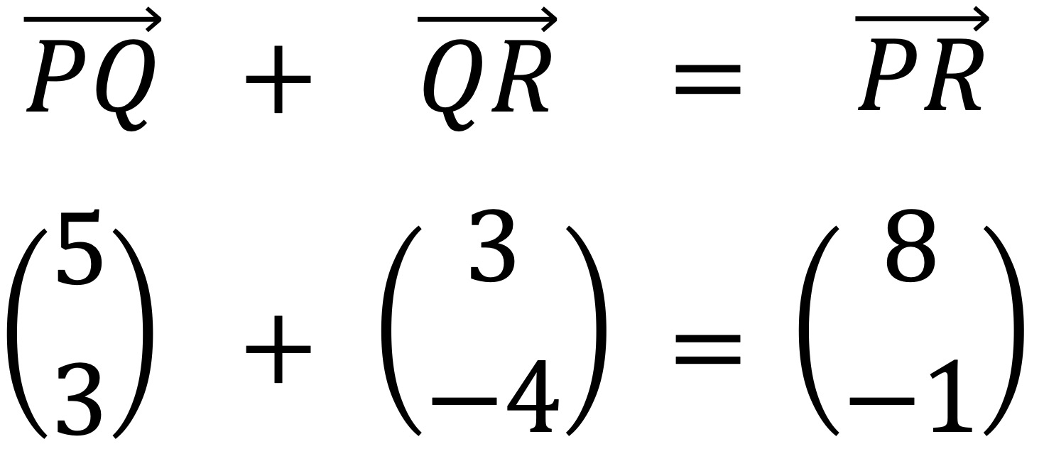
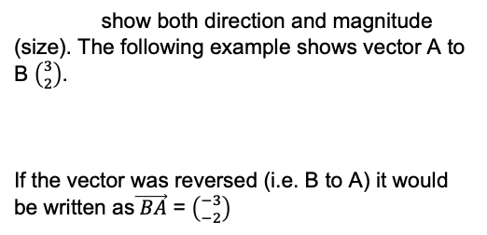
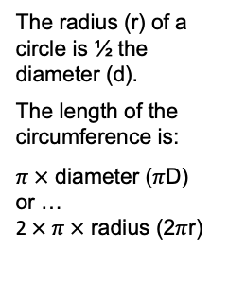
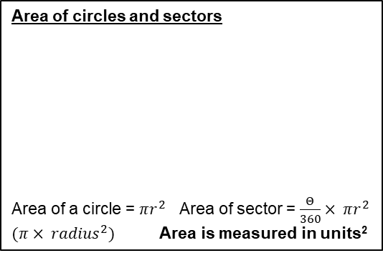
Year 10 − Geometry
Angles, Circles and Vectors
Know line and angle notation
Understand bearings
Know the parts of a circle
Calculate the area of circles and sectors
Know and use angle facts
Know how to calculate and determine vectors
Angle: a measure of turn
Bearing: an angle in degrees, measured clockwise from north, written as a 3-digit number
Radius: line segment from the centre of a circle to the circumference.
Diameter: any straight line segment that passes through the centre of the circle and whose endpoints lie on the circle.
Circumference: the perimeter of a circle.
Pi: the ratio of a circle's circumference to its diameter, ≈ 3.14159
Vector: a vector indicates both size and direction
Angle and line notation
Developing geometric reasoning (Y7)
Area of trapezia and circles (Y8)
Reasoning with geometry (Y9)
Line segment BC = 4.2cm
∠ABC = 38°
∠DBE = 97°
∠ABE = 135° (38° + 97°)
Bearings
A bearing is an angle in degrees measured clockwise from north, given as a three-figure number. For example, 30° clockwise from north is written as 030°
In the example (left) the bearing from A to B is 60° (clockwise from north). The bearing of A from B is 240° (clockwise from north).
ooo
360°
Parts of a circle
Area of circles and sectors
Area of a circle = $πr^{2}$ Area of sector = $\frac{Θ}{360}× πr^{2}$
$(π{ × radius}^{2})$ Area is measured in units²
The radius (r) of a circle is ½ the diameter (d).
The length of the circumference is:
$π ×$ diameter ($π$D)
or …
2$× π ×$ radius (2$π$r)
The exterior angles of any polygon sum to 360°
Angle facts
Vectors
show both direction and magnitude (size). The following example shows vector A to B $\left({3 \atop 2}\right)$.
If the vector was reversed (i.e. B to A) it would be written as$\vec{ BA}$ = $\left({−3 \atop −2}\right)$
The interior angles of a regular polygon sum to (n−2) × 180 (where n is the number of sides).
Vectors can be added or subtracted.

Slide 2
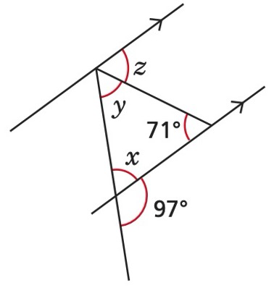
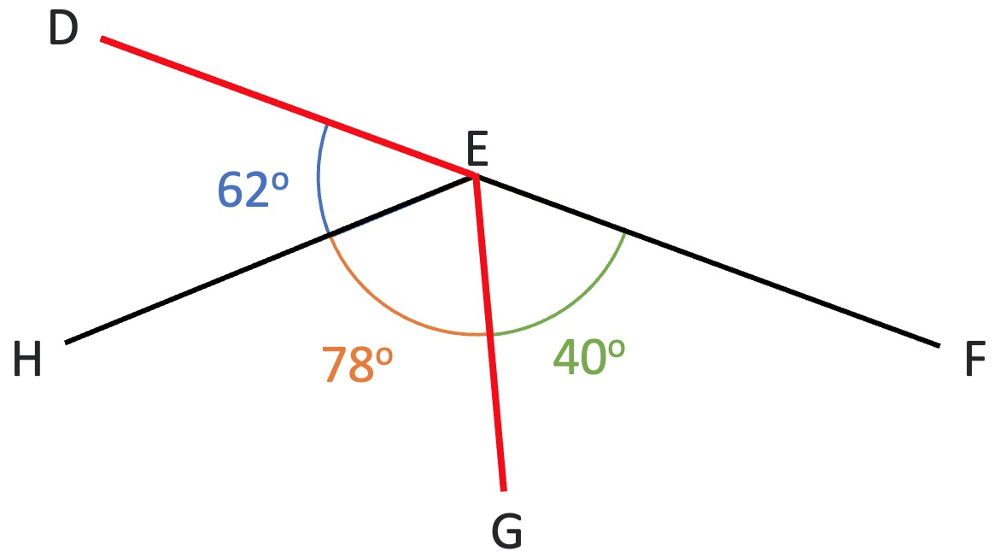
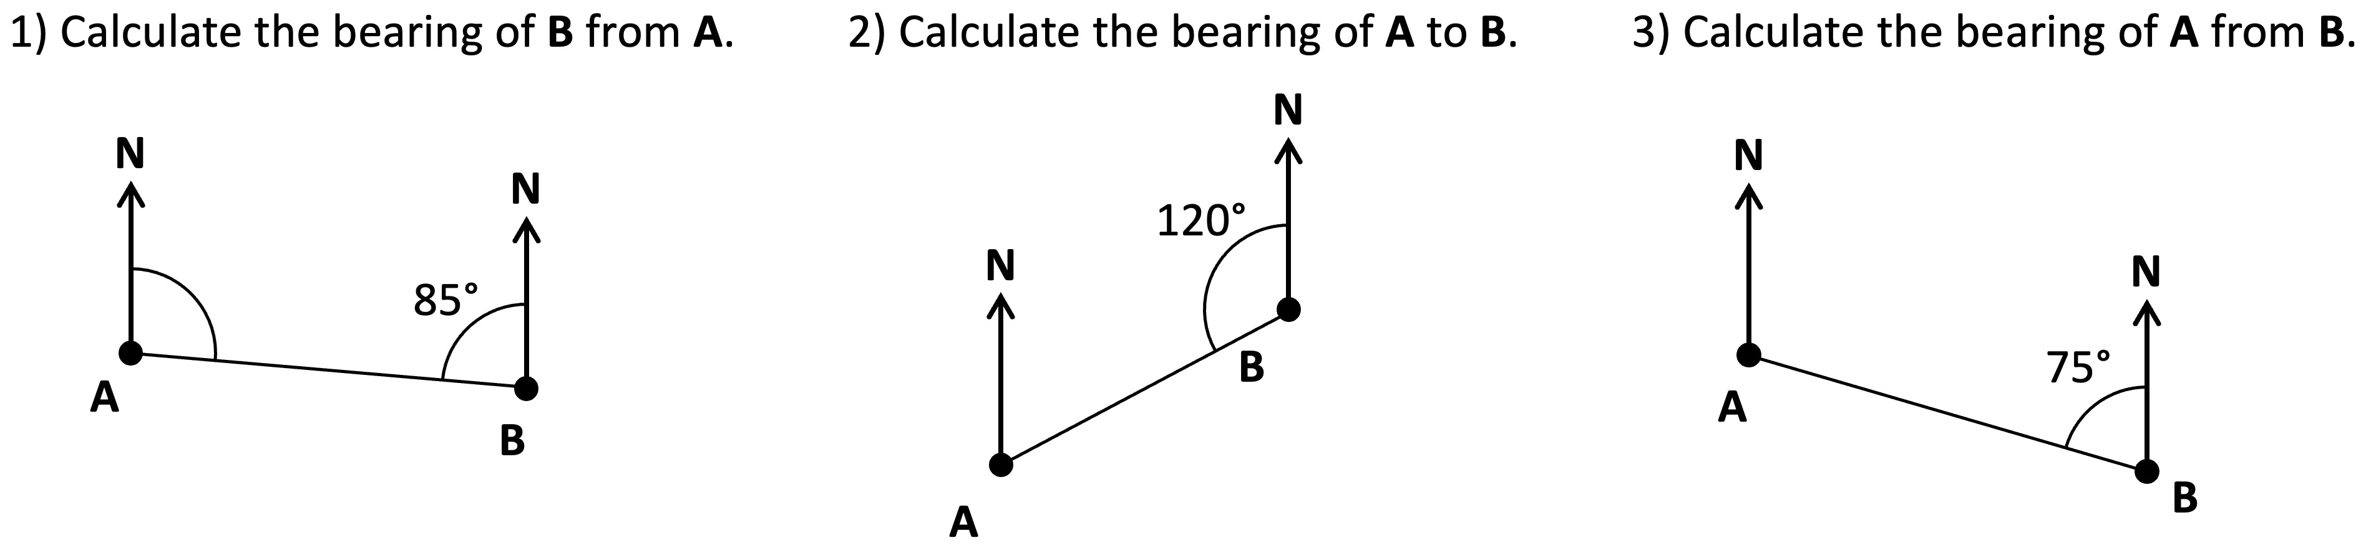
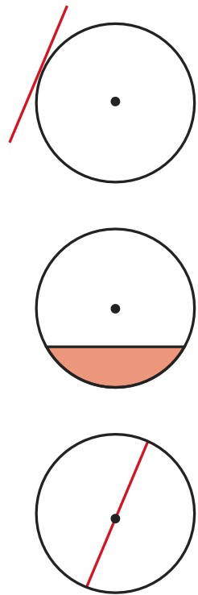
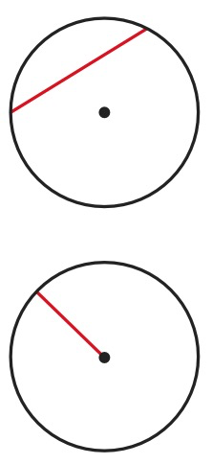
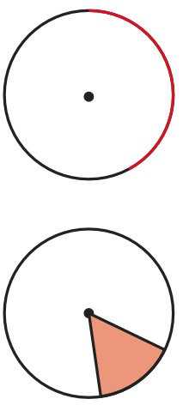
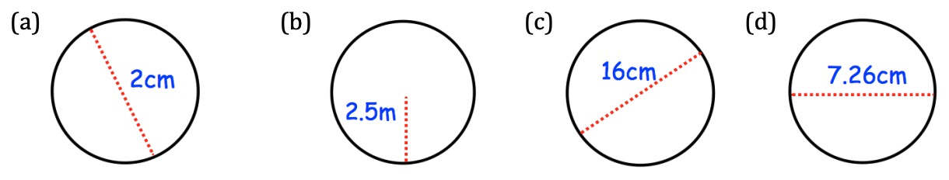
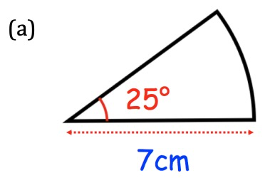
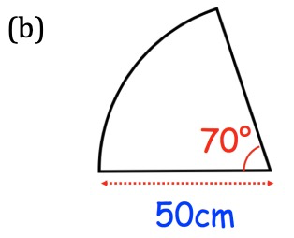
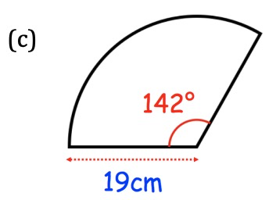
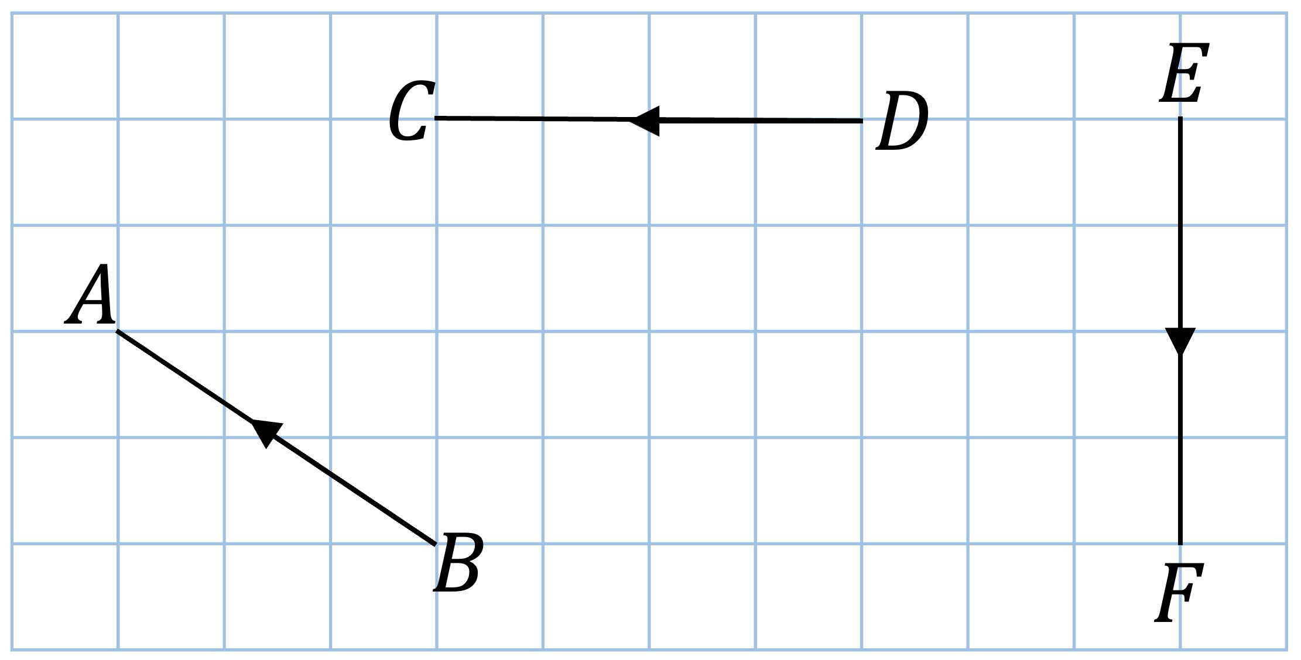
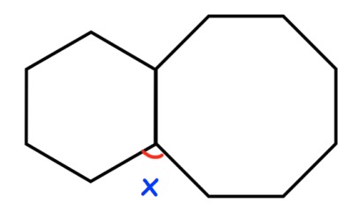
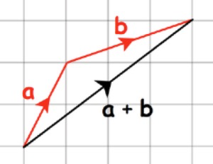
Year 10 − Geometry
Angles, Circles and Vectors
What are the sizes of angles x, y and z?
How do you know? (state the rules for each angle)
Use cover, look, write, check to write the definitions …
Angle:
Bearing:
Radius:
Diameter:
Circumference:
Pi:
Vector:
Angle and line notation
What is the size of …
∠DEH
∠FEG
∠HEF
Bearings
Use your understanding of angle rules in parallel lines to help you calculate these bearings. NB: bearings are measured clockwise from north.
Parts of a circle
Label the parts of each circle
Calculate the circumference of each circle
Area of circles and sectors
A circle has a diameter of 5cm. Calculate its area (to 2 decimal places)
A circle has an area of 30cm². Calculate its radius (to 2 decimal places)
Calculate the area of the following sectors to 2 decimal places (include suitable units)
_ _ _ _ _
_ _ _ _ _
_ _ _ _ _
_ _ _ _ _
_ _ _ _ _
_ _ _ _ _
_ _ _ _ _
Angle facts
Calculate the size of the exterior angle in …
A regular hexagon
A regular octagon
A regular decagon
The interior angle of a regular polygon is 168.75° Calculate the number of sides the polygon has.
The diagram shows two
regular polygons.
Calculate the value
of angle x
Vectors
Write the vectors shown using correct notation.
Write a as a column vector
Write b as a column vector
Write a + b as a column vector

