Slide 1

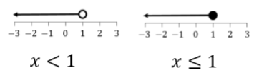


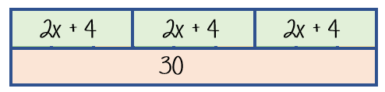
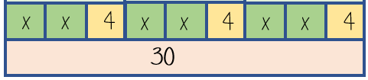
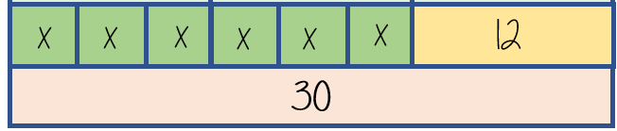



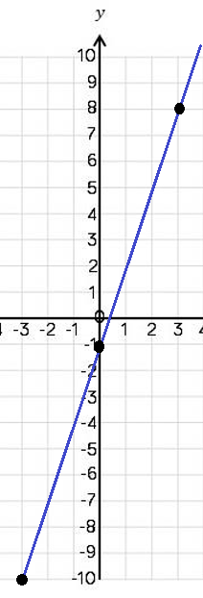







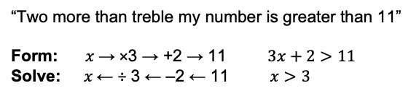








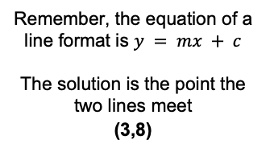




Year 10 − Developing Algebra
Representing solutions of equations & inequalities
Form and solve equations and inequalities
Represent inequalities on a number line
Draw straight line graphs
Form and solve equations and inequalities with unknowns on both sides
Solution: a value in place of a variable that makes the equation true
Variable: a symbol for a number we don’t know yet.
Equation: an equation says that two things are equal
Expression: numbers, symbols etc grouped together to show a value
Linear: an equation or function that is the equation of a straight line
Identity: An equation that is true no matter what values are chosen
Intersection: the point that two lines meet
Inequality: an inequality compares two values showing if one is greater than, less than or equal to another.
Form and solve inequalities
Understand & use algebraic notation (Y7)
Brackets, equations & inequalities (Y8)
Straight line graphs (Y9)
Forming & solving equations (Y9)
“Two more than treble my number is greater than 11”
Form: $x$→ ×3 → +2 → 11 $3x+2>11$
Solve: $x$← ÷ 3 ← –2 ← 11 $x>3$
Includes the value 1
Solutions on a number line line
Values less than or equal to 3 but also more than -1
Both represent values less than 1
Both represent values more than 1
$$−1<x≤3$$
Solve equations
Inequalities: unknown on both sides
3 (2x + 4) = 30
$$8x+5 ≤4x+13$$
6x + 12 = 30
$$8x+5≤4x+13$$
-12
-12
$$−4x$$
$$−4x$$
$$4x+5≤13$$
6x = 18
x = 3
$$−5$$
$$−5$$
÷ 6
÷ 6
Any value of 2 or less will satisfy this inequality
$$4x≤8$$
$÷$4
Substitute to check your answer.
This could be negative or a fraction or decimal
$÷$4
$$x≤2$$
Plotting straight line graphs
Find solutions using straight line graphs
$y=3x−$1
3 × the $x$ coordinate then – 1
$$y=8$$
$$y=3x−1$$
$$x=3$$
$$y=8$$
Draw a table to display the information
These two lines will cross at (3,8)
$$x$$ | −3 | 0 | 3
$$y$$ | -10 | -1 | 8
$$3x−1=8$$
You only need two points to form a straight line, but plotting more helps you decide if your calculations are correct (if they make a straight line).
Remember, the equation of a line format is $y = mx + c$
The solution is the point the two lines meet
(3,8)

Slide 2
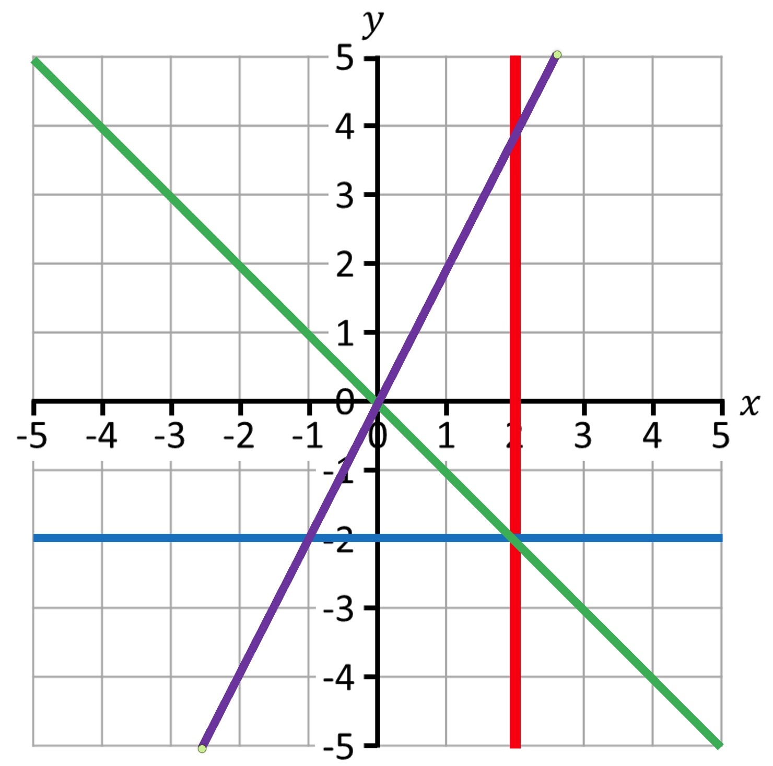
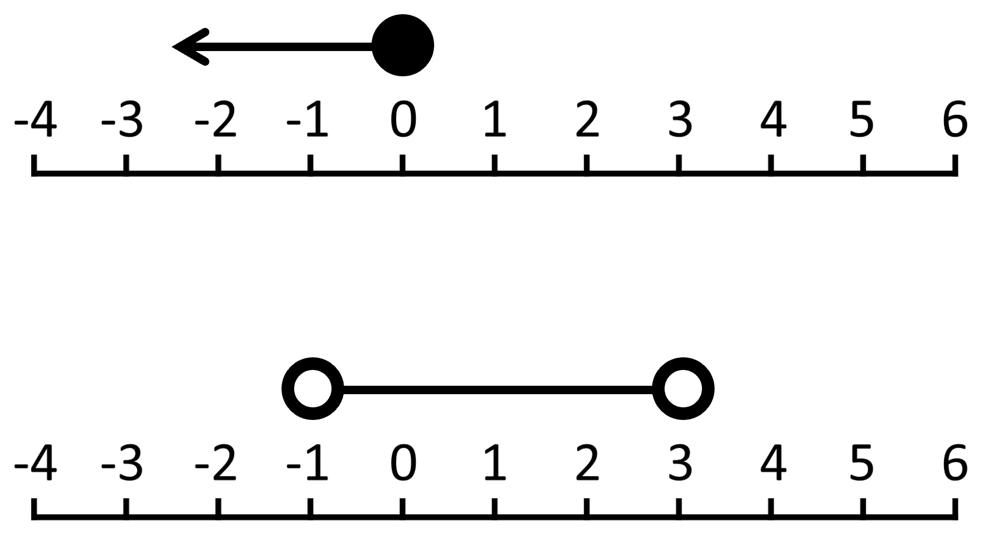
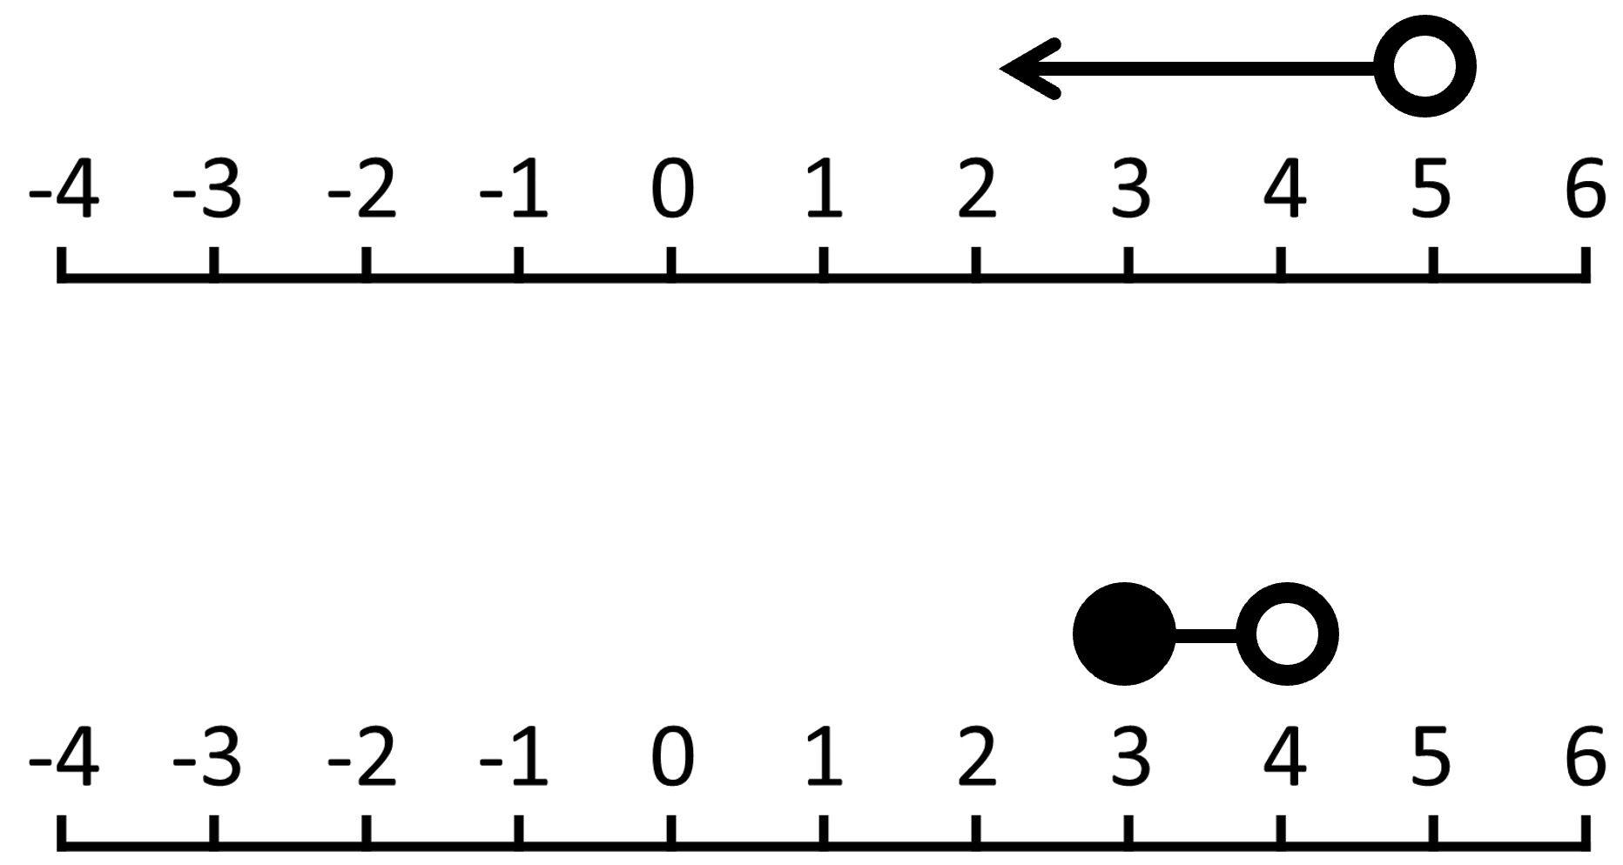
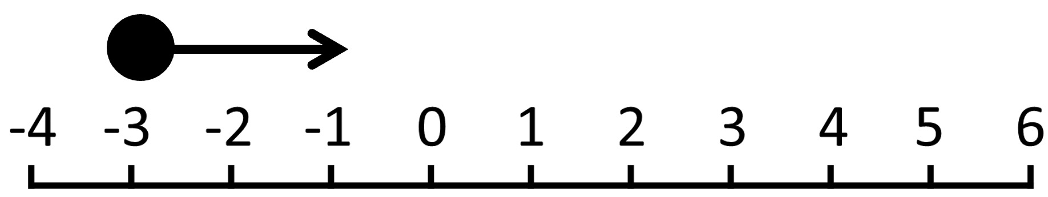
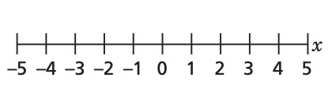
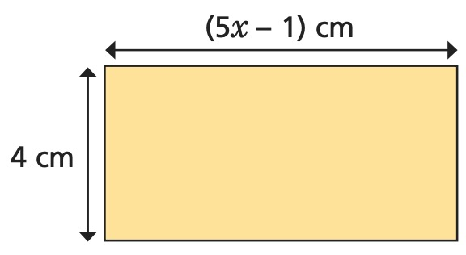
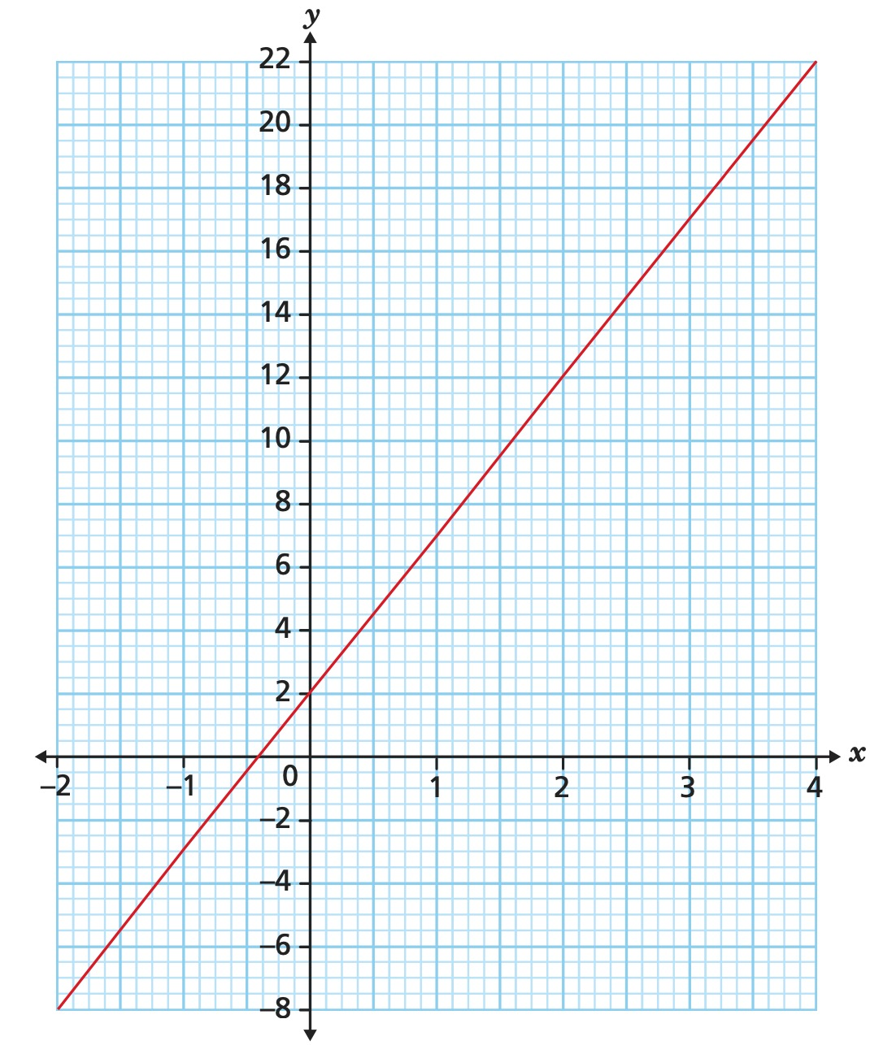
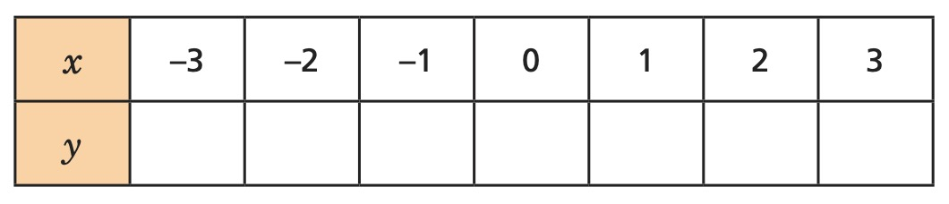
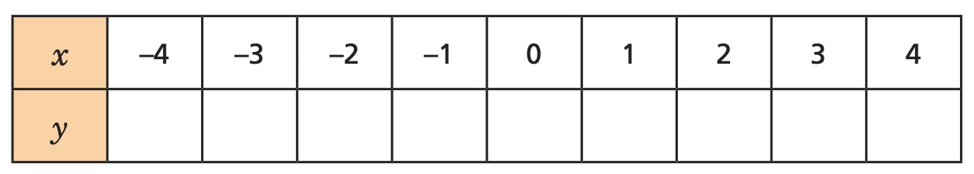




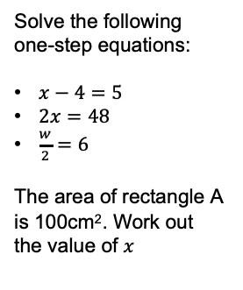

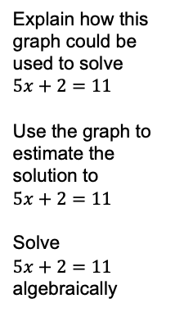
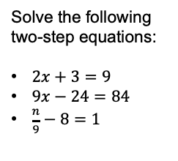
Year 10 − Developing Algebra
Representing solutions of equations & inequalities
State the equation of each line:
Use cover, look, write, check to write the definitions …
Solution: Variable:
Equation: Expression:
Linear: Identity:
Intersection: Inequality:
A
C
A) ______
B) ______
C) ______
D) ______
Form and solve inequalities
Form expressions for the following inequalities:
5 more than double my number is greater than 11.
3 less than half my number is less than 21.
Double my number plus three is less than 30.
B
D
Solutions on a number line
What inequalities do these diagrams represent?
Solve equations
Inequalities: unknown on both sides
Solve the following one-step equations:
$x−4=5$
$2x=48$
$\frac{w}{2}=6$
The area of rectangle A is 100cm². Work out the value of $x$
Solve the following two-step equations:
$2x+3=9$
$9x−24=84$
$\frac{n}{9}−8=1$
Solve the inequalities and represent your answers on the number lines.
$$8x+\text{12} <3x+32$$
A
$$7m−1<4m−10$$
Plotting straight line graphs
Find solutions using straight line graphs
Complete the table of values for the equation: $y = 2x + 5$
Explain how this graph could be used to solve $5x+2=11$
Use the graph to estimate the solution to
$$5x+2=11$$
Solve
$5x+2=11$ algebraically
Complete the table of values for the equation: $y =\frac{1}{2}x +1$
$$y=5x+2$$

