Slide 1

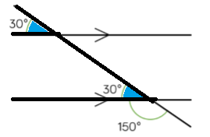
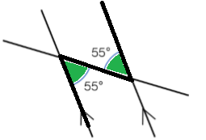
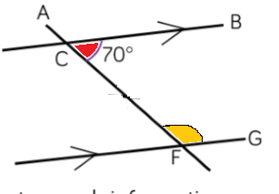
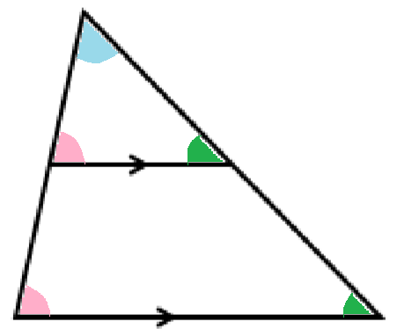
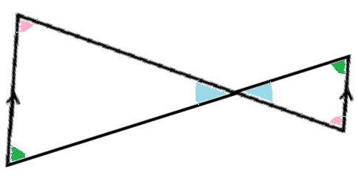
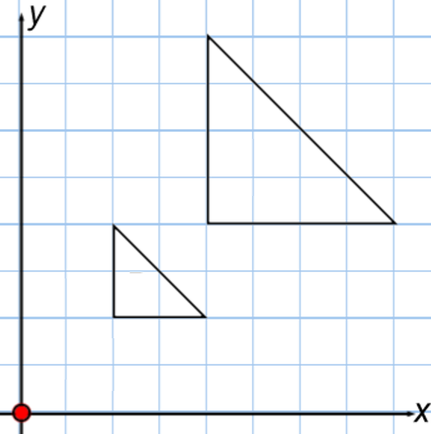
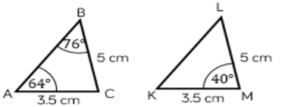
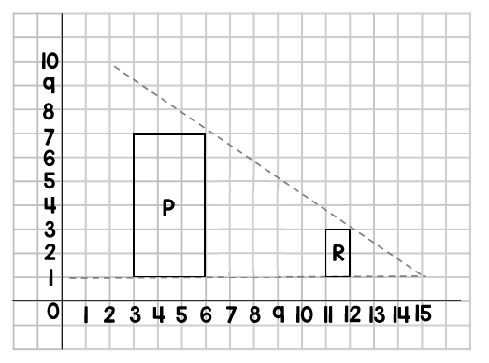
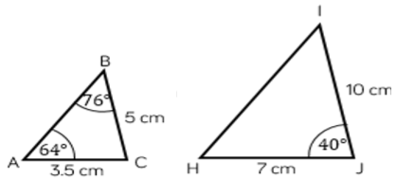

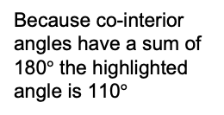

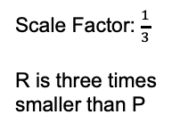
Year 10 − Similarity
Congruence, similarity & enlargement
Enlarge by a positive or fractional scale factor
Identify similar shapes
Work out missing sides and angles in similar shapes
Use parallel lines to find missing angles
Similarity and congruence
Enlarge: make a shape bigger or smaller by a multiplier / scale factor
Scale Factor (SF): the multiplier of enlargement
Centre of enlargement: the point the shape is enlarged from
Similar: when one shape can become another with a reflection, rotation, enlargement or translation.
Congruent: the same size and shape
Corresponding: items that appear in the same place in similar situations
Parallel: straight lines that never meet (equal gradients)
Identify similar shapes
Scale Factor (SF): Both sides on the bigger shape are 1.5 times bigger. Sides are in the same ratio.
8cm
12cm
Angles in parallel lines & polygons (Y8)
Constructions & congruency (Y9)
Enlargement & similarity (Y9)
6cm
9cm
6 : 9
2 : 3
8 : 12
2 : 3
Alternate angles
Angles in parallel lines
Corresponding angles
Alternate angles are equal
Co-interior angles
Corresponding angles are equal
Because co-interior angles have a sum of 180$°$ the highlighted angle is 110$°$
Similar triangles
Positive scale factors
As all angles are the same, these are similar triangles
Share a vertex
Enlargement from a point
Alternate angles
Enlarge shape A by a SF of 2 from (0,0)
The shape is enlarged by a scale factor of 2
The distance from the point enlarges by a scale factor of 2
Parallel lines – all angles will be the same in both triangles.
B
Corresponding angles are equal
A
Vertically opposite angles
Congruence and similarity
Fractional scale factors
Congruent shapes are identical
Fractions less than 1 make a shape smaller
A$\hat{C}$B = K$\hat{M}$L
R is an enlargement of P by a scale factor $\frac{1}{3}$ from centre of enlargement (15,1)
Because all the angles are the same and AC=KM BC=LM, triangles ABC and KLM are congruent
Scale Factor: $\frac{1}{3}$
R is three times smaller than P
Because all angles are the same, but all sides are enlarged by 2, ABC and HIJ are similar

Slide 2
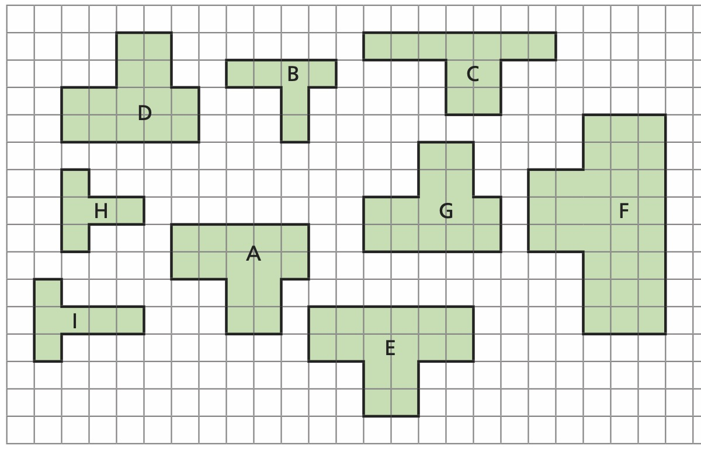
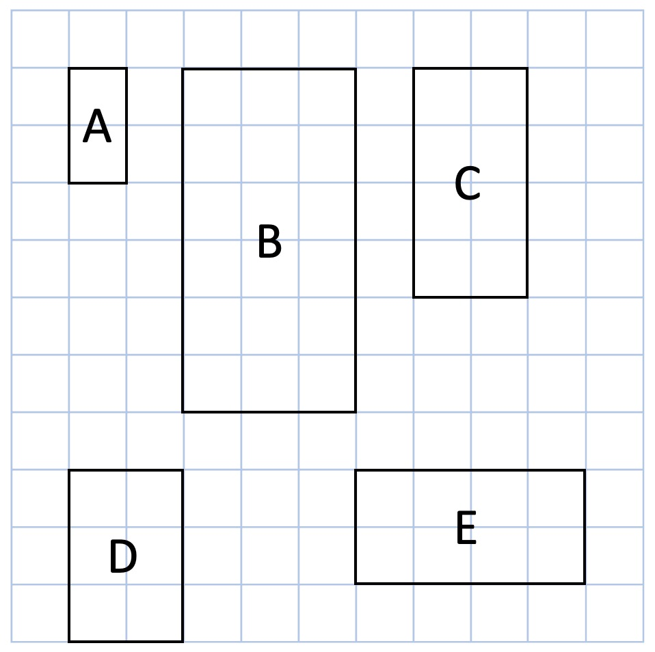
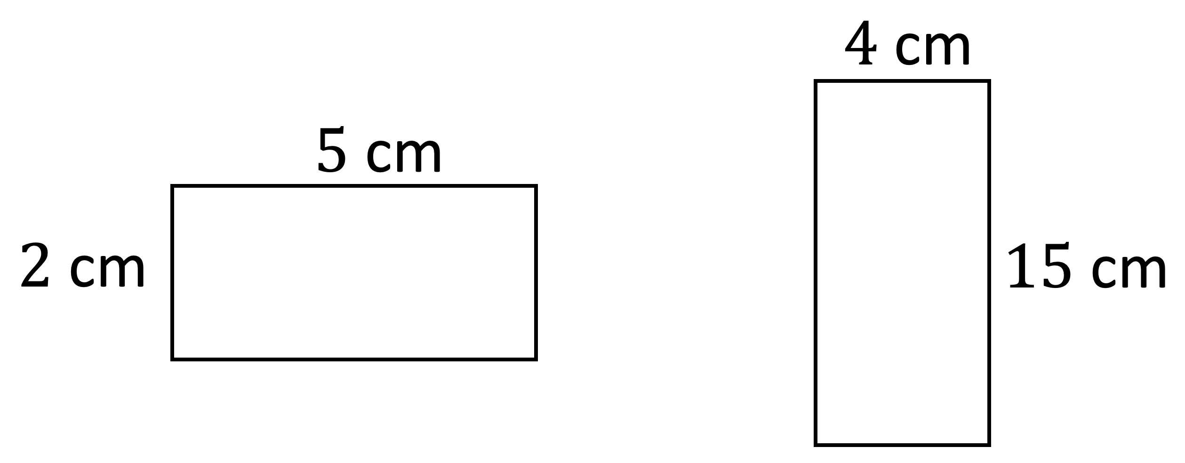
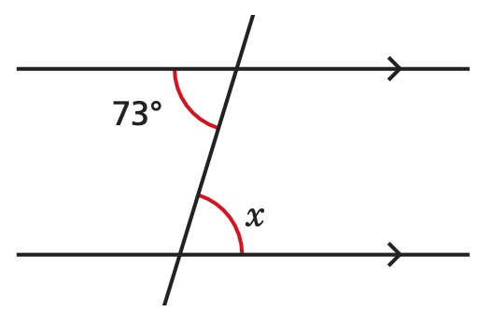
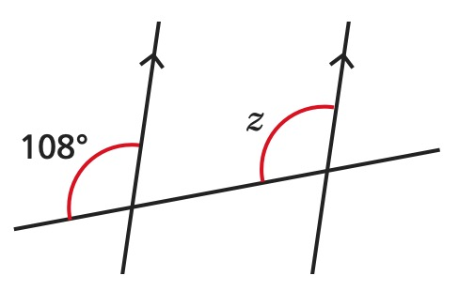
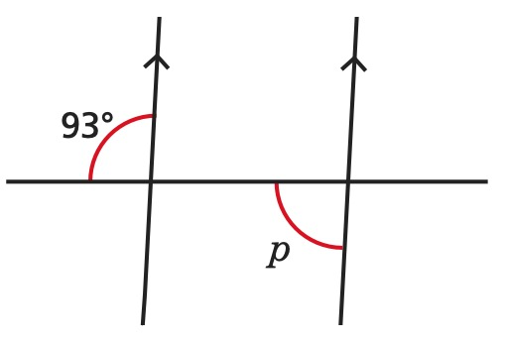
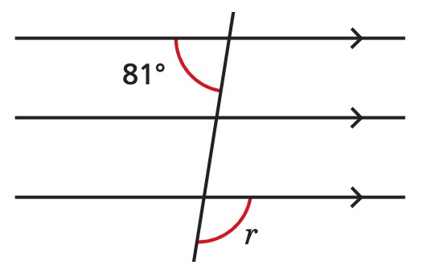
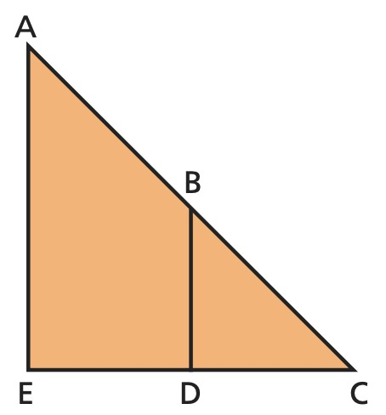
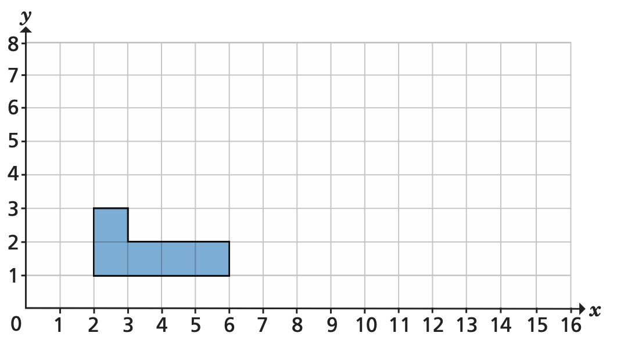
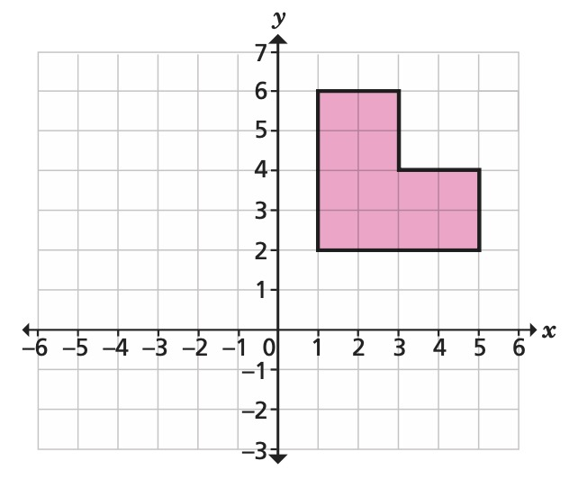
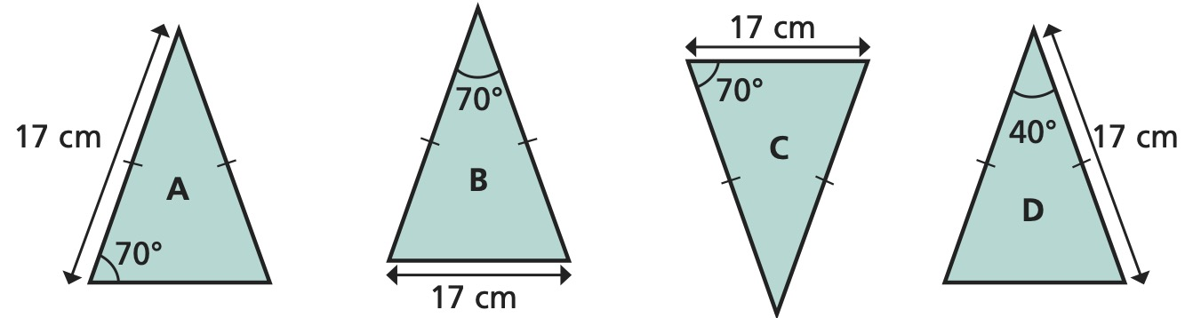
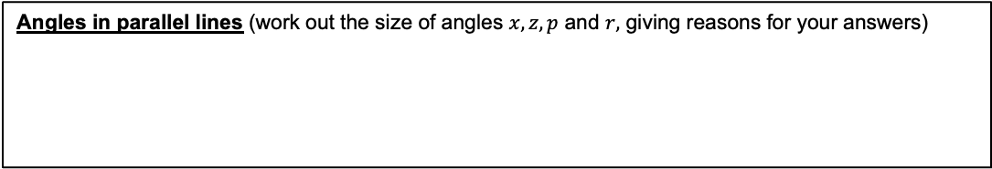
Year 10 − Similarity
Congruence, similarity & enlargement
Which octagons are congruent to A?
Use cover, look, write, check to write the definitions …
Enlarge:
Scale Factor:
Centre of enlargement:
Similar:
Congruent:
Corresponding:
Parallel:
Which rectangles are similar to rectangle A and what is the scale factor of enlargement?
Identify similar shapes
Explain why these
rectangles are not
similar.
Angles in parallel lines (work out the size of angles $x, z, p$ and $r,$ giving reasons for your answers)
Similar triangles
Positive scale factors
In the diagram, AE and BD are parallel. Complete the statements
to show the angles that
are equal.
∠ AEC =
∠ EAC =
∠ ECA =
Are the triangles similar?
Enlarge the shape from the origin by a scale factor of 2
Congruence and similarity
Fraction scale factors
Which triangle is congruent to triangle A?
Which triangle is similar to triangle A?
Enlarge the shape by a scale factor of 0.5, using the centre of enlargement (–5, 6)

