Slide 1

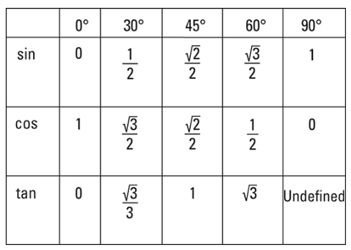
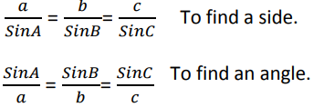

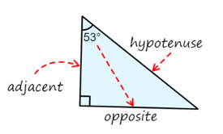
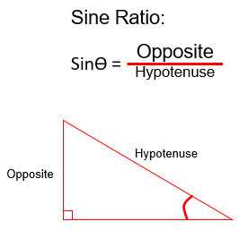
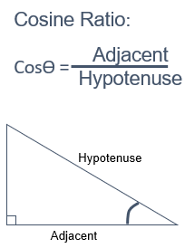
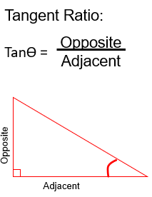
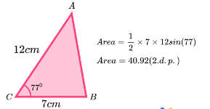


Year 9- Trigonometry
Know trigonometric ratios. Know the exact values of sin, cos, tan for required angles. Know how to identify the sides in a triangle. Know the sine and cosine rule. Know the area of triangle rule. Know how to find lengths using the sine and cosine rule.
Trigonometry - the study of the relationship between the sides and angles of a right-angled triangle
Hypotenuse – The longest side in a right angles triangle
Adjacent –The side next to the angle you are finding/using
Opposite- The side opposite the angle you are finding/using
Exact Trig values
Right angles triangles, Pythagoras
Sine and cosine rules
Labelling a triangle
Hypotenuse – The longest side opposite the right angle
Adjacent- The angle next to the angle you are using
Opposite- The angle opposite the angle you are using.
Trigonometric ratios
Area of triangle
$$\frac{1}{2}$$
Area of a triangle = ab Sin C
$$\frac{1}{2}$$
Area = x 7 x 12 Sin (77)
Area = 40.92 (2dp)

Slide 2
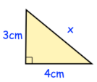
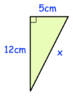

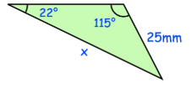
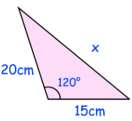
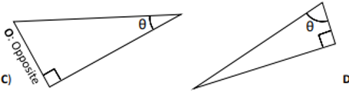
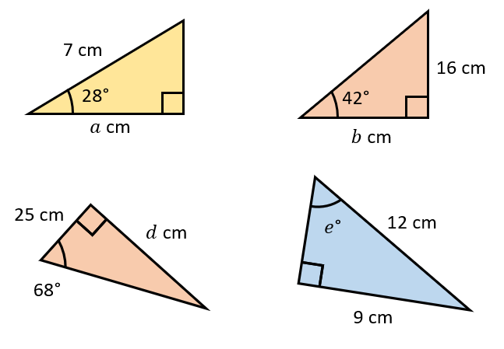
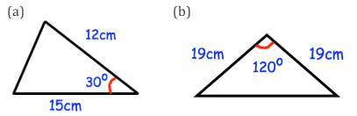
Year 9-Trigonometry
Find the missing side lengths using Pythagoras
Write the definition of the following keywords
Trigonometry
Hypotenuse
Adjacent
Opposite
Exact trig values
Write down the exact values of each of the following
(a) sin 30°
(b) cos 0°
(c) tan 45°
(d) sin 90°
(e) sin 0°
(f) cos 60°
(g) tan 0°
(h) sin 45°
(i) cos 30°
(j) tan 60°
Sine and cosine rules
Decide if you would use Sine or cosine rule on the triangles below
Labelling a triangle
Label the sides of the triangles below
Trigonometric ratios
Decide which Trigonometric ratios to use to
find the missing side in each triangle.
Area of triangle
Use the formula to find the area of the triangles below

