Slide 1

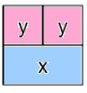
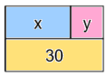
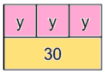

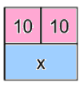
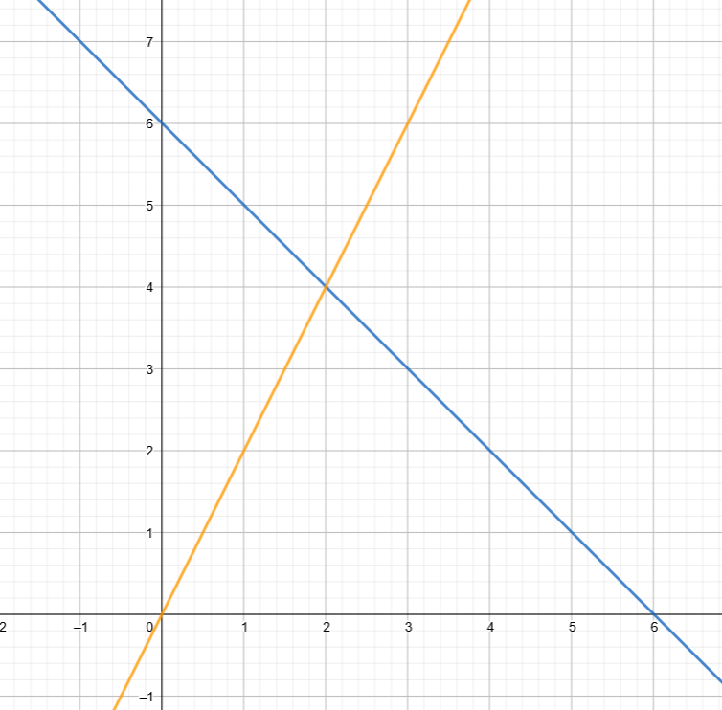
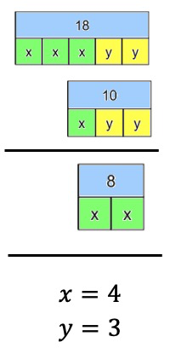
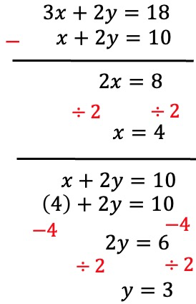
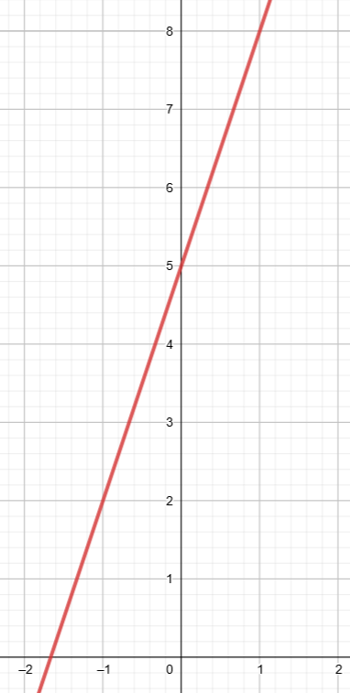

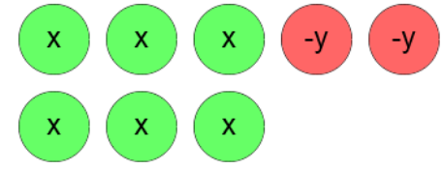
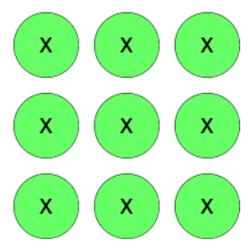




















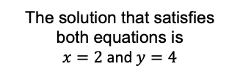







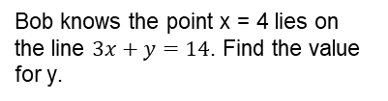

















Year 9 − Developing Algebra
Simultaneous equations
Determine whether (x,y) is a solution
Solve by substituting a known variable, an expression, graphically, by subtracting/ adding equations, by adjusting equations.
Substitute: replace a variable with a numerical value
LCM: lowest common multiple (the first time the times table of two or more numbers match)
Eliminate: to remove
Expression: a maths sentence with a minimum of two numbers and at least one math operation (no equals sign)
Coordinate: a set of values that show an exact position.
Intersection: the point two lines cross or meet.
Substituting known variables
Understand & use algebraic notation (Y7)
Brackets, equations & inequalities (Y8)
Straight line graphs (Y9)
Forming & solving equations (Y9)
Bob knows the point x = 4 lies on the line $3x+y=14$. Find the value for y.
$$12+y=14$$
$$−12$$
$$−12$$
$$3x+y=14$$
$$3\left(4\right)+y=14$$
$$y=2$$
Substituting in an expression
Substitute $2y$ in place of the $x$ variable as they represent the same value
x = 2y
Pair of simultaneous equations
$$3y=30$$
$$÷3$$
$$÷3$$
x + y = 30
$$x=2y$$
$$x+y=30$$
$$3y=30$$
$$y=10$$
$$x=20$$
$$3x+2y=18$$
Solve graphically
Solve by subtraction
(2, 4) is the point of intersection
$$−$$
$$x+2y=10$$
x + y = 6
y = 2x
Linear equations are straight lines. The point of intersection provides the x and y solution for both equations.
The solution that satisfies both equations is
$x=2$and $y=4$
Is (x, y) a solution?
Solve by addition
$$3x+2y=16$$
Addition makes zero pairs
Does the coordinate (1,8) lie on the line y = 3x + 5?
(2,7)
$$+$$
$$3x+2y=16$$
$$6x−2y=2$$
$$=16$$
$$6x−2y=2$$
$$y=3x+5$$
$$9x=18$$
$$=2$$
$$8=3(1)+5$$
$$÷9$$
$$÷9$$
As the substitution makes the equation correct the coordinate (1,8) IS on the line y=3x+5
$$x=2$$
$$3x+2y=16$$
$$=18$$
$$3(2)+2(y)=16$$
$$6+2y=16$$
$$=2$$
Is (2,7) on the same line?
$$−6$$
$$−6$$
$$=5$$
$$7≠3(2)+5$$
No 7 does NOT equal 6+5
$$2y=10$$
$$y=5$$

Slide 2
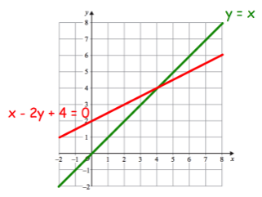
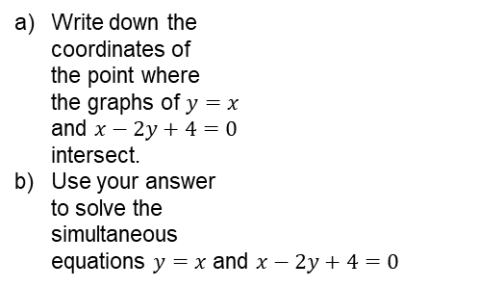

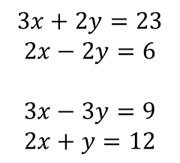

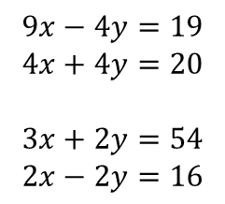
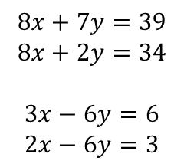
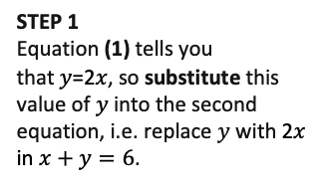
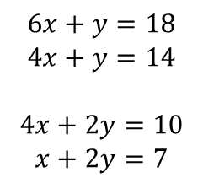
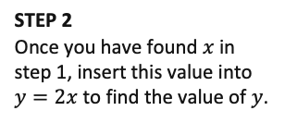
Year 9 − Developing Algebra
Simultaneous equations
The equation 9x = 27 has an answer of x=3. Write down five different equations with an answer of x = 3.
Ronald is x years old.
His friend Colin is 3 years older than than Ronald.
Colin is 19 years old.
Write down an equation for this information.
Solve your equation to find how old Ronald is.
Use cover, look, write, check to write the definitions …
Solution:
Substitute:
LCM:
Eliminate:
Expression:
Coordinate:
Intersection:
Substituting known variables
Bob knows the point x = 4 lies on that line. Find the value for y.
$$12+y=14$$
$$−12$$
$$−12$$
$$3x+y=14$$
$$3\left(4\right)+y=14$$
$$y=2$$
Substituting in an expression
STEP 1
Equation (1) tells you that 𝑦=2𝑥, so substitute this value of 𝑦 into the second equation, i.e. replace $y$ with 2𝑥 in $x+y=6$.
STEP 2
Once you have found $x$ in step 1, insert this value into $y=2x$ to find the value of $y$.
(1)
y = 2x
Pair of simultaneous equations
(2)
x + y = 6
Solve graphically
Solve by subtraction
Write down the
coordinates of
the point where
the graphs of $y=x$
and $x−2y+4=0$
intersect.
Use your answer
to solve the
simultaneous
equations $y=x$ and $x−2y+4=0$
Solve the following simultaneous equations by subtraction.
$$6x+y=18$$
$$4x+y=14$$
$$4x+2y=10$$
$$x+2y=7$$
$$8x+7y=39$$
$$8x+2y=34$$
$$3x−6y=6$$
$$2x−6y=3$$
Is (x, y) a solution?
Solve by addition
Is the point (3, 5) on the graph of y = x + 2 ?
Is the point (4, 2) on the graph of y = x – 2 ?
Is the point (6, 3) on the graph of y = x + 3 ?
Which of the following lines does the point
(3, 6) lie on? (There may be more than one).
y = x + 2 y = x + 3 y = 2x y = 3x
y = x + 5 y = 4x – 6
Write down two functions whose graphs will pass through the point (2, 8).
Solve the following simultaneous equations by addition.
$$9x−4y=19$$
$$4x+4y=20$$
$$3x+2y=54$$
$$2x−2y=16$$
$$3x+2y=23$$
$$2x−2y=6$$
$$3x−3y=9$$
$$2x+y=12$$

