Slide 1

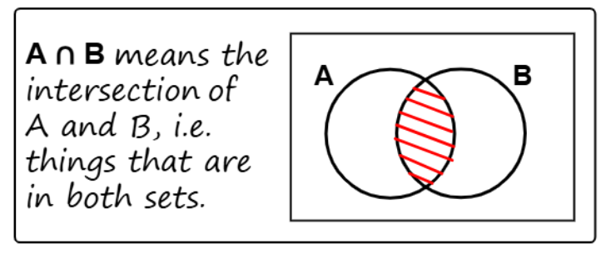
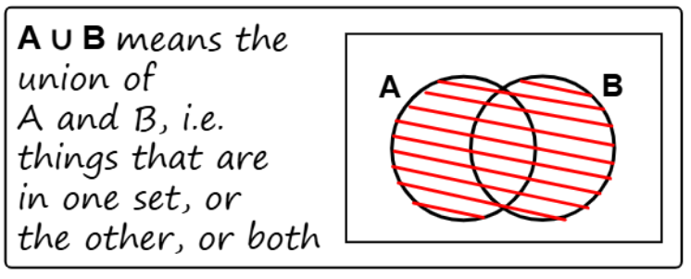
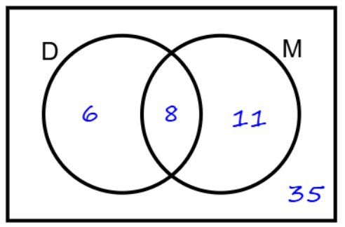
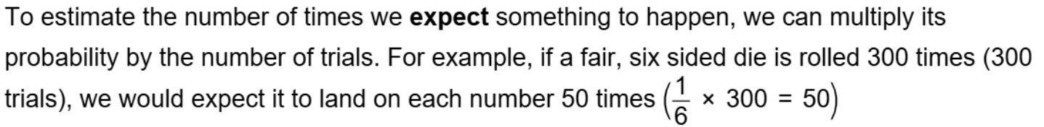
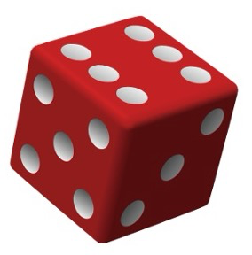
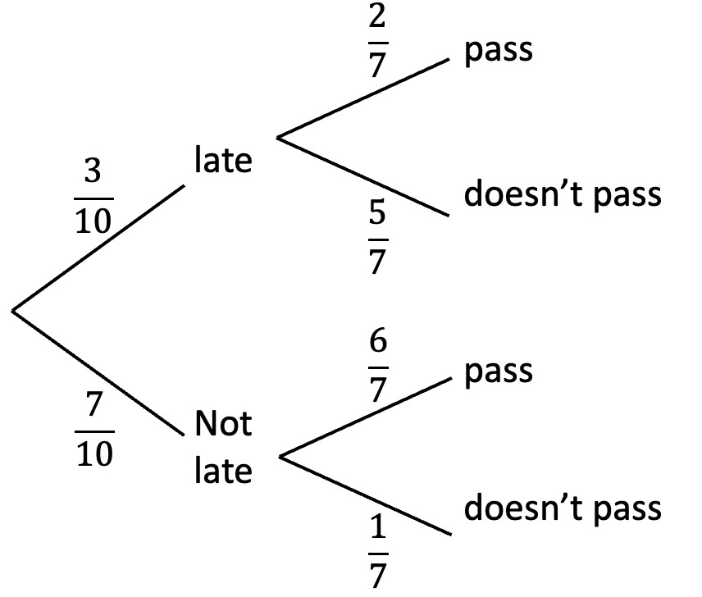
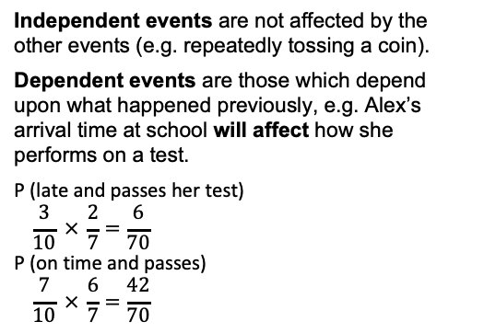
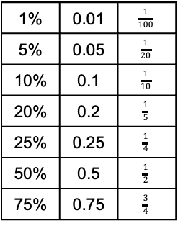
Year 9 –Probability
Calculate probability
Understand dependent and independent events
Theoretical probability: number of times we expect something to happen.
Relative frequency: the number of times an event happens divided by the number of outcomes that took place.
Dependent events: in probability theory, the probability of a dependent event is affected by previous events.
Venn diagram notation
Ratio & scale (Y8)
Fractions & percentages (Y8)
Probability (Y9)
Solving ratio & proportion problems (Y9)
Venn diagrams
A Venn diagram is a way of sorting information into categories.
The Venn diagram shows the number of pupils who study Drama or music.
The overlapping section represents the number of pupils who study both.
Percentages, decimals & fractions
Expected outcomes
To estimate the number of times we expect something to happen we multiply the probability by the number of trials. For example if a fair six-sided die is rolled 300 times, we would expect it to land on each number 50 times.
1% | 0.01 | $$\frac{1}{100}$$
5% | 0.05 | $$\frac{1}{20}$$
10% | 0.1 | $$\frac{1}{10}$$
20% | 0.2 | $$\frac{1}{5}$$
25% | 0.25 | $$\frac{1}{4}$$
50% | 0.5 | $$\frac{1}{2}$$
75% | 0.75 | $$\frac{3}{4}$$
To find a percentage of an amount, multiply the amount by the decimal equivalent, e.g.
10% of 50 (0.1 × 50 = 5)
20% of 48 (0.2 × 48 = 9.6)
A percentage decrease reduces an amount, e.g. 10% off £90, is:
90 − 9 = 81
Probability (1)
Probability (2)
Theoretical probability refers to the
number of times we expect something
to happen, e.g. if we roll a dice 60 times we would expect to get 10 ones, 10 twos etc.
Experimental probability refers to the times something actually happens, e.g. if we roll a dice 60 times we might get 8 ones, 12 twos etc.
Relative frequency is the number of times an event happens divided by the total number of outcomes that took place. The more times an experiment is carried out, the closer the relative frequency will be to the theoretical probability.
Independent events are not affected by the other events (e.g. repeatedly tossing a coin).
Dependent events are those which depend upon what happened previously, e.g. Alex’s arrival time at school will affect how she performs on a test.
P (late and passes her test)
$$\frac{3}{10} × \frac{2}{7}=\frac{6}{70}$$
P (on time and passes)
$$\frac{7}{10} × \frac{6}{7}=\frac{42}{70}$$

Slide 2
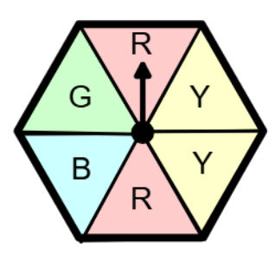
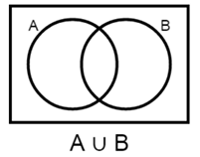
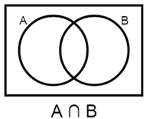
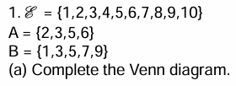
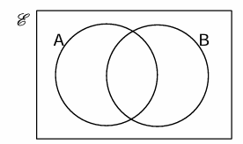
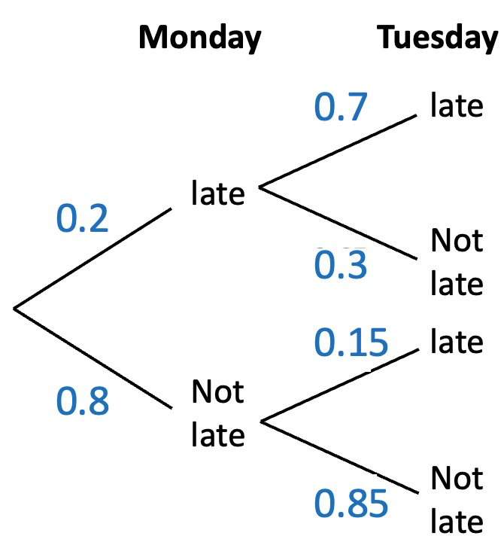
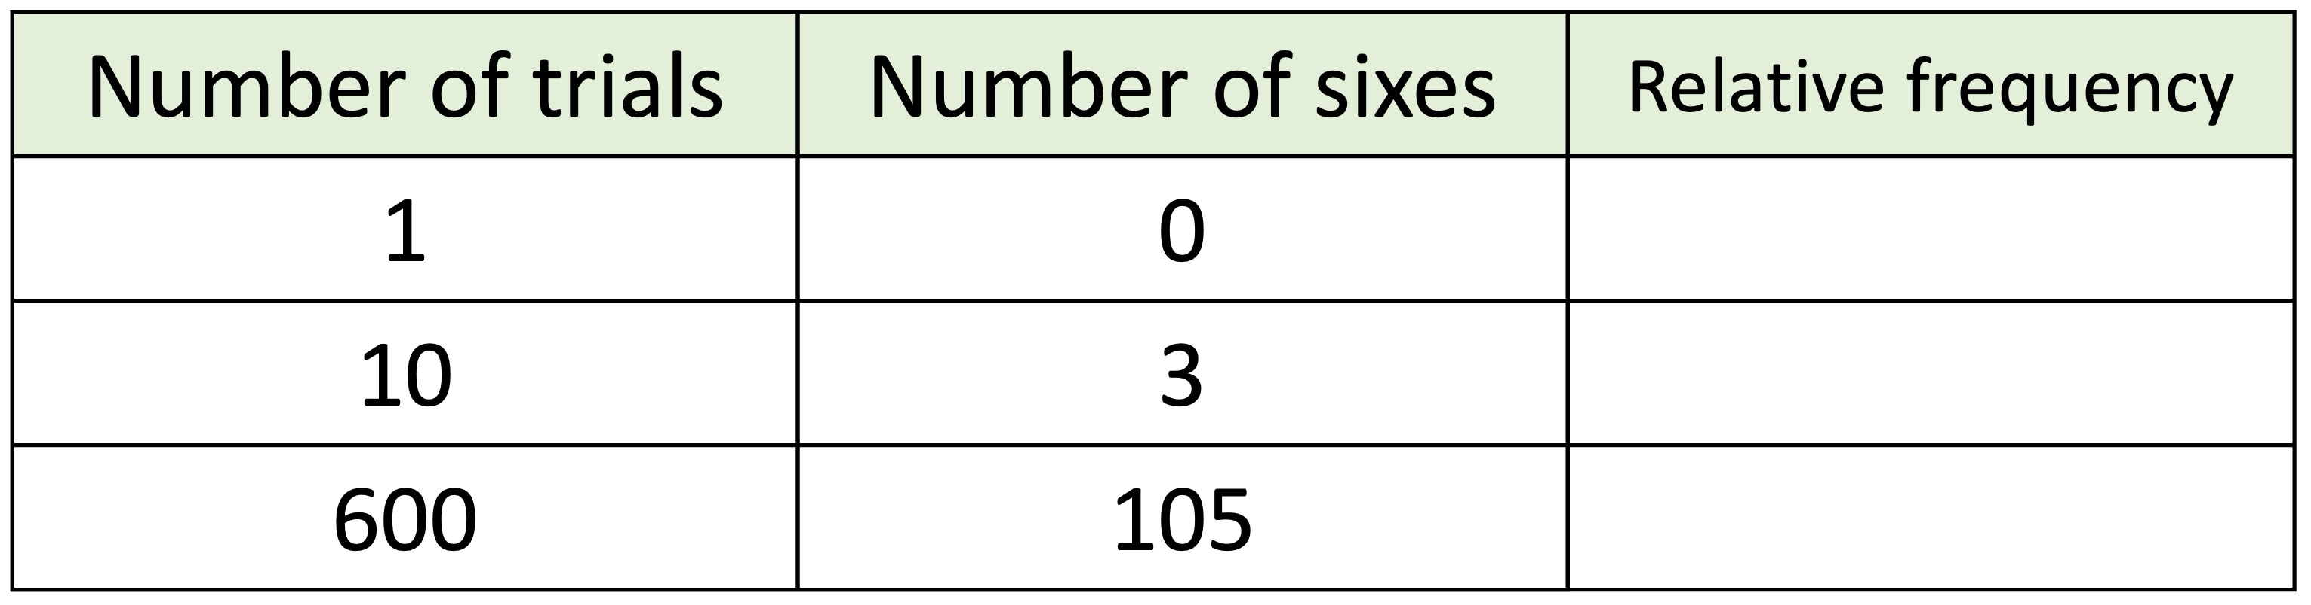
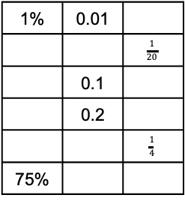
Year 9- Probability
Use cover, look, write, check to write the definitions …
Theoretical probability:
Relative frequency:
Dependent events:
Look at the spinner. Calculate the probability:
P(Green) b) P(Red)
c) P(Yellow) d) P(Red or blue)
Venn Diagram Notation
Shade the regions
Venn diagrams
Percentages, decimals & fractions
Expected outcomes
A coin is flipped 50 times, how many times would you expect it to land on heads?
A fair six-sided dice is rolled 600 times how many times would you expect to roll a 2 or 3?
Complete the table
Calculate:
10% of 48
36% of 780
Decrease 120 by:
10%
25%
State the % multiplier for:
40%
3%
A 25% increase
1% | 0.01
 |  | $$\frac{1}{20}$$
 | 0.1
 | 0.2
 |  | $$\frac{1}{4}$$
75%
Probability (1)
Probability (2)
Complete the relative frequency table.
A dice is rolled 54 times. How many fives would you expect to roll?
What is the theoretical probability that you flip three heads in a row?
Two dice are rolled. What is the theoretical probability that the total of both dice is 12?
The probability of Amir
being late for work on
Monday and Tuesday
is shown in the tree
diagram.
Calculate:
The probability Amir is late
on both days.
The probability that he is late on at least one day.

