Slide 1


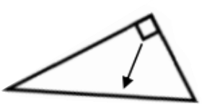
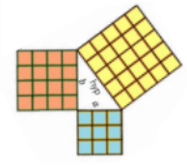
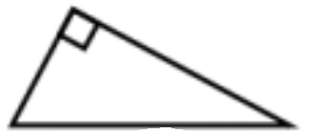
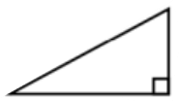




Year 9- Reasoning With Geometry- Pythagoras’ Theorem
Use square and square roots
Identify the hypotenuse
Determine whether a triangle is right-angled
Calculate the hypotenuse
Find a missing side in a right angled triangle
Use Pythagoras’ theorem on coordinate axes
Square number: the output of a number multiplied by itself
Square root: a value that can be multiplied by itself to give a square number
Hypotenuse: the largest side on a right angled triangle. Always opposite the right angle.
Opposite: the side opposite the angle of interest
Adjacent: the side next to the angle of interest
Squares and Square Roots
Understanding square numbers (Y5 and Y6)
Substitution (Y7)
Solve algebraic equations (Y8)
5² = 25
√25 = 5
Identifying the Hypotenuse
1 $×$1
2 $×$ 2
3 $×$ 3
4 $×$ 4
= 1
= 4
= 9
= 16
The hypotenuse is always the longest side on a triangle because it is opposite the biggest angle.
Determine if a Triangle is Right-Angled
hypotenuse
If a triangle is right-angled, the sum of the squares of the shorter sides will equal the square of the hypotenuse.
a² + b² = hypotenuse²
Calculate the Hypotenuse
e.g. a² + b² = hypotenuse²
3² + 4² = 5²
9 + 16 = 25
b
Either of the short sides can be called a or b
3cm
6cm
a = 3 b = 4 c = 5
a
Substituting the numbers into the theorem shows that this is a right-angled triangle
hypotenuse
a² + b² = hypotenuse²
Calculate a Missing Side
15cm
Step 1- Substitute in the values for a and b
a² + b² = hypotenuse²
hypotenuse
b
3² + 6² = hypotenuse²
Step 1- Substitute the given values
a
9 + 36 = hypotenuse²
12² + b² = 15²
12cm
45 = hypotenuse²
144 + b² = 225
Step 2- To find the hypotenuse, square root the sum of the squares of the shorter sides.
Step 2- Rearrange and solve the equation
hypotenuse = √45
144 + b² = 225
-144
-144
hypotenuse = 6.71 cm
b² = 81
√
√
b = 9cm

Slide 2
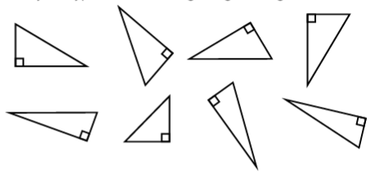
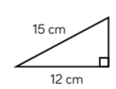
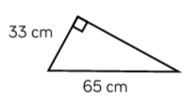


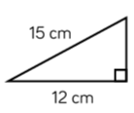
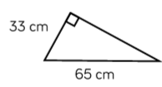

Year 9- Reasoning With Geometry- Pythagoras’ Theorem
If 3² = 9 then √9 = 3
Define the following key words:
Complete the sentences…
Square number:
Square root:
Hypotenuse:
If 4² = 16 then √16 = __
If 5² = __ then √__ = 5
If __² = 36 then √36 = __
Identifying the Hypotenuse
If __² = __ then √100 = __
Identify the hypotenuse on each of these right-angled triangles
Determine if a Triangle is
Right-Angled
Show that this triangle contains a right-angle
8cm
17cm
15cm
Calculate a Missing Side
Calculate the missing sides of each of these triangles
Calculate the Hypotenuse
Calculate the hypotenuse of each of these triangles
Problem Solving
Calculate the area of each of these triangles

