Slide 1

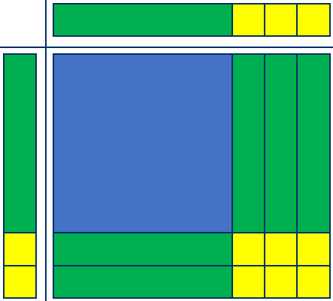
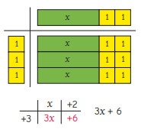
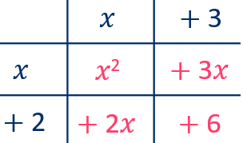
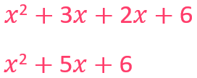
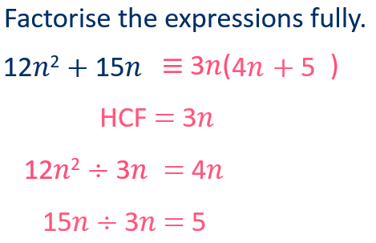
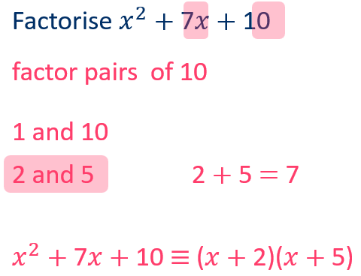
Year 9 – Algebraic Manipulation
Expand: multiply each term inside the bracket by the expression outside of the bracker
Simplify: group and collect like terms
Factorise: writing an expression with the HCF of each term outside of the brackets - the reverse of expanding
Identity: an equation that is always true for every possible value of the variables
Simplify expressions by collecting like terms
Expand and simplify both
single and double brackets
Factorise into both single and double brackets
Expand double brackets
Expand
(x+3)(x+2)
Simplifying using index laws (Y8)
Substitution (Y8)
Algebraic notation (Y7) unit 2
Expand a single bracket
Expand 3(x+2)
Factorise into a single bracket
Factorise into double brackets

Slide 2





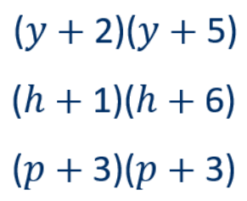
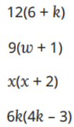
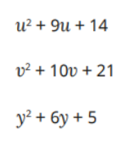





Year 9 – Algebra – Algebraic Manipulation
Write as a single power
Use cover, look, write, check to write the definitions
Expand
Simplify
Factorise
Identity
Expand double brackets
Expand & Simplify
Expand a single bracket
Expand these expressions
Factorise into double brackets
Factorise into a single bracket
Factorise:

