Slide 1

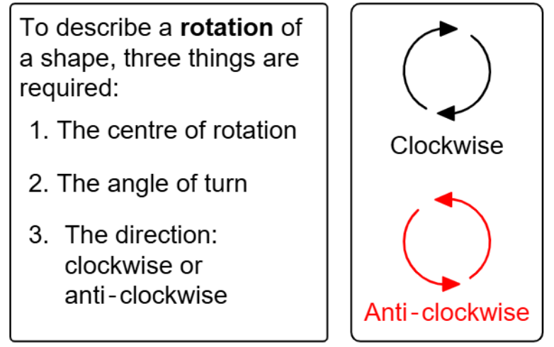
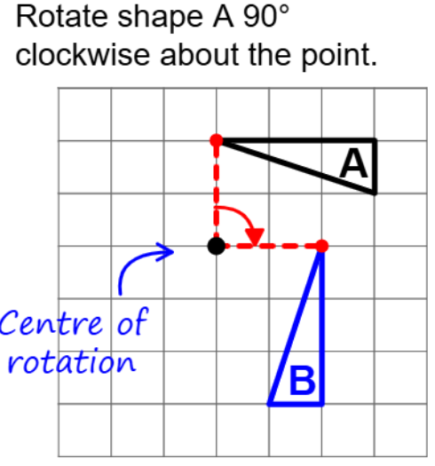
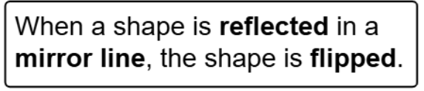
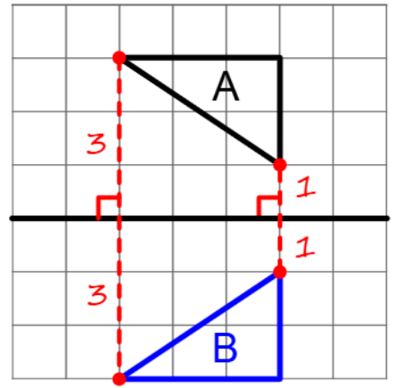
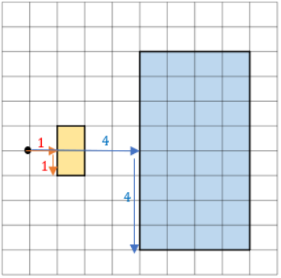
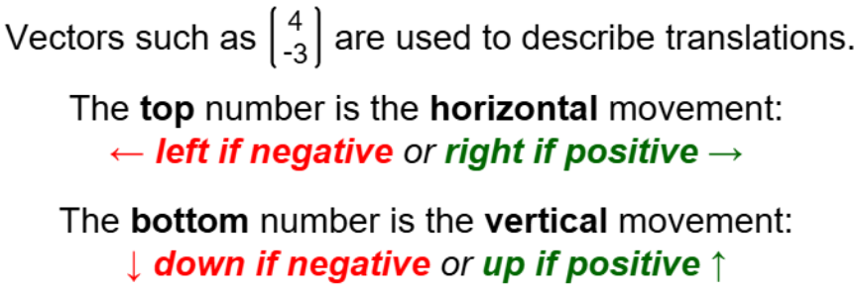
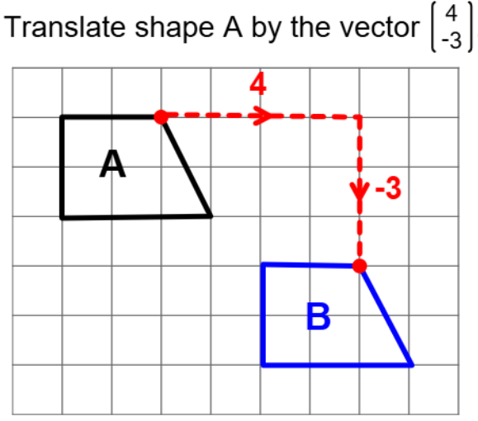
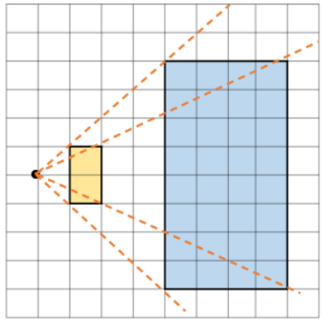
Year 9 – Transformations
Know when a shape is rotated, reflected or translated it produces a congruent shape.
A enlargement produces a similar shape
Rotation: A transformation where a shape is turned around a fixed point.
Enlargement: A transformation where a shape is made bigger or smaller using a scale factor
Reflection: A transformation where a shape is flipped over the mirror line
Translation: A movement of a shape from one position to another using a vector
Rotation
Be able to read and plot coordinates in all four quadrants
Describe position and direction using accurate language
Reflection
Enlarge a shape from a point
Scale distances method
Rays method
Translation
Scale the distance between the point of enlargement and each corresponding vertices
Multiply the distance from the centre of corresponding vertices by the scale factor along the ray

Slide 2
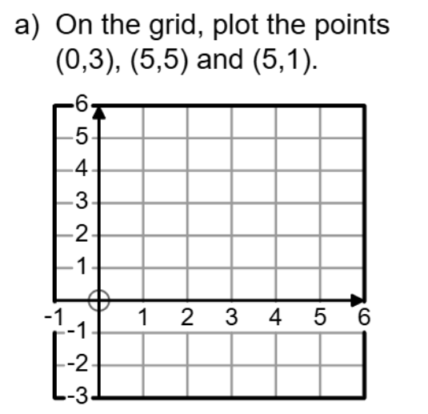
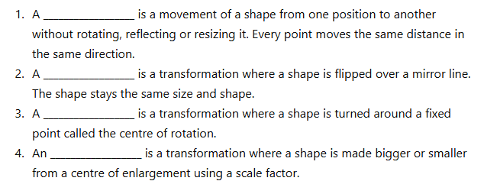
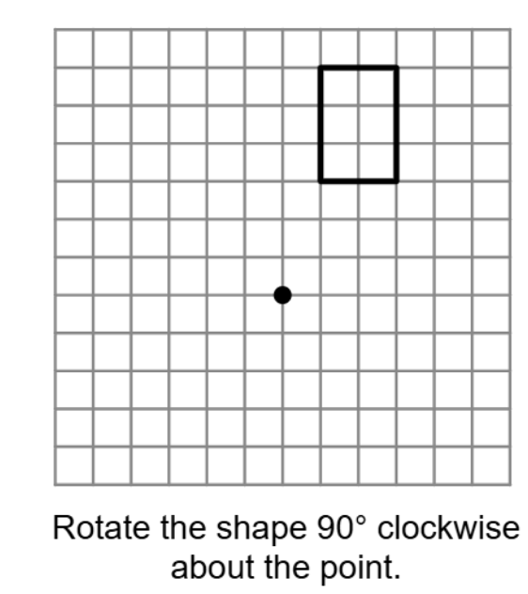
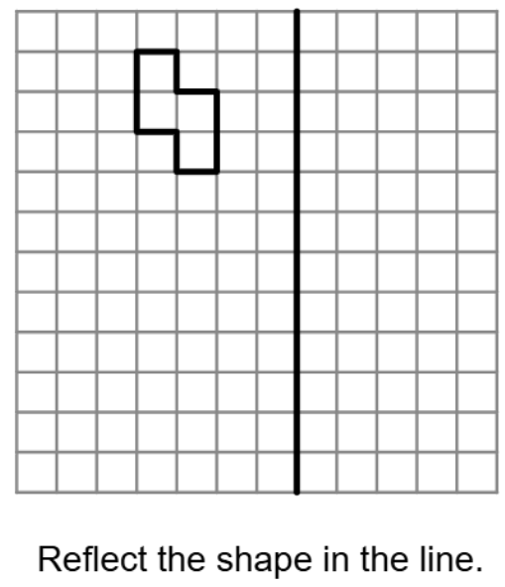
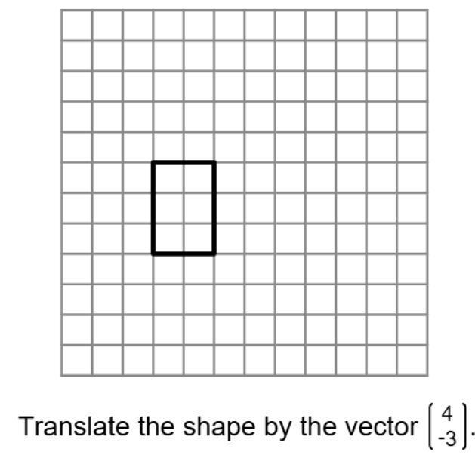
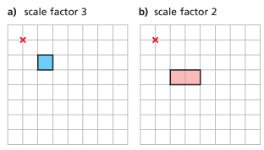
Year 9 Transformations
Rotation
Reflection
Translation
:
Enlarge a shape from a point
Enlarge the shapes from these points
(count the squares or use the rays method to help you)

