Slide 1






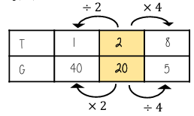
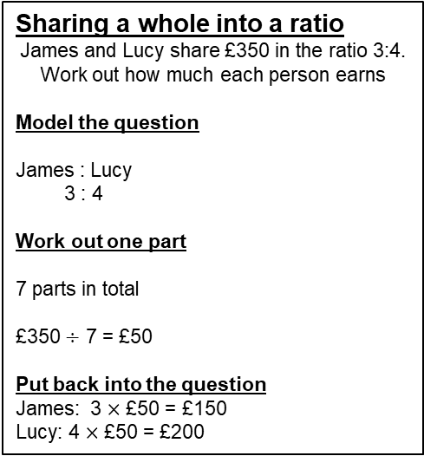
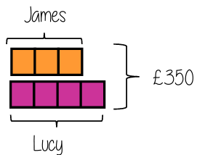
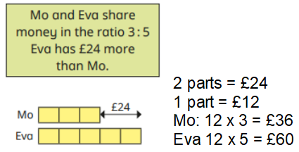
Year 9 - Ratio & Proportion
Solve problems with direct proportion
Use conversion graphs
Solve problems with inverse proportion
Solve ratio problems
Ratio: the comparison of two or more values
Share: divide a quantity into equal size parts
Conversion: process of changing a quantity from one unit to another
Direct proportion: a relationship between two quantities where they increase or decrease at the same rate
Inverse proportion: a relationship between two quantities where as one increases the other decreases at the same rate
Direct proportion
As one variable changes, the other changes at the same rate.
4 cans of pop cost £2.40
Year 8- Ratio and proportion / scale
Year 7- Solving problems with multiplication and division
4 cans = £2.40
Conversion graphs
Compares two
variables
2 cans = £1.20
This is always a straight line because as one variable increases so does the other at the same rate
Sometimes it is easier to work out how much one unit is first- this is called unitary method
4 cans = £2.40
12 cans = £7.20
kilometres
This multiplier is the same, in the same way that it
would be for ratio
miles
To make conversions between units find the point to compare – then find the associated point on the other axis.
Labelling of both axes is vital
Inverse proportion
As one variable is multiplied by a scale factor the other is divided by the same scale factor.
Solving ratio problems

Slide 2
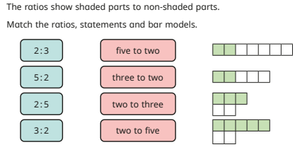
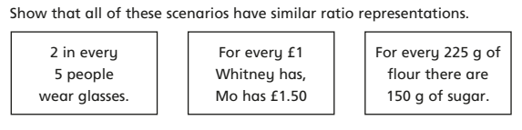
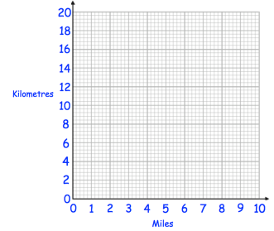
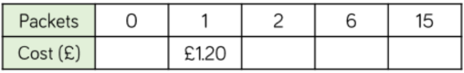
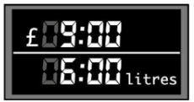
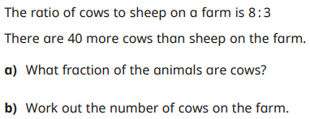
Year 9 - Ratio & Proportion
Use cover, look, write, check to write the definitions
Ratio:
Conversion:
Direct proportion
Inverse proportion
Arial size 11
Conversion graphs
Use the knowledge that 5 miles = 8 kilometres to complete the conversion graph.
A car is travelling 60km/h. Use the conversion graph to find out the speed of this car in miles per hour.
Direct proportion
One packet of stickers costs £1.20. Complete the table.
At a petrol station, 6 litres of petrol costs £9.
How much does 60 litres of petrol cost?
How much does 24 litres of petrol cost?
How much does 2 litres of petrol cost?
Solving ratio problems
Sharing into a ratio
Euan and Finlay share £100 in the ratio 3:2. How much does each person get?
Sarah and Kevin share £42 in the ratio 2:5. How much does each person get?
John and Fiona share £60 in the ratio 7:3. How much more does John get?
Eva and Pat share £360 in the ratio 5:4. How much does Eva get?
Inverse proportion
One machine can print 10,000 pages in one hour. How long would it take the following amount of machines to print 10,000 pages?
2 machines
10 machines
4 machines
15 machines

