Slide 1


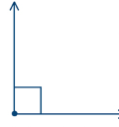
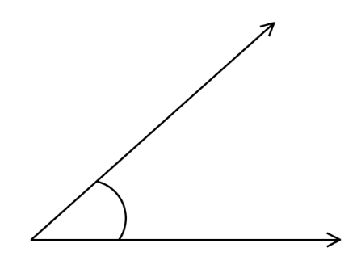
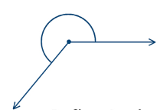
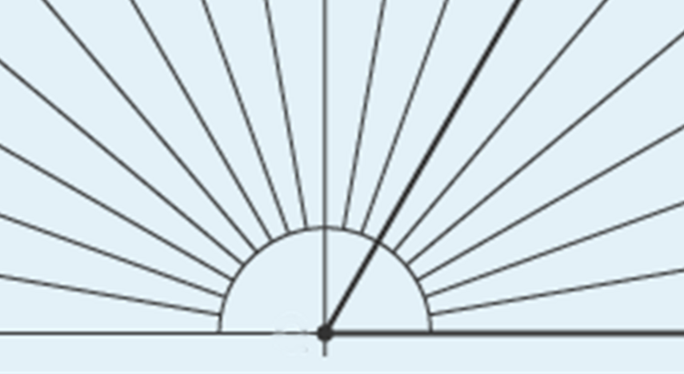
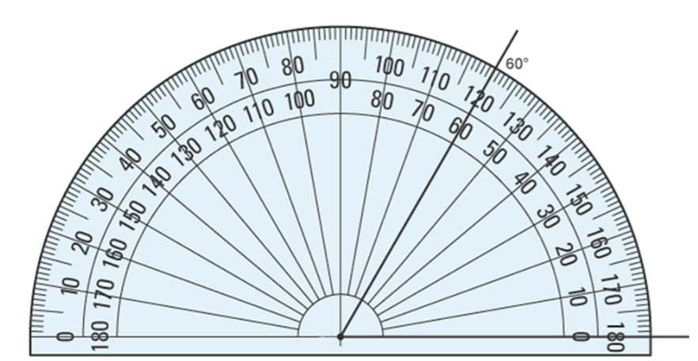
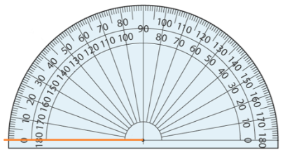
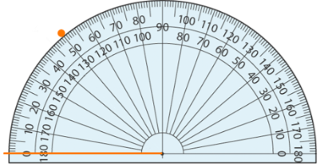
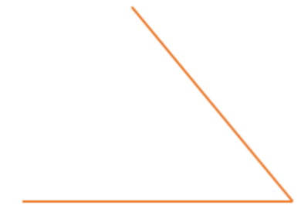
Year 9- Constructing in 2 and 3 Dimensions-and congruency
Draw and measure angles
Know the meaning of congruence
Know the meaning of perpendicular
Acute- An angle which is measuring less than 90°
Obtuse- an angle which is greater than 90° and less than 180°
Reflex- an angle that measures more than 180° but less than 360°
Right angle- an angle that measures exactly 90°
Line segment- a line bounded by two distinct points
Corresponding- a pair of matching sides that are in the same spot in two different shapes
Congruent- identical in form
Perpendicular- at an angle of 90° to a given line, plane, or surface
Types of angles
Year 7- Lines and angles
Year 8- Angles in parallel lines and polygons
Obtuse angle-An angle greater than 90º and less than 180º
Measuring angles
Right angle is 90º .Usually marked as a square
Acute angle
Less than 90º
You can measure an angle using a protractor.
Step 1: Line up the vertex (corner) of the angle with the cross section of the protractor.
Step 2: Make sure that one of the angle lines goes right through the zero.
Step 3: See which number the other line of the angle reaches on the protractor. Always read from the zero
Reflex Angle – An angle greater than 180º and less than 360º
Drawing angles
Draw an angle of 50°.
Step 1: Draw a straight line using a ruler.
Step 2: Place the centre (cross section) of the protractor at one end of the line. This will become the vertex (corner) of the angle. Make sure the line lines up with the base line of the protractor.
Step 3: Look for 50° on the protractor.
Step 4: Remove the protractor. Using a ruler, join the mark you made to the end of the line that was in the centre of the protractor.
Congruency
Two shapes are described as congruent if they are identical.
The lengths of sides (edges) and sizes of angles must be equal between the two shapes for them to be congruent.
Reflections or rotations change the orientation of a shape but they are still congruent to the original shape.

Slide 2
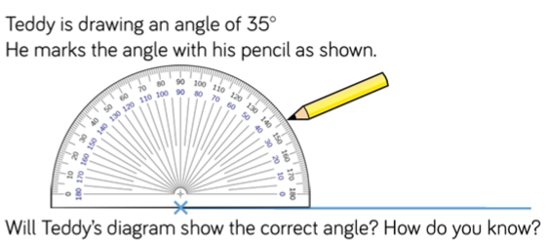
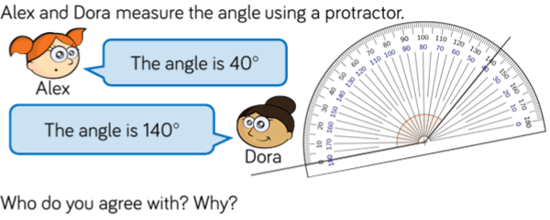
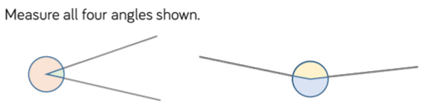
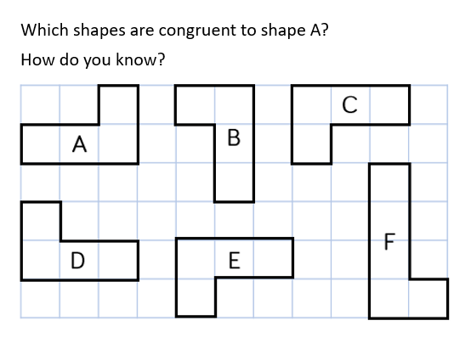
Year 9- Constructing in 2 and 3 dimensions and congruency
What is an acute angle?
What is an obtuse angle?
What is a reflex angle?
Define the word perpendicular and draw two perpendicular lines
Drawing angles
Measuring angles
Draw angles of size…
50°
10°
15°
85°
27°
160°
107°
Congruent shapes

