Slide 1

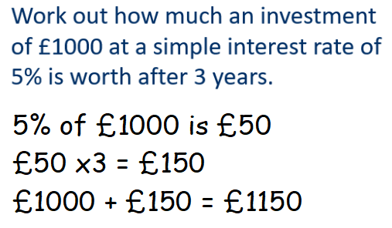
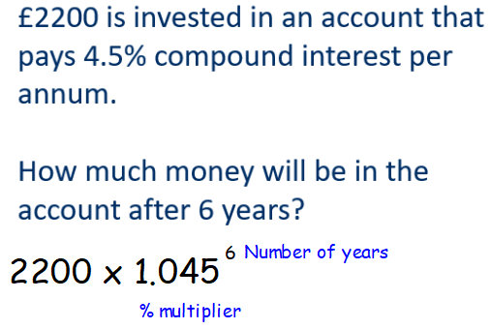
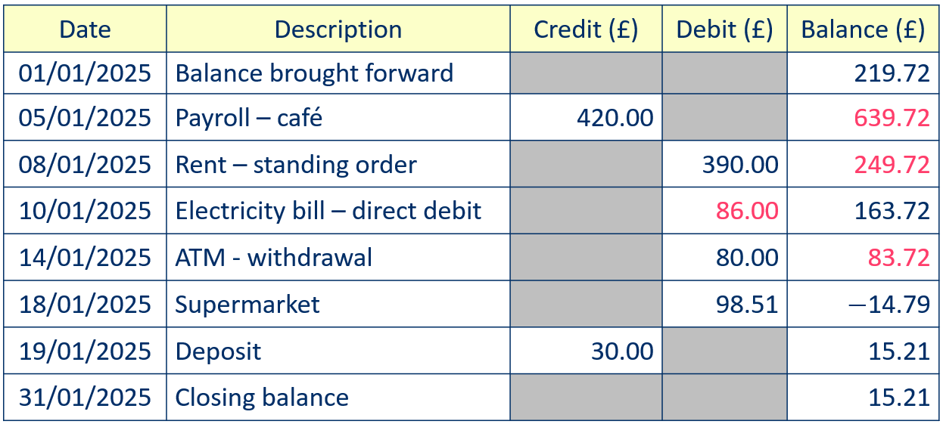
Year 9 - Maths & Money
Know % multipliers for %
increase & decrease
Difference between Simple
& Compound interest
Concept of Tax & VAT
Understand Debit/Credit &
Balance in account
statements
Balance - amount of money currently available in a bank account
Debit - amount of money leaving an account
Credit - amount of money going into an account
Direct debit - an automatic payment set up by the recipient
Balance - the amount in a bank account after a credit / debit
Simple interest - calculated just on the original amount
Compound interest – calculated on the accumulated amount
Account Number – 8 digits, Sort Code – 6 digits
Title – percentage multipliers
Finding a percentage
Conversion between units eg £ and p
Mental maths methods
To increase by 15%
100% + 15% = 115%
115% = 1.15 (percentage divided by 100)
Percentage multiplier for a 15% increase is x1.15
Title – Simple Interest
To decrease by 15%
100% - 15% = 85%
85% = 0.85 (percentage divided by 100)
Percentage multiplier for a 15% decrease is x0.85
Title – Compound Interest
-
Title – Bank account statements
+

Slide 2
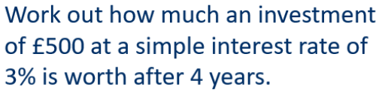
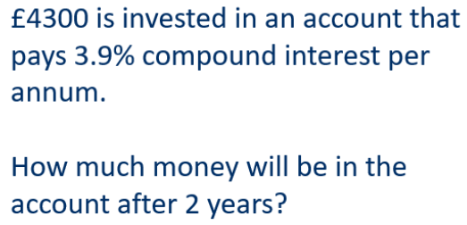
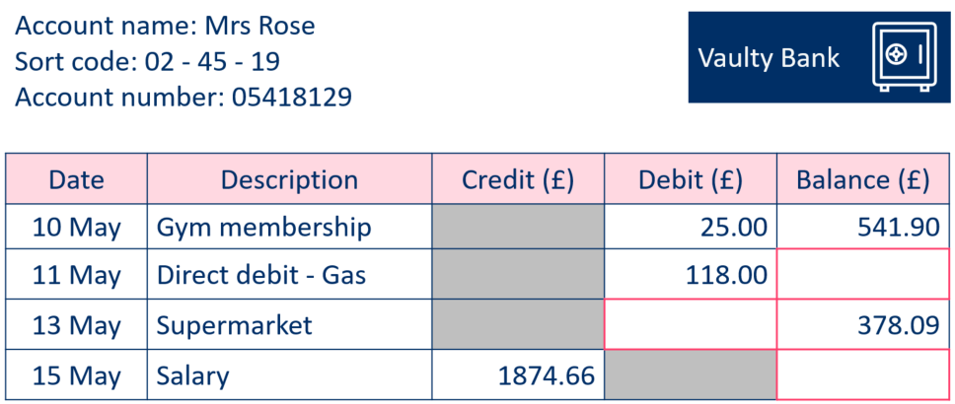
Year 9 – Maths & Money
Define the following:
Calculate the following % of £150:
50%
25%
10%
5%
1%
Debit
Credit
Direct debit
Balance
Simple Interest
Compound Interest
Account Number
Sort Code
Convert £ to p
£3.82
15.75
Title – Simple & Compound interest
Convert p to £
679p
24p
Title – percentage multipliers
What is the percentage multiplier for
16% increase
13% decrease
8% decrease
39% increase
2% increase
4.5% increase
4.5% decrease
Title – bank account statements Fill in the missing amounts

