Slide 1



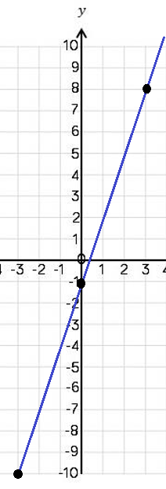
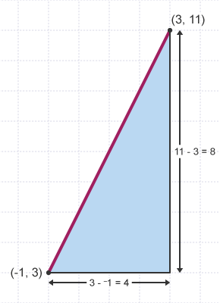



Year 9 – Straight Line Graphs
Plot straight line graphs
Using y=mx+c
Finding the equation of a line
Represent the solution to inequalities on a graph (higher only)
Finding the midpoint of a line segment
Parallel: lines that are the same distance apart and will never cross
Perpendicular: lines that meet at a right angle
Horizontal: left to right
Vertical: up and down
Gradient: how steep a line is
Y-intercept: where the line crosses the y axis
Midpoint: the middle point of a line
Equation of a Line
To find the equation of a straight line:
Find the gradient of the line (m)
2. Find the value of c (y-intercept).
Using the x and y values from any point, substitute into the equation and solve to find c
Coordinates and Graphs (Y8)
Straight Line Graphs (Y9)
y value
x value
y = mx + c
Plotting straight line graphs
y intercept
gradient
Draw a table to display the information
 | −3 | 0 | 3
 | -10 | -1 | 8
You only need two points to form a straight line, but plotting more helps you decide if your calculations are correct (if they make a straight line).
Finding the Midpoint of a Line
To find the midpoint of a line between two sets of coordinates, find the average of the x-axis coordinates and the average of the y-axis coordinates.
e.g. Find the midpoint of the line joining the point D (10,5) and E (4,11).
Average of x-coordinates
Average of y-coordinates
The midpoint is (7,8)

Slide 2
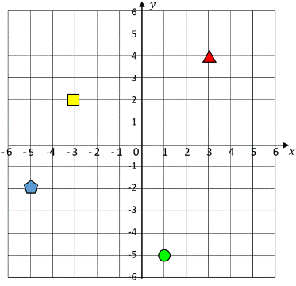

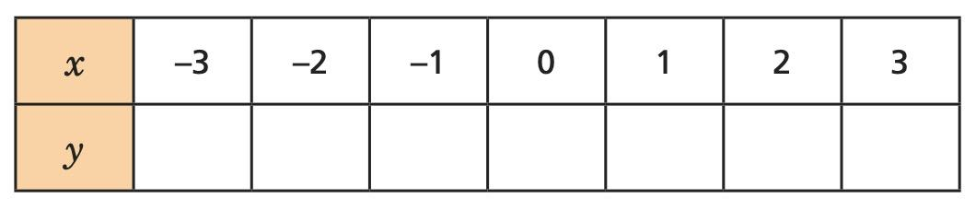

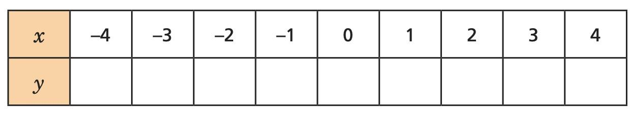
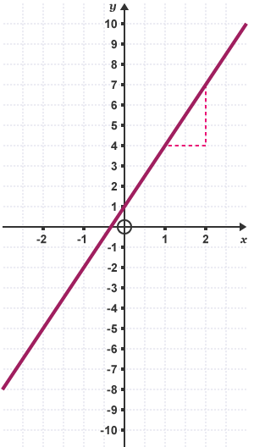
Year 9 – Straight Line Graphs
Define the following keywords:
What are the four co-ordinates denoted by the shapes on this set of axes?
Parallel:
Perpendicular:
Horizontal:
Vertical:
Gradient:
Y-intercept:
Midpoint:
Triangle:
Square:
Circle:
Pentagon:
Plotting straight line graphs
Finding the Midpoint of a Line
G is the point (5, –2) and H is the point (–9, 10). What are the coordinates of M, the midpoint of the line GH?
Finding the Equation of a Line
Find the equation of the line that goes through the points (3, 4) and (12, −2).
Find the equation of this line

