Slide 1



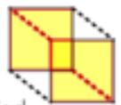

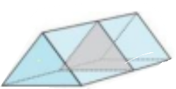

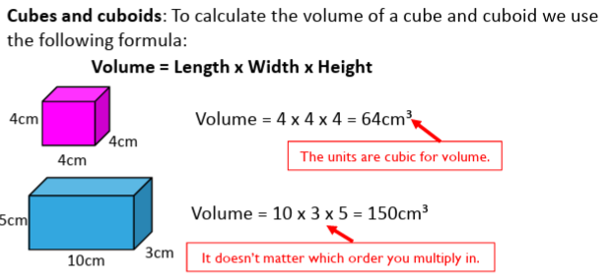
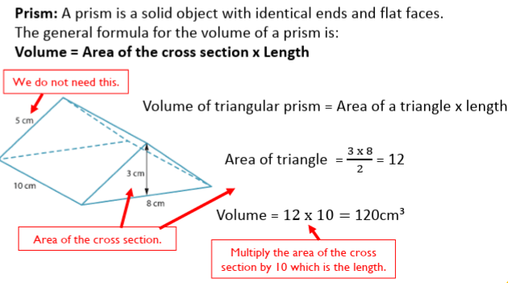
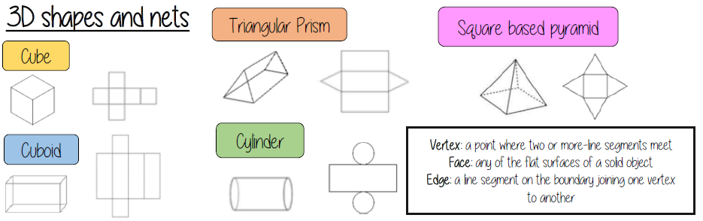
Year 9 – Geometry and Measure
Area and Volume
Know the nets of common 3-D shapes & how to state the correct units for area, surface area and volume. Know the formulae for finding the surface area of cubes and cuboids. Know how to identify a prism & the formula to find the volume of prisms and cylinders.
Area: the size of a surface (2D shapes)
Perimeter: the distance around a 2D shape
Volume: the amount of 3 dimensional space an object takes up (with liquid this is called capacity)
Perpendicular: two lines that meet at 90 90°Vertex: a point where two or more line segments meet
Face: any of the flat surfaces of a solid object
Edge: a line segment on the boundary joining one vertex to another
Commutative: you can swap the order around in the calculation and still achieve the same answer
Know the names and properties of common 2D and 3D shapes. Know the formulae for area rectangle, triangle, trapezium & circle. Know the Units for measuring area and volume.
Surface Area
sides
6 x 7
6 x 7
Recognise Prisms
front and
back
12 x 7
A solid object with two identical
ends and flat sides
The cross section will also
be identical to the end faces
12 x 7
top and
bottom
12 x 6
12 x 6
The surface area is the sum of the area of all the sides
Volume

Slide 2
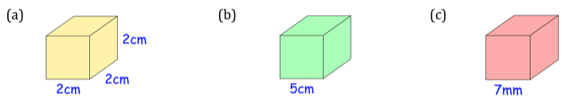
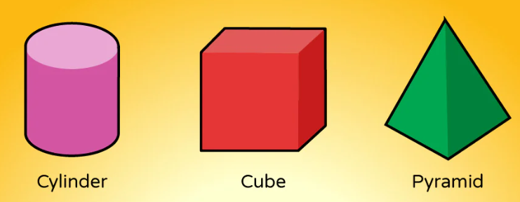
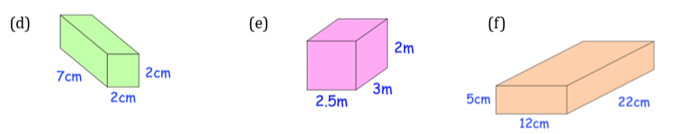
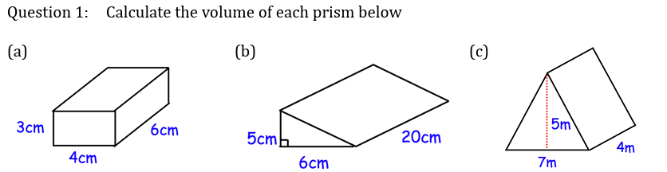
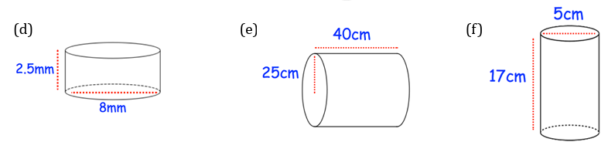
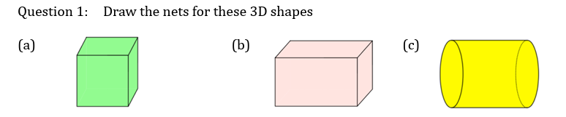
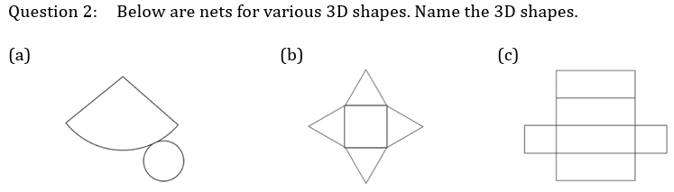
Year 9 – Geometry and Measure
Area and Volume
Know the nets of common 3-D shapes & how to state the correct units for area, surface area and volume. Know the formulae for finding the surface area of cubes and cuboids. Know how to identify a prism & the formula to find the volume of prisms and cylinders.
Give the definition of area
What is an edge?
What does perpendicular mean?
What does commutative mean? Can you give an example?
What is volume?
Know the names and properties of common 2D and 3D shapes. Know the formulae for area rectangle, triangle, trapezium & circle. Know the Units for measuring area and volume.
Surface Area
Calculate the surface area of the following cubes and cuboids:
Recognise Prisms
Tick all of the prisms below
Volume
Nets

