Slide 1

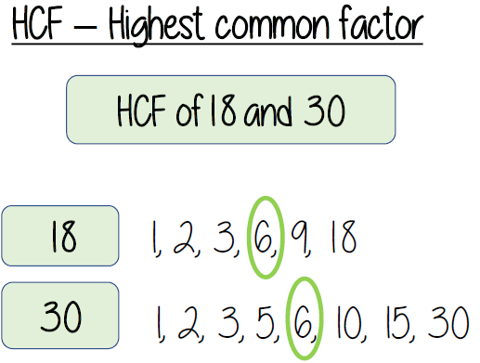
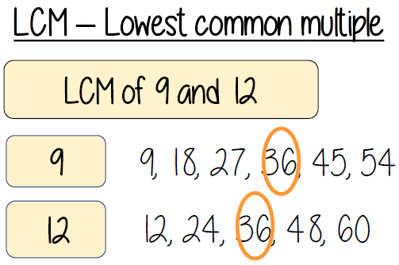
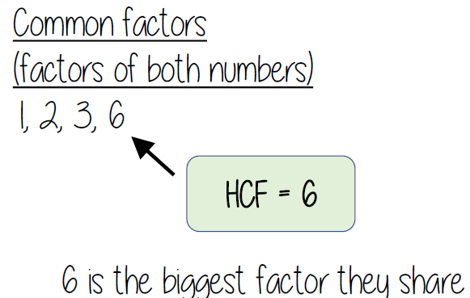
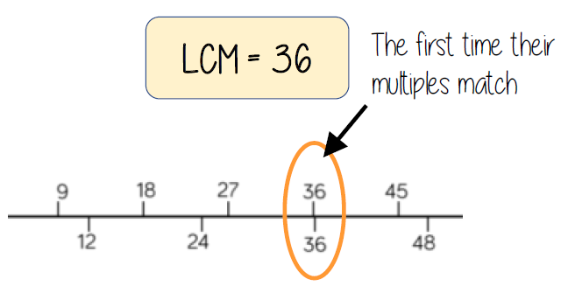

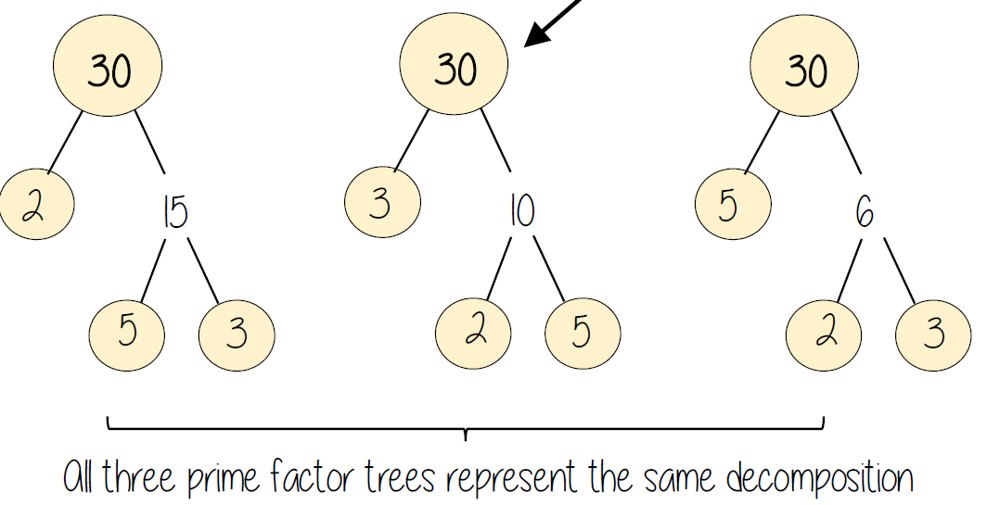
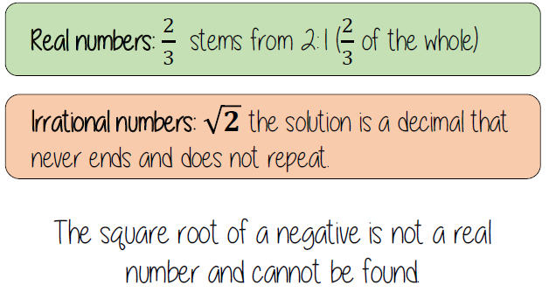
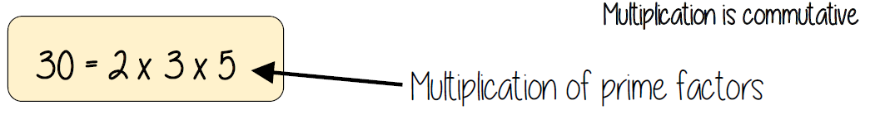
Year 9 – Number – Properties of Number
Know the meaning of lowest common multiple.
Know the meaning of the highest common factor.
Know that product means multiply.
Understand the term product of prime factors.
Multiples: found by multiplying any number by positive integers
Factor: integers that multiply together to get another number.
Prime: an integer with only 2 factors.
HCF: highest common factor (biggest factor two or more numbers share)
LCM: lowest common multiple (the first time the times table of two or more numbers match)
Integer: a whole number that is positive or negative
Rational: a number that can be made by dividing two integers
Irrational: a number that cannot be made by dividing two integers
Common factors and HCF
Know the definitions of and be able to identify factors, multiples and primes. Know that a prime number has only two factors, 1 and itself. Know 2 is the only even prime number.
Common factors are factors two or more numbers share
Common multiples and LCM
Common multiples are multiples two or more numbers share
Product of prime factors
Integers, real and rational numbers
Rational - root word: Ratio

Slide 2
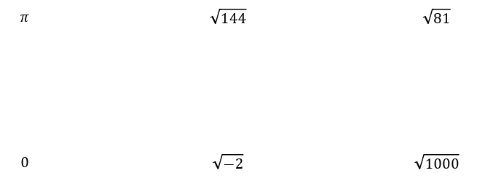
Year 9 – Number – Properties of Number
Write a number as a product of its prime factors.
Find common factors including HCF.
Find common multiples including LCM.
Know the definition of integer, real and rational numbers.
Give the definition of an integer
What is a multiple?
What are the first 5 prime numbers?
What is a rational number? Give an example of one.
What is an irrational number? Give an example of one.
Common factors and HCF
Know the definition of and be able to identify factors, multiples and primes.
1
(a) List all the factors of 14
(b) List all the factors of 21
(c) Find the highest common factor (HCF) of 14 and 21.
2
(a) List all the factors of 24
(b) List all the factors of 36
(c) Find the highest common factor (HCF) of 24 and 36.
3
Martin says that 6 is a common factor of 42, 36 and 50. Is he correct? Prove it!
Common multiples and LCM
1
(a) Write down the first ten multiples of 5. (b) Write down the first ten multiples of 8. (c) Find the lowest common multiple (LCM) of
5 and 8.
2
(a) Write down the first ten multiples of 6. (b) Write down the first ten multiples of 8. (c) Find the lowest common multiple (LCM) of 6 and 8.
3
A toad croaks every 8 seconds. A frog croaks every 6 seconds. They both croak at the same time. After how many seconds will they next both croak at the same time?
a) Write each value as a product of its prime factors
1) 24 2) 90 3) 120 4) 54 5) 23
b) Write each value as a product of its prime factors and try to spot a pattern
1) 64 2) 81 3) 36 4) 100 5) 144
c) Write each value as a product of its prime factors and try to spot a pattern
1) 27 2) 8 3) 125 4) 216 5) 512
Product of prime factors
Integers, real and rational numbers
State whether each of the numbers below are: integers, rational or irrational.

