Slide 1





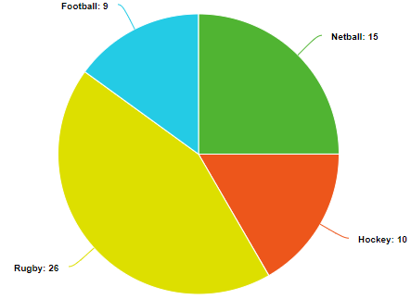
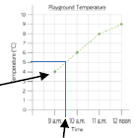
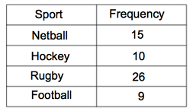

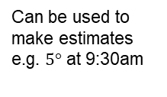



Year 8 – Graphs and charts
• Set up a statistical enquiry
• Design and criticise questionnaires
• Draw and interpret multiple bar charts and line graphs
• Represent and interpret grouped quantitative data
• Find and interpret the range
Hypothesis: an idea or question you want to test
Sampling: the group of things you want to use to check your hypothesis
Primary Data: data you collect yourself
Secondary Data: data you source from elsewhere e.g. the internet/ newspapers/ local statistics
Discrete Data: numerical data that can only take set values
Continuous Data: numerical data that has an infinite number of values (often seen with height, distance, time)
Average: a measure of central tendency – one value that represents all.
Statistical Enquiry
Bar Charts and Line Graphs (Y7)
Types of Data (Y8 Autumn Term)
Write a suitable hypothesis
Design a Data Collection Sheet
Pros/Cons of Sampling
Pros/Cons of Primary/ Secondary Data
Types of Data
Grouped or Ungrouped Categories
Primary Data is collected by you e.g. a questionnaire or survey that you get people to fill in. This makes it more reliable but is also time-consuming.
Secondary Data is sourced from somewhere else e.g. a library, newspaper or the internet. This is easy to gather, but might not be as trustworthy.
Discrete Data can only hold certain values, such as shoe size (can only be full or half sizes).
Continuous Data is measured and can hold any value e.g. a distance or time.
Total in that group
Pictograms, Bar and Line Charts
Pictogram –
. Remember to include a key
. Visually identify mode
Bar Chart –
. Title
. Gap between bars
. Label and scale axes
. Discrete Data
Line Chart –
. Gap between bars
. Label and scale axes
. Discrete Data
Pie Charts
Line Graphs
Record information then join with straight lines.
Usually shows change over a time, relating one piece of data compared to another.
A circle has 360$°$.
26 out of 60 people preferred rugby.
$\frac{26}{60}$ x 360 = 192$°$
$$\frac{26}{60}=\frac{}{360}$$
or
x 6
Can be used to make estimates e.g. $5°$ at 9:30am
Measure $192°$ with a protractor

Slide 2
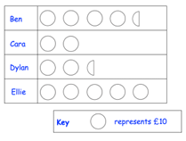
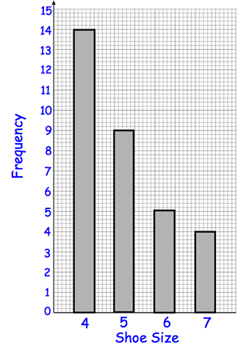
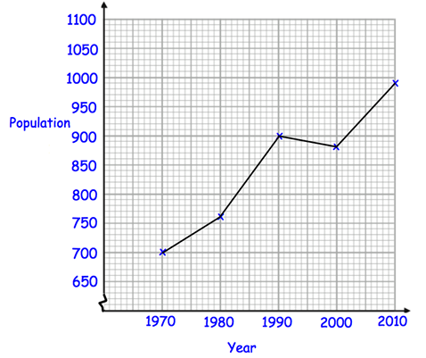
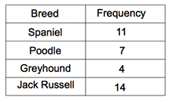
Year 8 – Graphs and charts
Express the following statements as a ratio:
“For every 6 dogs, there are 8 cats”
“For every teacher, there are 5 pupils”
Express the following diagram as a ratio of red counters to green to blue:
Define the following key words:
Discrete Data -
Primary Data -
Average -
Pictograms and Bar Charts
Answer the following questions:
How much did Dylan
Raise for charity?
(b) How much more did
Ben raise than Cara?
(c) How much money was
raised in total?
Types of Data
Label the following categories of data as discrete or continuous:
. Height of a Tree
. Age (in years)
. Shoe Size
. Amount of Pets
. Time it takes to run a race
Answer the following questions:
What was the modal
shoe size?
(b) How many people
wear a size 6 or a size 7?
Pie Charts
Line Graphs
Calculate the value of the angle each dog would represent on a pie chart.
Answer the following questions:
What was the population in 1980?
How much greater was the population in 2010 than in 1970?
What was the population drop between 1990 and 2000?

