Slide 1

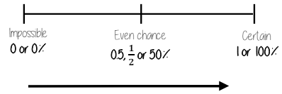

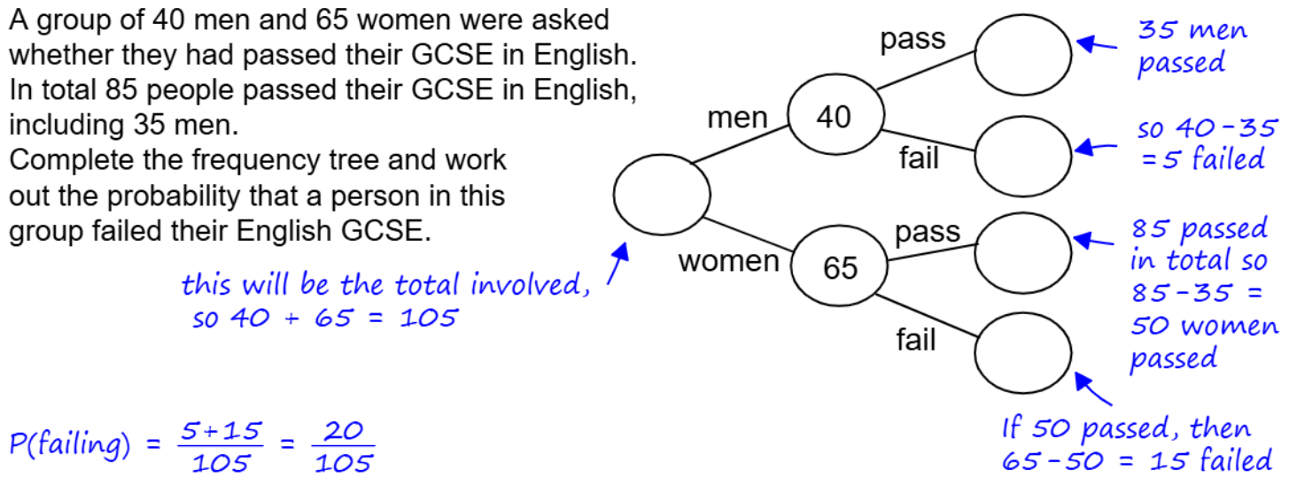
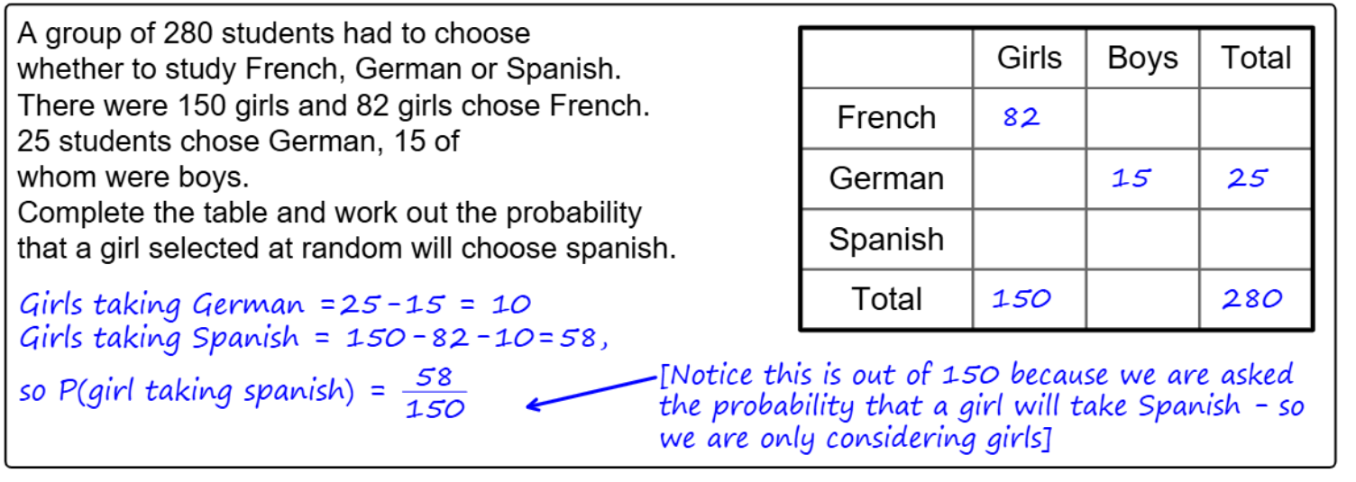
Year 8- Probability
Know the meaning of certain, impossible, likely, unlikely and even. Know that probability lie between 0 and 1. Know that probability can be expressed as a fraction, decimal or percentage. Know and define intersection and union.
Mutually Exclusive: events that do not occur at the same time Probability: likelihood of an event happening
Bias: a built-in error that makes all values wrong .
Random: something happens by chance and is unable to be predicted
Probability of a single event
Know how to convert between Fraction, decimal and percentage. Know the meaning of frequency.
Probability = number of times event happens
total number of possible outcomes
Probability can be a fraction, decimal or percentage value.
Probability is always a value between 0 and 1.
The probability scale
P(Blue) = 4
10
There are four blue sectors and 10 sectors altogether
The more likely an event the further up the probability it will be in comparison to another event
Frequency trees
Two way tables

Slide 2
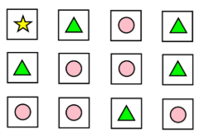
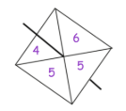

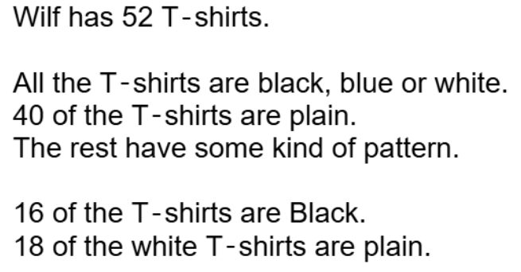
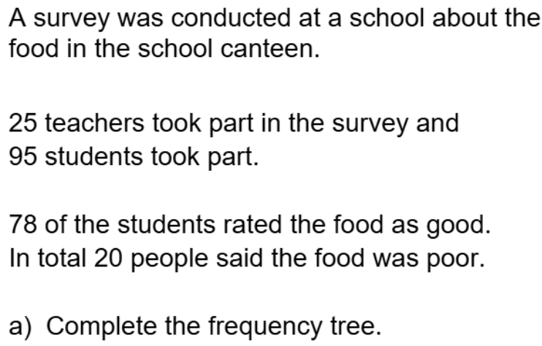
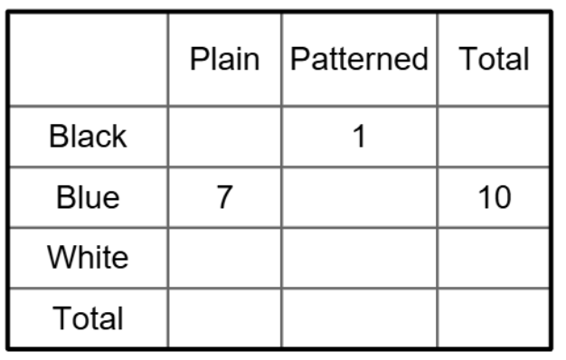
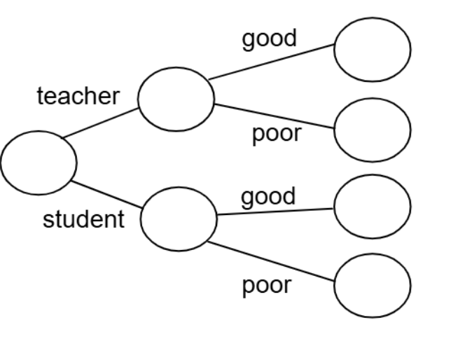
Year 8- Probability
Write a event that fit the words below:
Certain
Impossible
Likely
Unlikely
Write a definition for the following words.
Mutually Exclusive:
Probability:
Bias:
Random:
Probability of a single event
Convert the following :
¼ to decimal:
0.75 to fraction:
60% as a fraction:
The probability scale
Leah has 12 cards, each with a shape on it. She takes a card at random.
What is the probability that Leah takes a card with a star on it?
What is the probability that Leah takes a card with a triangle on it?
What is the probability that Leah takes a card with a circle on it?
1) Mark with an A the probability of getting a 4.
2) Mark with a B the probability of getting a 5 OR 6.
Two way tables
Frequency trees
Complete the table

