Slide 1

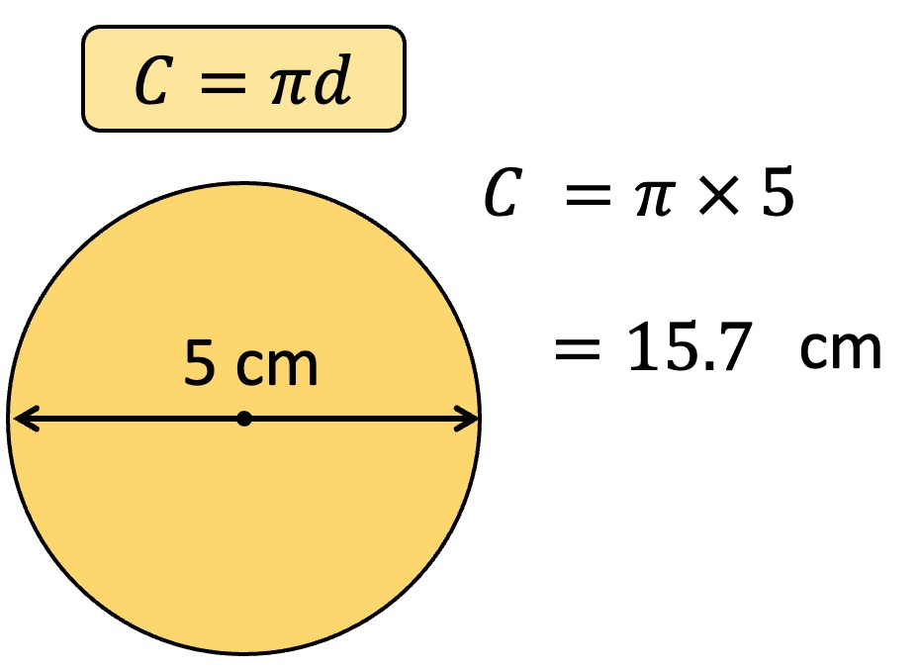
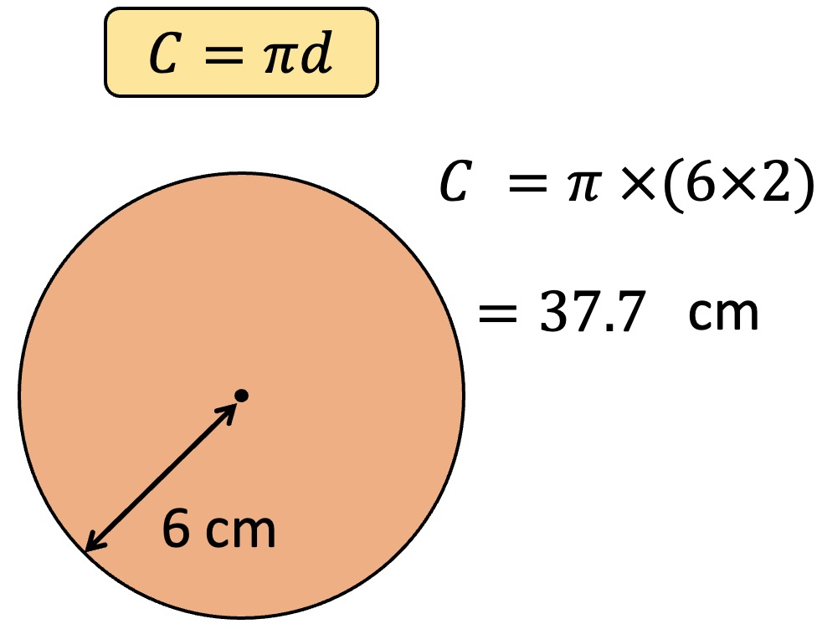
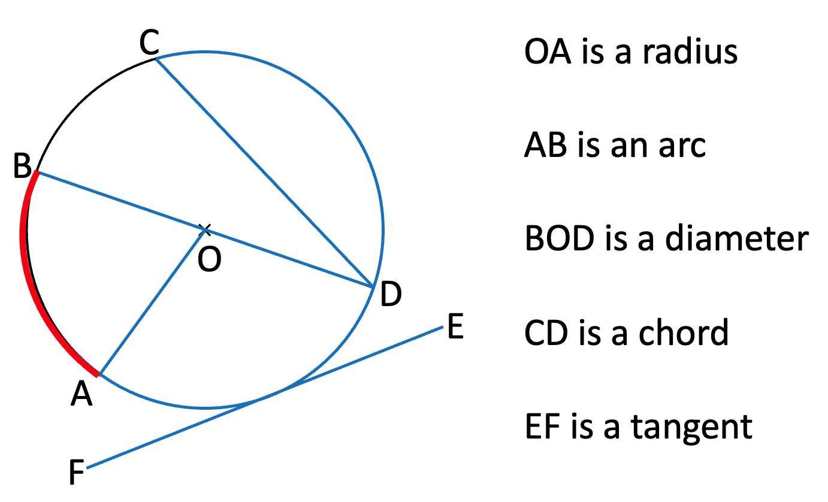
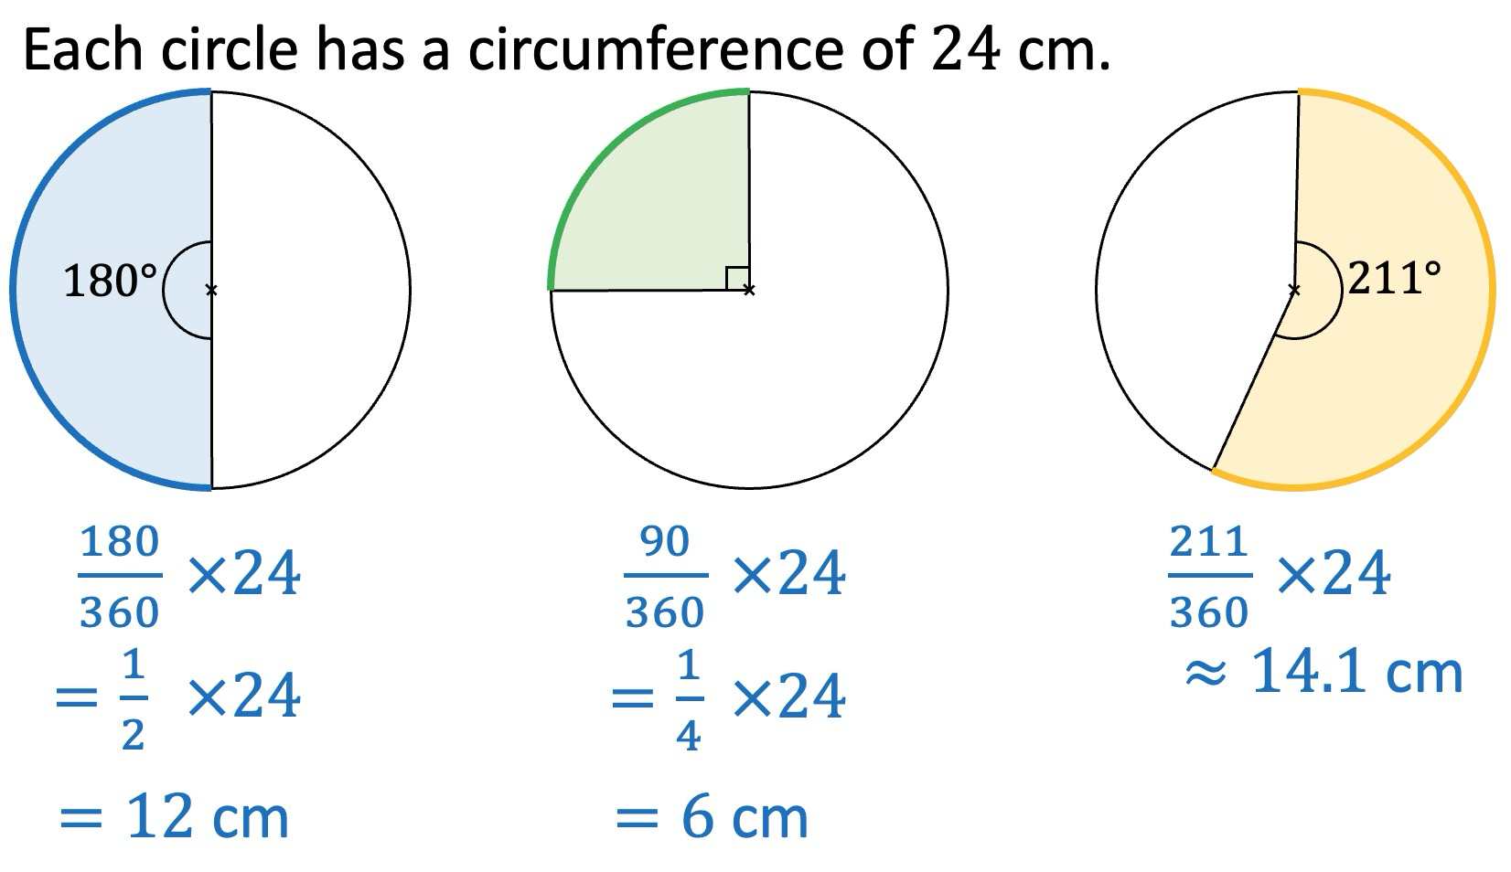
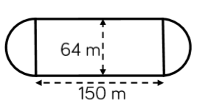
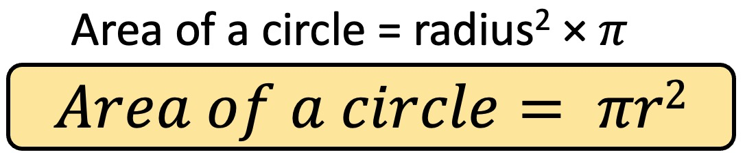
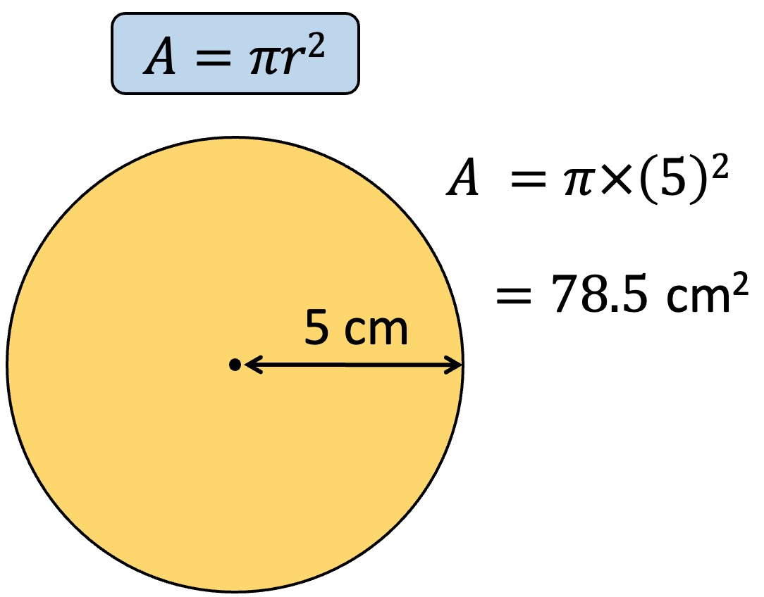
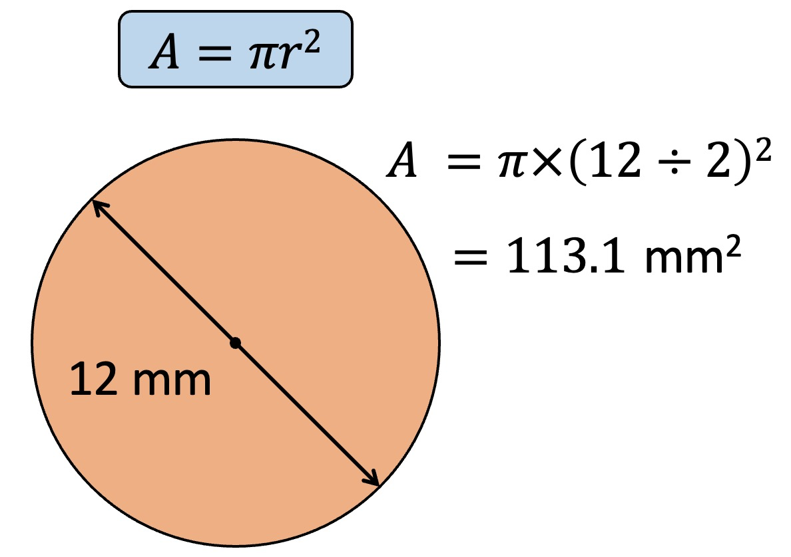


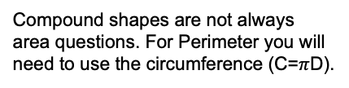

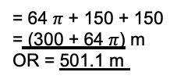
Year 8 - Circles
Identify the parts of a circle
Calculate the circumference of a circle
Calculate length of an arc
Calculate the area of a circle
Calculate the area of compound shapes
Radius: a straight line from the centre of a circle to the circumference.
Diameter: a straight line connecting two points on the circumference of a circle passing through the centre.
Circumference: the perimeter of a circle.
Chord: a straight line which joins two points on the circumference.
Arc: a part of the circumference of a circle.
Sector: a part of a circle enclosed by an arc.
Segment: a part of a circle enclosed by an arc and a chord.
Circumference of a circle
Year 7- Perimeter and area
Circumference = $π$ × Diameter
$π$ (Pi) is the relationship between
a circle’s diameter and its circumference.
Parts of a circle
Length of an arc
Compound shapes
Compound shapes are not always area questions. For Perimeter you will need to use the circumference (C=$π$D).
This dimension is also the diameter of the semi circles.
Area of a circle
Arc lengths = $π$ x 64
= 64 $π$
Arc lengths + Straight lengths = total perimeter
= 64 $π$ + 150 + 150
= (300 + 64 $π$) m
OR = 501.1 m
Remember to split up the compound shape into smaller more manageable individual shapes first.

Slide 2
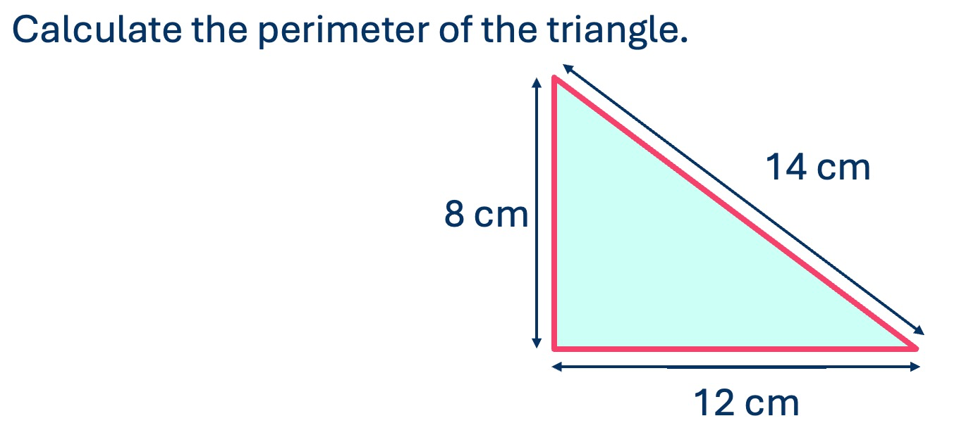
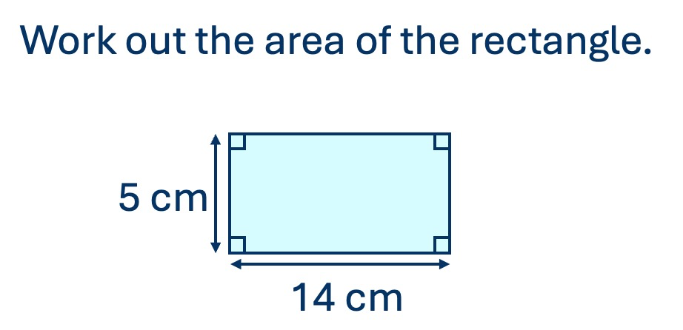
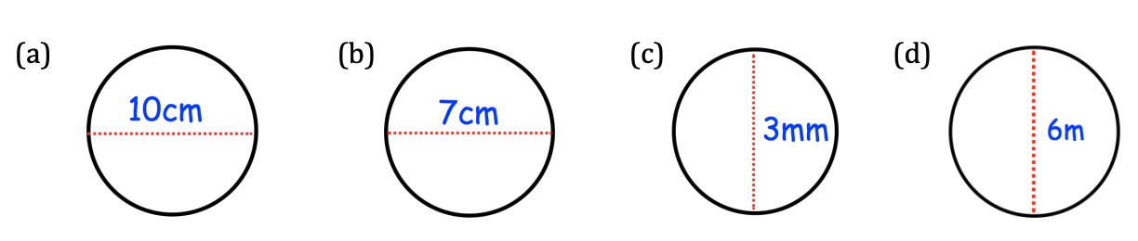
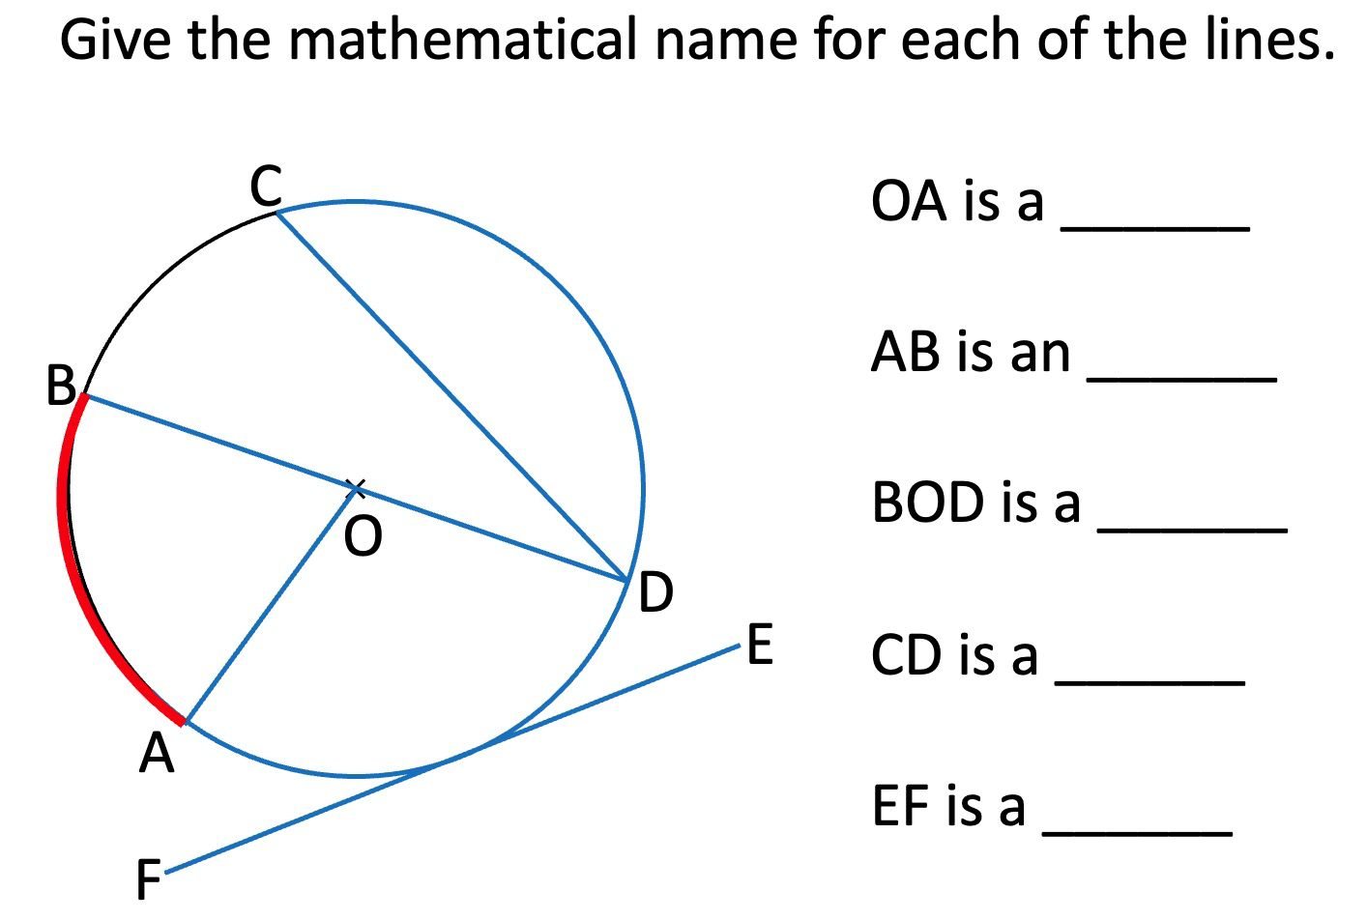
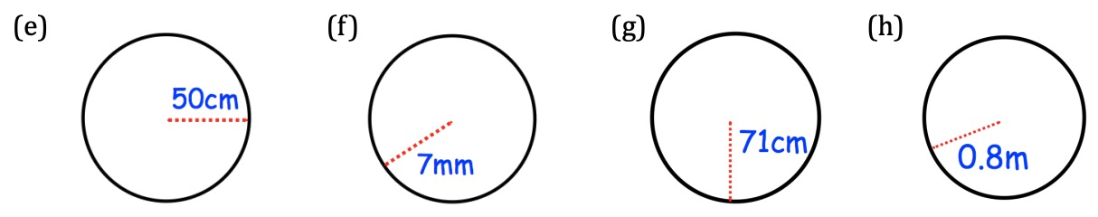
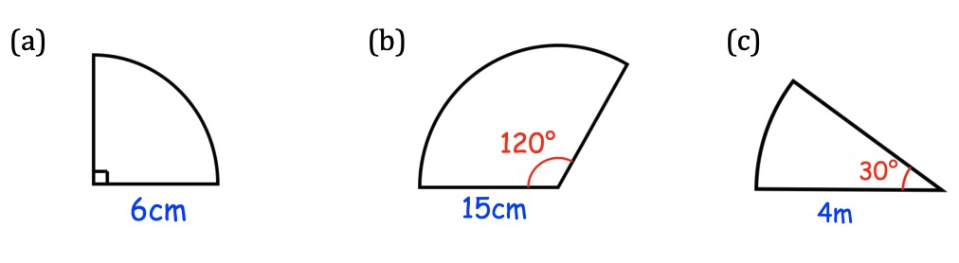
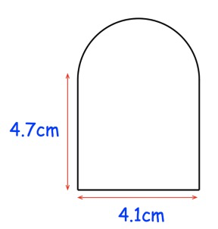
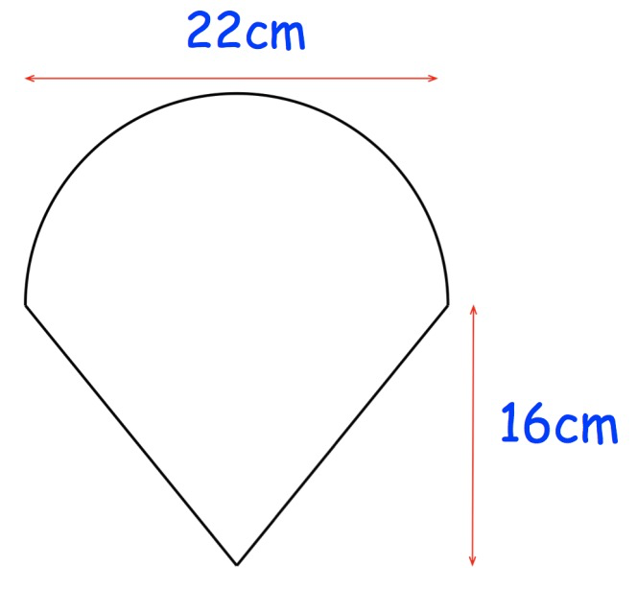
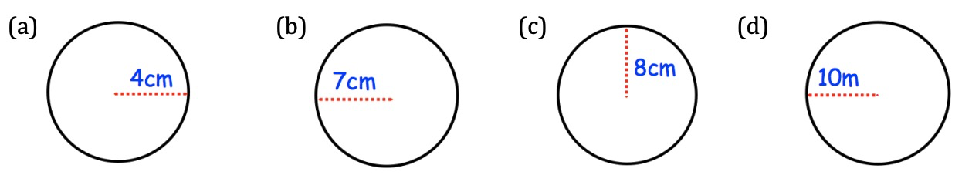
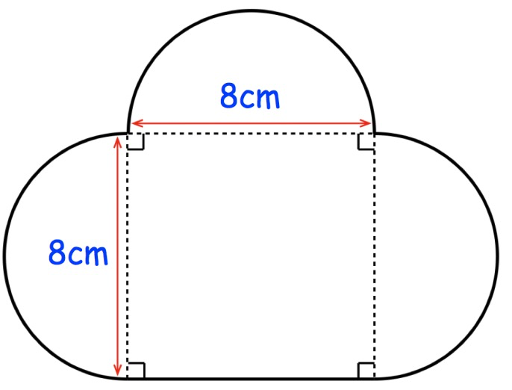
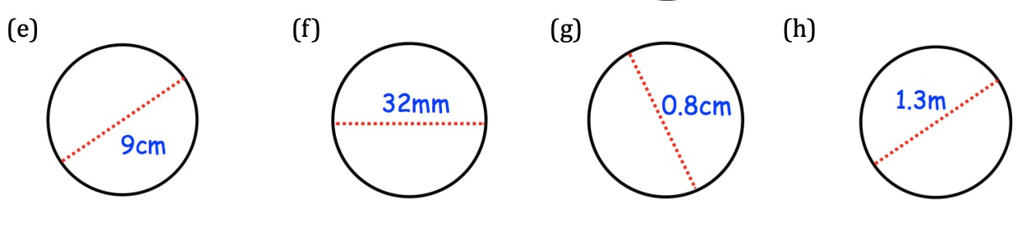
Year 8 - Circles
Radius:.
Diameter:
Circumference:
Chord:
Arc:
Sector:
Segment:
Circumference of a circle
Calculate the circumference of the circles:
Parts of a circle
Length of an arc
For each sector, calculate the length of the arc:
Compound shapes
Calculate the area and perimeter of the compound shapes:
Area of a circle
Calculate the area of the circles:

