Slide 1

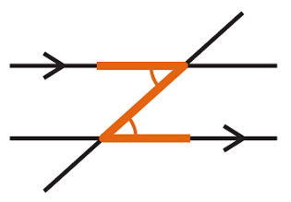
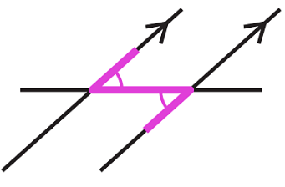
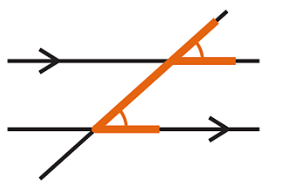
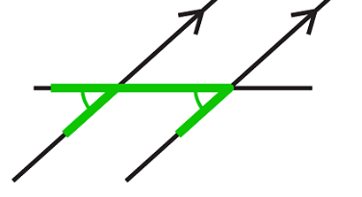
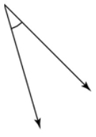
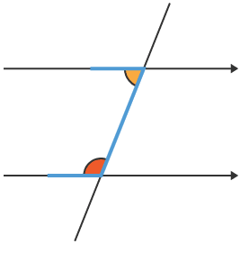
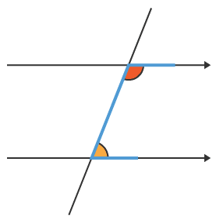
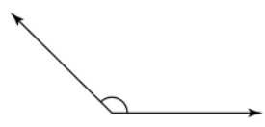

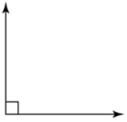
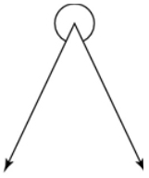

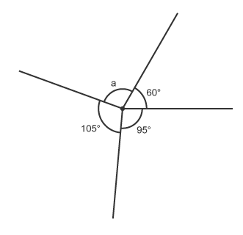
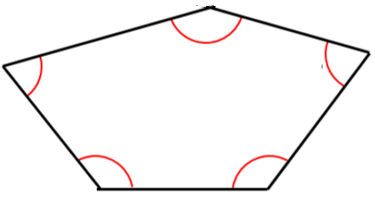
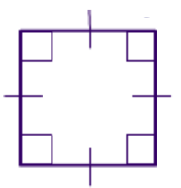
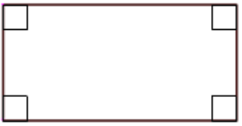
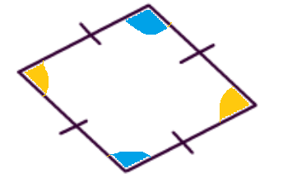
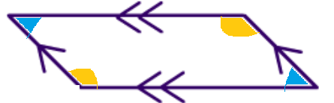
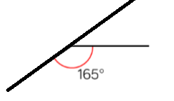
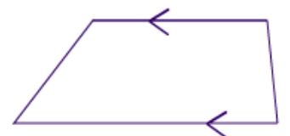
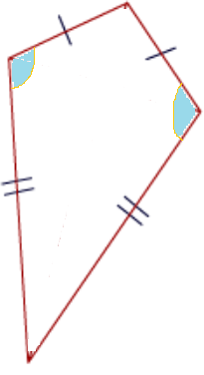












Year 8 - Angles in Parallel Lines and Polygons
Identify alternate angles
Identify corresponding angles
Identify co-interior angles
Find the sum of interior angles in polygons
Find the sum of exterior angles in polygons
Parallel: Straight lines that never meet
Angle: Formed by two straight lines meeting (measured in degrees)
Transversal: A line that cuts across two or more parallel lines
Isosceles: Two equal size lines and angles (in a triangle or trapezium)
Polygon: A 2D shape made with straight lines
Sum: Addition (total of all the interior angles added together)
Regular polygon: Sides have equal length; Interior angles have equal size.
Angles in parallel lines
Alternate angles
are equal
Corresponding
angles are equal
Co-interior angles
sum to 180°
Year 7- Angles and polygons
Basic angle rules and notation
Acute Angles
0$°$< angle <90$°$
Straight Line
180$°$
Obtuse
90$°$< angle <180$°$
Right Angles
90$°$
Reflex
180$°$< angle <360$°$
Vertically opposite angles are equal
Sum of interior angles
Angles around a point sum to 360$°$
(number of sides – 2) x 180
Sum of the interior angles = (5 – 2) x 180
Properties of quadrilaterals
This shape can be made from three triangles. Each triangle has 180$°$
Square
All sides equal. All angles 90$°$
Opposite sides are parallel
Sum of the interior angles = 3 x 180
= 540$°$
Rectangle All angles 90$°.$
Opposite sides are parallel
Sum of exterior angles
Rhombus All sides equal.
Opposite angles are equal
Exterior angles sum to 360$°$
Parallelogram
Opposite sides are parallel
Opposite angles are equal
Co-interior angles = 180°
Exterior Angle
Trapezium
One pair of parallel lines
Interior Angle
Kite
No parallel lines
Equal lengths on top sides
Equal lengths on bottom sides
One pair of equal angles
Interior angle + Exterior angle = 180$°$
Exterior angle = 180 – 165 = 15$°$
Number of sides = 360$° ÷$ exterior angle
Number of sides = 360 $÷$ 15 = 24 sides

Slide 2
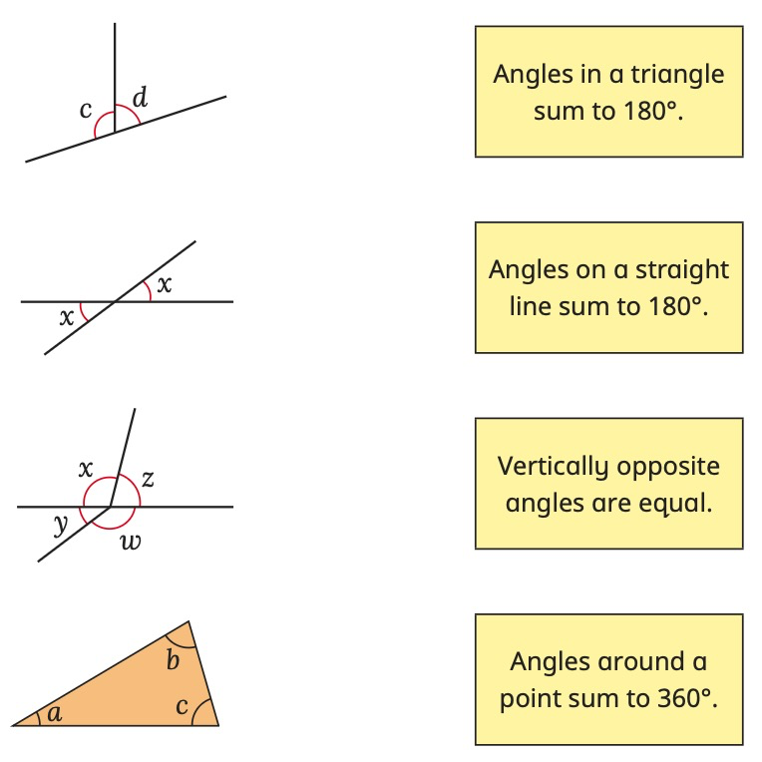
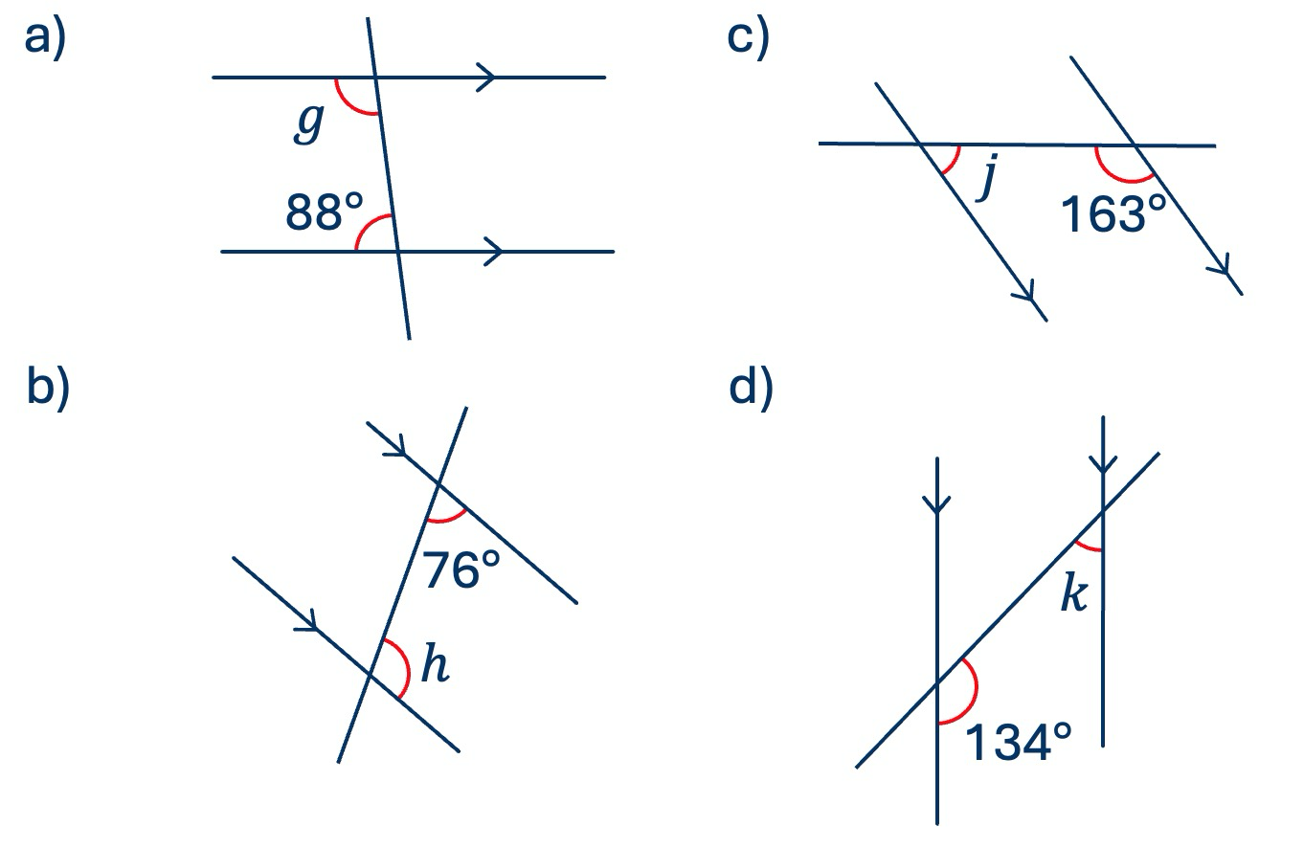
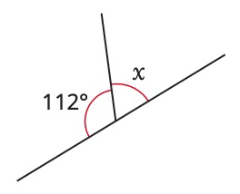
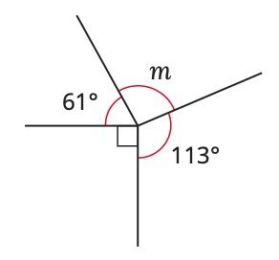
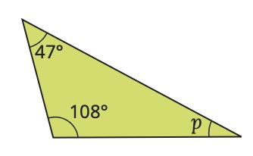
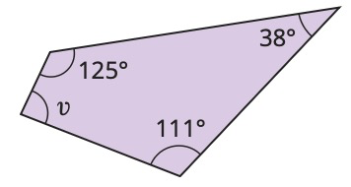
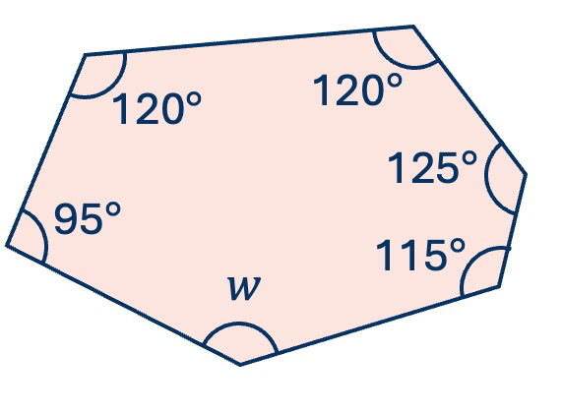
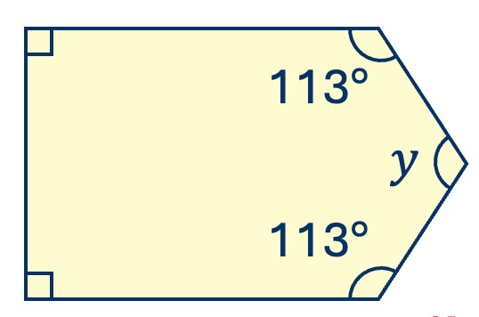
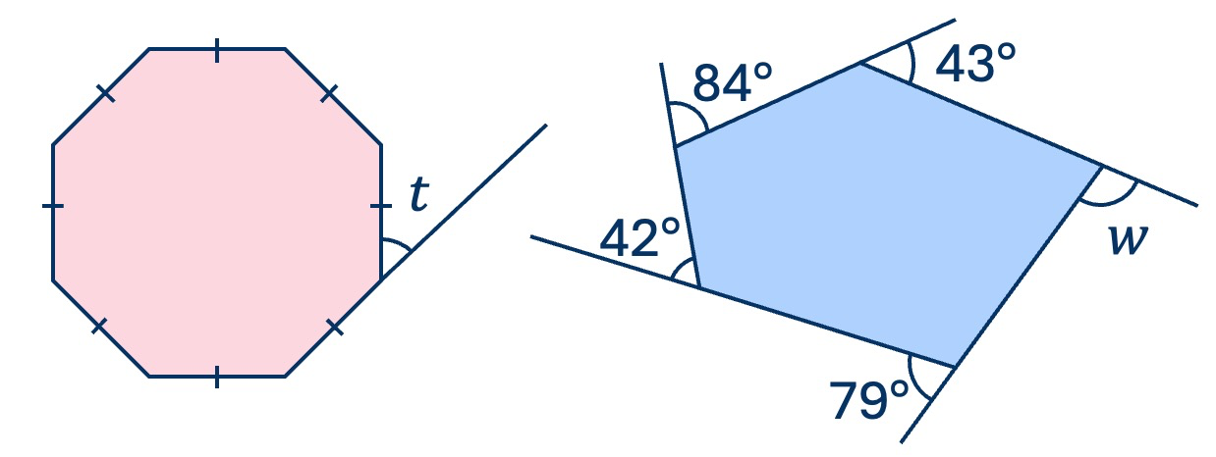
Year 8 - Angles in Parallel Lines and Polygons
Match the diagrams to the angle rules
Parallel:
Angle:
Transversal:
Isosceles:
Polygon:
Sum:
Regular polygon:
Angles in parallel lines
Work out the angles marked with letters.
Basic angle rules and notation
Work out the angles marked with letters.
Sum of interior angles
Work out the angles marked with letters.
Properties of quadrilaterals
Identify the properties of the following quadrilaterals …
Square:
Rectangle:
Rhombus:
Parallelogram:
Trapezium:
Kite:
Sum of exterior angles
Work out the angles marked with letters.

