Slide 1

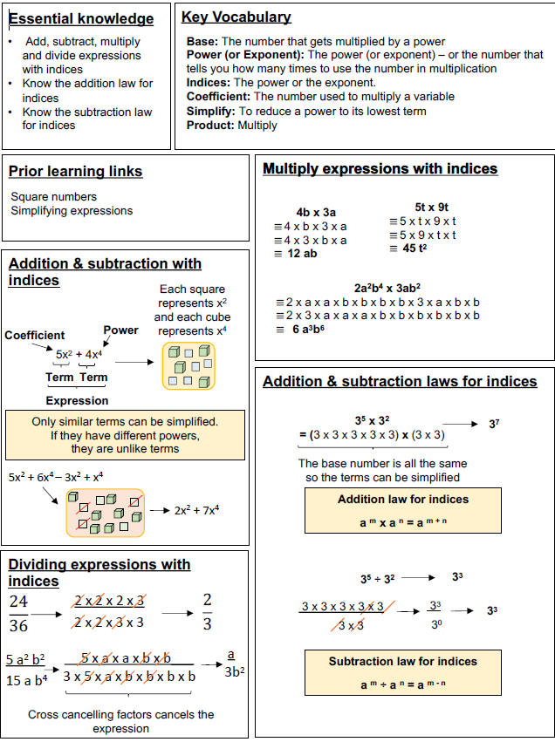
Year 8 – Indices
Add
D – N
Title
N
Title
Title
Title
Title
Title

Slide 2
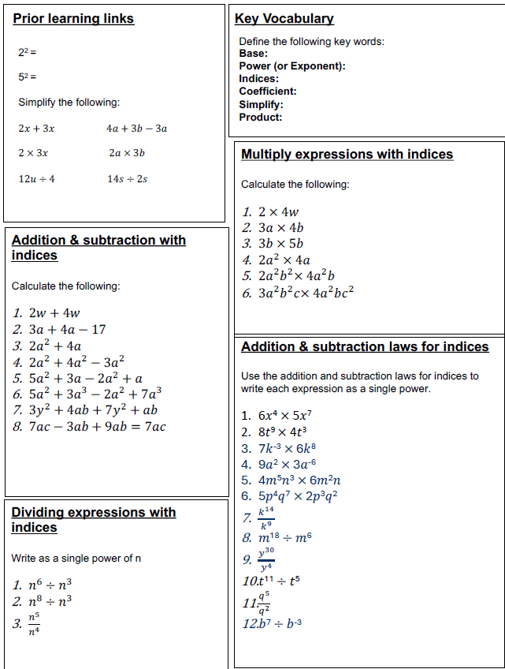
Year 8 – Indices
Put
1.)
2.)
3.)
Define the key vocabulary
Directed number –
NN –
NN –
NN –
Title
Calculate the following:
Title
Calculate the following:
Title
Calculate the following:
Title
Calculate the following:

