Slide 1

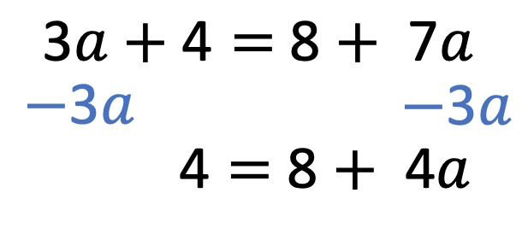
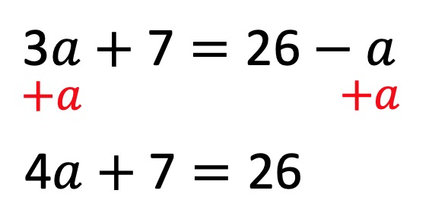
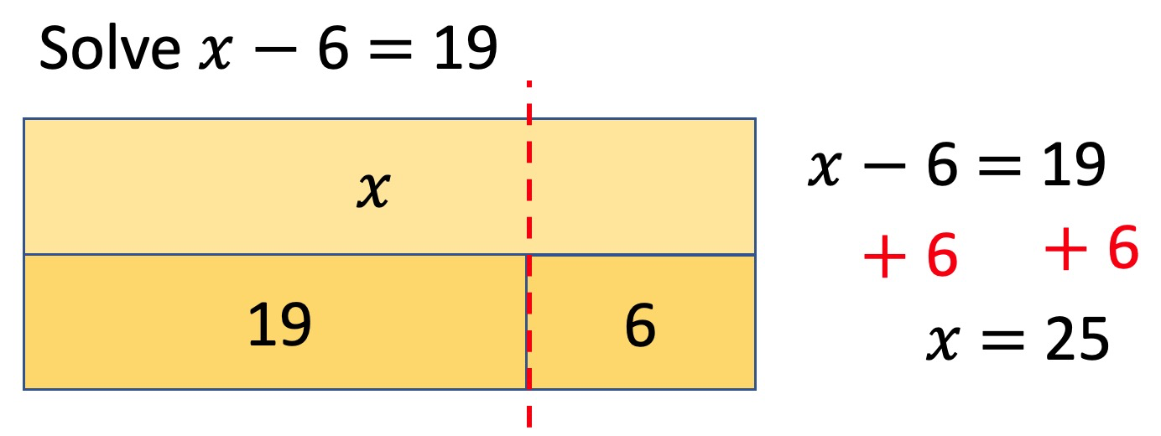
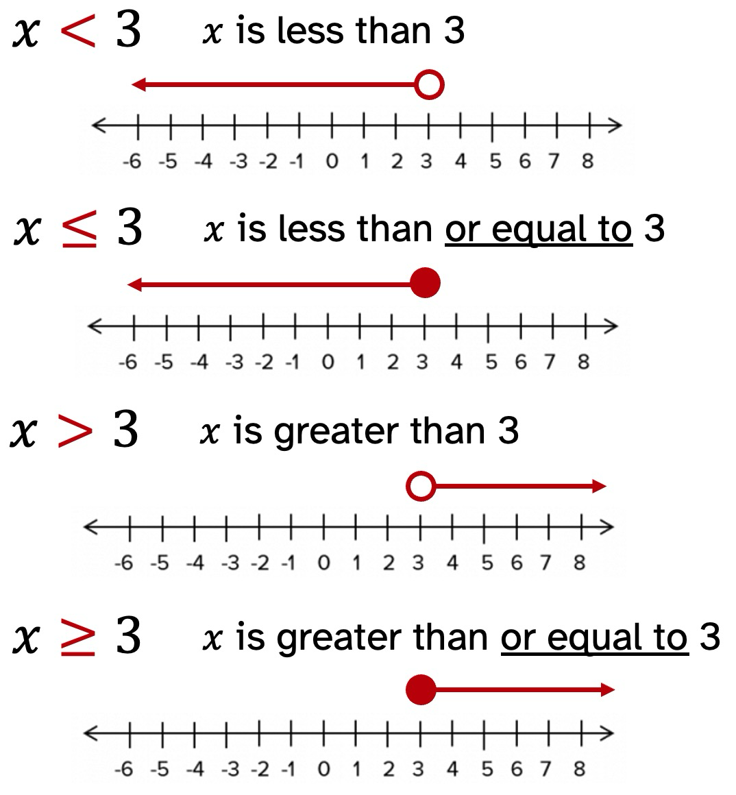
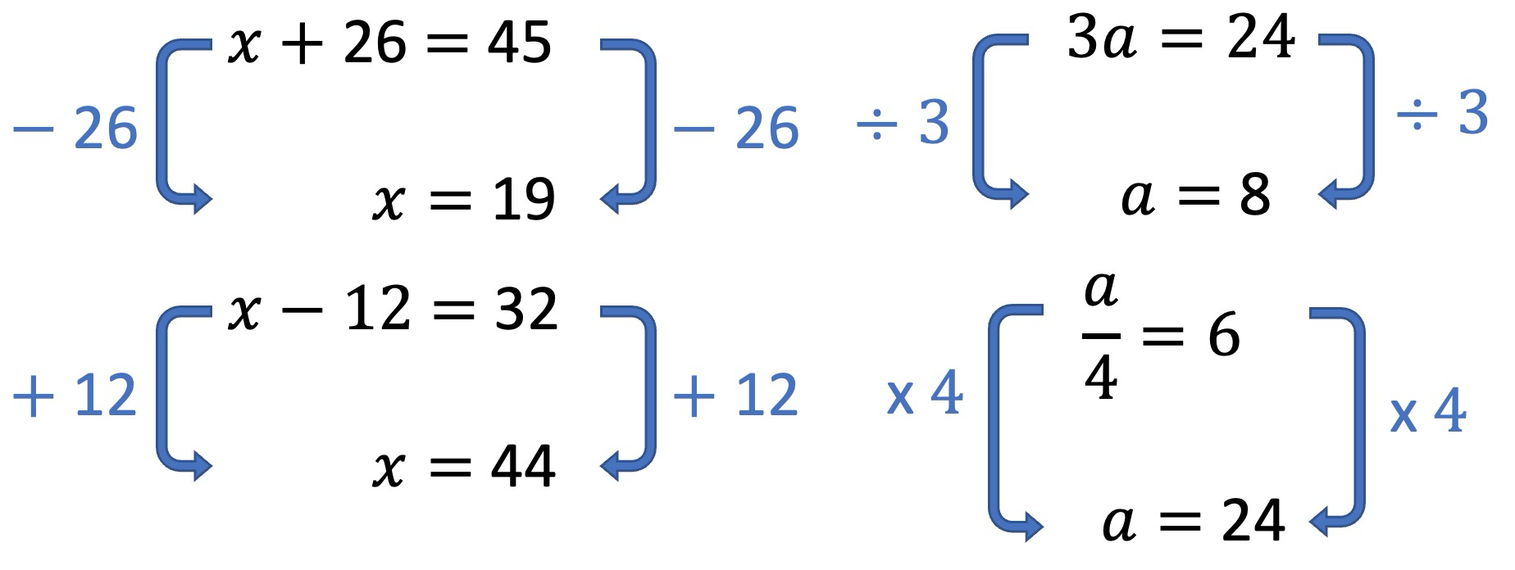
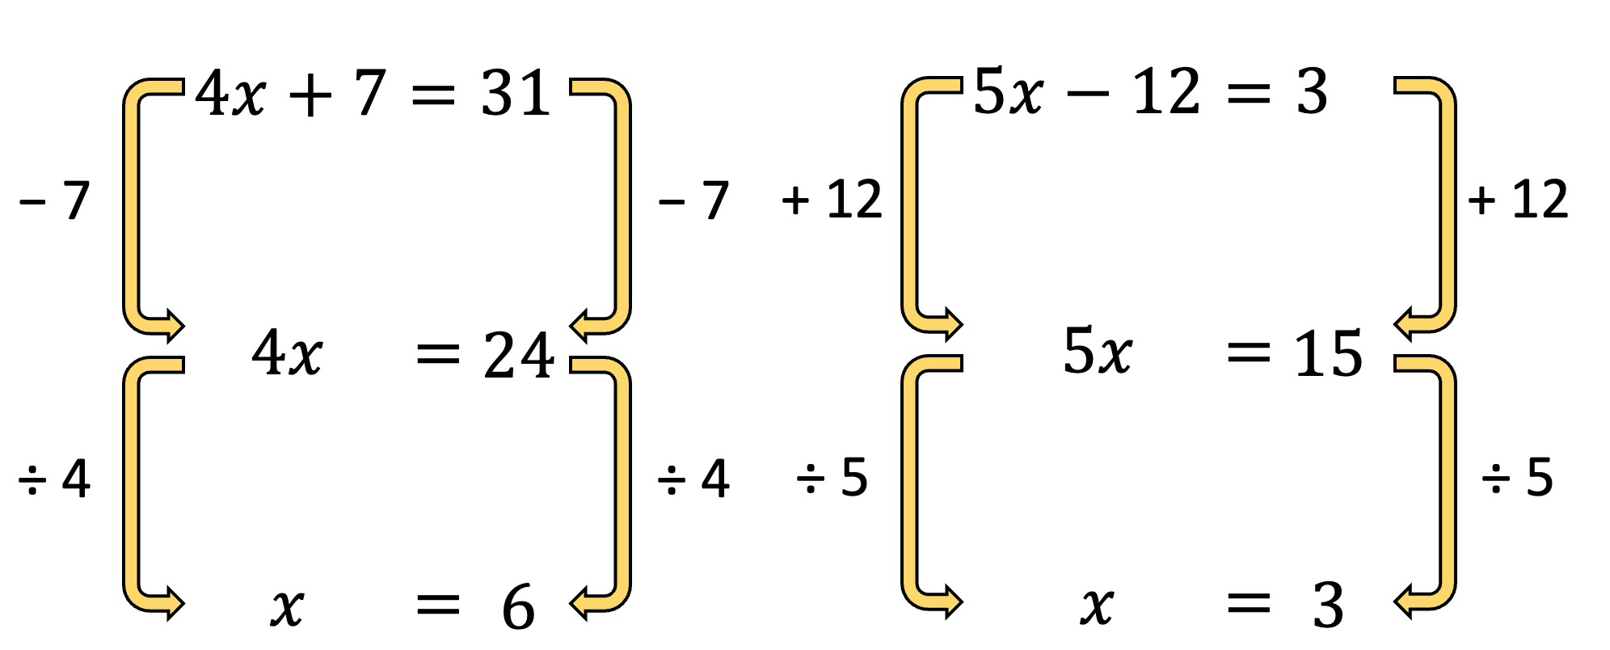
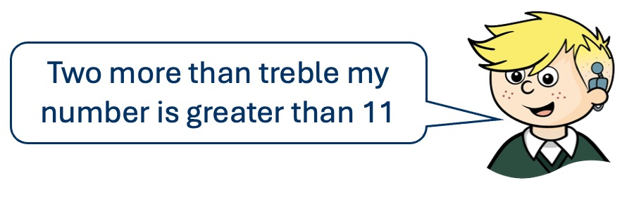
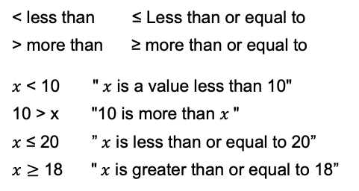
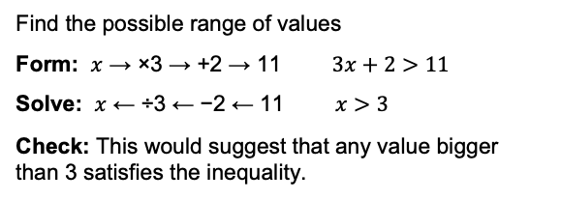
Year 8 – Equations & Inequalities
Form expressions
Form and solve equations
Solve fractional equations
Form and solve inequalities
Understand and use inequalities
Inequalities on a number line
Inequality: An inequality compares values, showing if one is greater than, less than, or equal to another.
Coefficient: A number used to multiply a variable.
Variable: A symbol or letter than represents an unknown or changing value.
Equation: An equation in a mathematical statement that uses an equals sign (=) to show that two expressions are equal in value.
Equations with unknowns on both sides
Function machines
Bar modelling
Inverse operations
To solve equations with unknowns on both sides,
first move all the variable terms to one side by adding or subtracting the variable with the smallest coefficient.
Solve one & two step equations
Inequalities on a number line
Form and solve inequalities
Simple Inequalities
< less than ≤ Less than or equal to
> more than ≥ more than or equal to
$x$ < 10 " $x$ is a value less than 10"
10 > x "10 is more than $x$"
$x$ ≤ 20 ” $x$ is less than or equal to 20”
$x≥$ 18 " $x$ is greater than or equal to 18”
Find the possible range of values
Form: $x$ → ×3 → +2 → 11 $3x+2>11$
Solve: $x$ ← ÷3 ← −2 ← 11 $x>3$
Check: This would suggest that any value bigger than 3 satisfies the inequality.

Slide 2






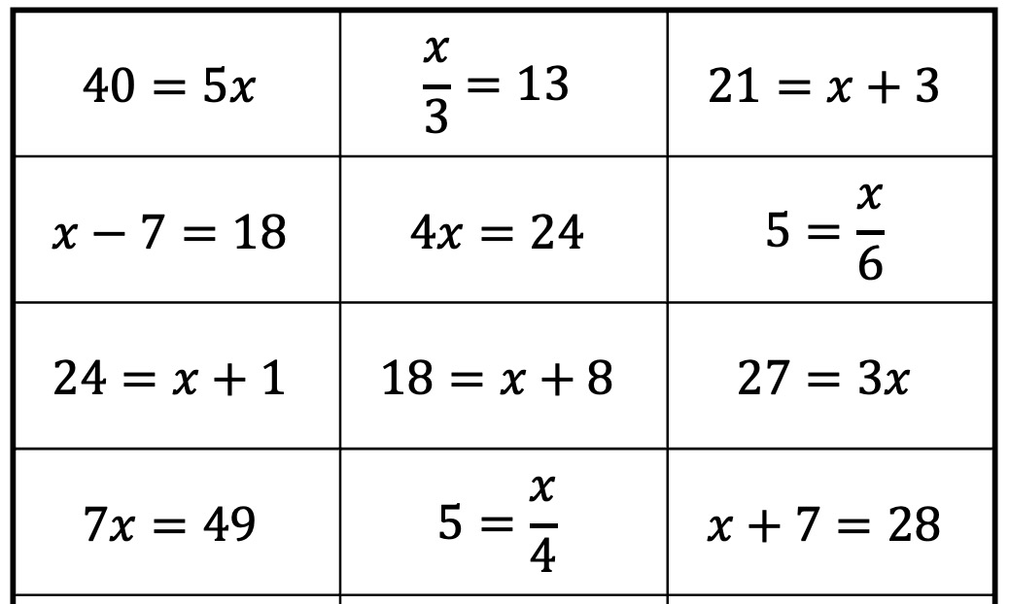
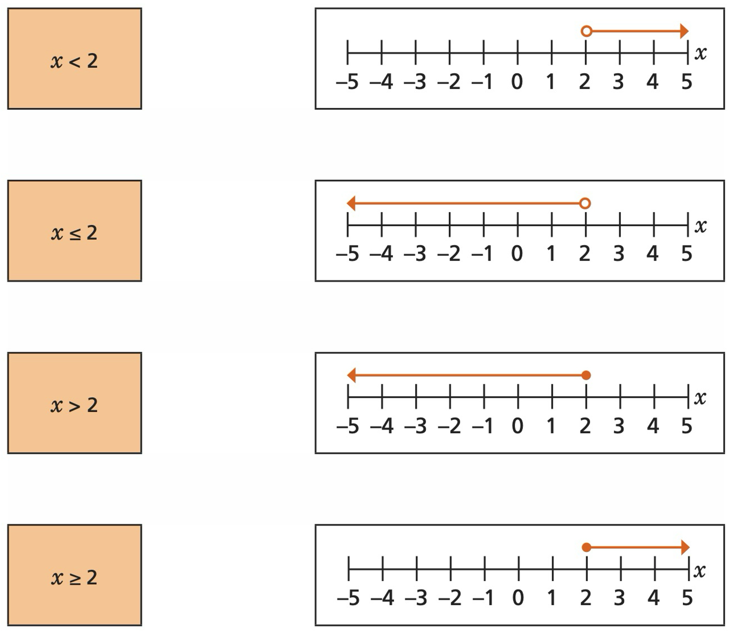
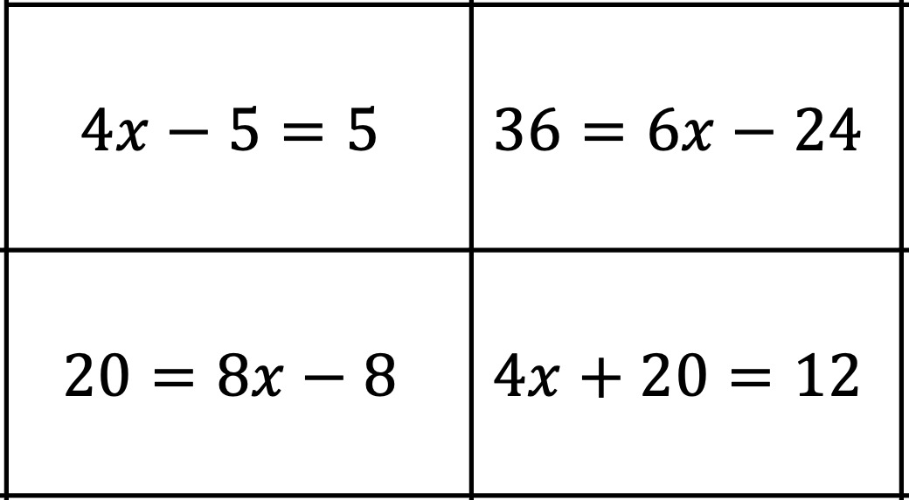
Year 8 – Equations & Inequalities
Function machines
1) Work out the output when the input is 8
2) Work out the output when the input is 2
3) Work out the input when the output is 26
4) Work out the input when the output is – 4
Inverse operations
The inverse of addition is ___________
The inverse of subtraction is _________
The inverse of multiplication is _______
The inverse of division is_ __________
Define the key words:
Inequality:
Coefficient:
Variable:
Equation:
Equations with unknowns on both sides
Solve the following equations:
Solve one & two step equations
Solve the following equations:
Inequalities on a number line
Match the inequalities to the correct number line.
Form and solve inequalities
Simple Inequalities
Solve:
(a) x + 4 > 9
(b) x - 3 < 2
(c) 2x ≤ 14
(d) 3x - 5 > 16
(e) 4x + 7<11
Write down an inequality for the following:
(a) y is less than or equal to 1
(b) y is greater than or equal to -2
Write the following inequalities in words:
y < 3
y ≥ 6
List the first 5 integers that satisfy the following inequalities:
p ≤ −2
p ≥ −6

