Slide 1


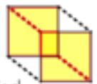

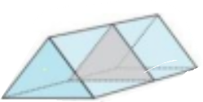
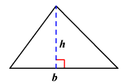
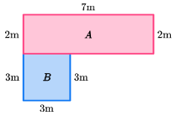





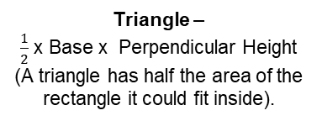

Year 8 – Area volume and density
Know and name 2D and 3D shapes
Identify and draw nets, plans and elevations of 3D shapes
Calculate area of 2D shapes
Calculate volume and surface area of 3D shapes
Identify congruency
2D- two dimensions to the shape e.g. length and width
3D- three dimensions to the shape e.g. length, width and height
Vertex- a point where two or more line segments meet
Edge- a line on the boundary joining two vertex
Face- a flat surface on a solid object
Cross-section- a view inside a solid shape made by cutting through it
Plan- a drawing of something when drawn from above (sometimes birds eye view)
Rectangles, Triangles and Parallelograms
Year 7 - Lines and Angles
Year 8 - Developing Geometry
Rectangle – Base x Height
Recognise prisms
A solid object with two identical
ends and flat sides
The cross section will also
be identical to the end faces
Parallelogram –
Base x Perpendicular Height
(identify the height that meets the base at a right angle)
Triangle –
$\frac{1}{2}$ x Base x Perpendicular Height
(A triangle has half the area of the rectangle it could fit inside).
Density, Mass, Volume
$$density= \frac{mass}{volume}$$
$$volume= \frac{mass}{density}$$
$$mass = volume × density$$
Area of Compound Shapes
Volume
Volume is the 3D space it takes up
Cubes/ Cuboids = base x width x height
Prisms and cylinders = area of cross section x height
cross section
Split the shape into known shapes
Calculate the areas separately
Add together to find total area.
Areas – square units Volumes – cube units
Areas and volumes can be left in terms of π
√

Slide 2
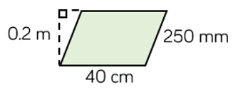

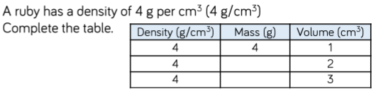
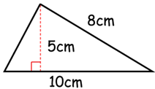


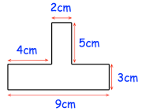
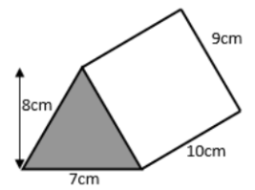
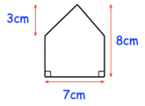
Year 8 – Area volume and density
Write the formula for the area of a :
Triangle
Parallelogram
Trapezium
Write the formula to find the volume of a prism.
Define the following words:
Vertex:
Edge:
Face:
Cross section:
Plan:
Area of Known Polygons
Calculate the area of the following shapes:
Density, Mass, Volume
Area of Compound Shapes
Calculate the area and perimeter of these shapes:
Volume
Calculate the volume of this triangular prism

