Slide 1



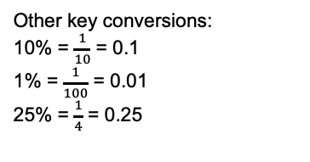
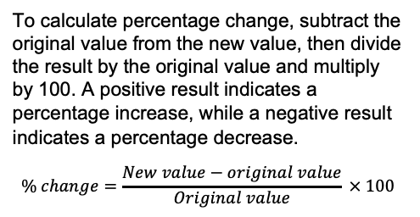
Year 8 – Percentages
Know common fractions
Convert FDP
Calculate percentage multipliers (increase and decrease).
Find percentage of an amount (calc and non-calc)
Calculate % change
Percent: parts per 100 written using the % symbol.
Decimal: a number in our base 10 number system. Numbers to the right of the decimal place are called decimals.
Fraction: a fraction represents how many parts of a whole value you have.
Equivalent: of equal value.
Integer: whole number, can be positive, negative or zero
Express one number as a % of another
FDP Equivalence
Percentages being “out of 100”
You can calculate one number as a percentage of another by dividing the numbers and then multiplying by 100.
Example
Find 23 as a percentage of 80.
Calculate 23 ÷ 80 = 0.2875.
0.2875 × 100 = 28.75%.
Percentage increase & decrease
(using a decimal multiplier)
Increase (get larger)
100% + 42% = 142%
142% = 1.42 (Multiplier is more than 1)
Decrease (become smaller)
100% - 58% = 42%
58% = 0.42 (Multiplier less than 1)
Convert FDP
100%
18%
Percentage to fraction:
Put the % as the numerator and make the denominator 100. Then simplify,
e.g. 50/100 = ½
Fraction to decimal: Divide the numerator by the denominator e.g. 1 ÷ 2 = 0.5
½
50%
0.5
100%
Decimal to percentage:
Multiply by 100 e.g. 0.5 x 100 = 50
42%
Decrease by 58%
Other key conversions:
10% = $\frac{1}{10}$ = 0.1
1% = $\frac{1}{100}$ = 0.01
25% = $\frac{1}{4}$ = 0.25
Percentage change
Percentage of an amount
To calculate percentage change, subtract the original value from the new value, then divide the result by the original value and multiply by 100. A positive result indicates a percentage increase, while a negative result indicates a percentage decrease.
$$\% change=\frac{New value−original value}{Original value} × 100$$
Find 60% of 90
Non-Calculator:
Break down into chunks
60% = 50% +10%
50% of 90 = 45
10% of 90 = 9
60% = 45 + 9
60% = 54
Calculator:
Convert to a decimal
60% = 0.6
Multiply by the amount
0.6 x 90
= 54

Slide 2
Year 8 – Percentages
What does the denominator tell us in a fraction?
What does the numerator tell us in a fraction?
What is a percentage out of?
Complete the following:
8 x 100 = 4.2 x 10 = 70÷100=
Define the following key words:
Fraction:
Decimal:
Percentage:
Place value
Interval:
Express one number as a % of another
For every 50 students at Hightown School, 39 are right-handed.
What percentage are right-handed?
Susan brings 500 flapjacks to a local fair. She sells 450 of the flapjacks.
What percentage of the flapjacks did Susan sell?
Percentage increase & decrease
(using a decimal multiplier)
What multipliers would we use to calculate:
26% increase?
14% decrease?
30% decrease?
3% increase?
110% increase?
2% decrease?
Convert FDP
Convert the following decimals to percentages
(a) 0.5
(b) 0.35
(c) 0.7
(d) 0.1
Convert the following percentages to fractions in their simplest form
65%
(b) 70%
(c) 6%
(d) 55%
Convert the following fractions to decimals
1/2
(b) 3/5
(c) 5/8
(d) 3/4
Percentage change
Percentage of an amount
The value of a painting rises from £120,000 to £192,000.
Work out the percentage increase in the value of the painting.
A puppy weighed 2kg. Eight weeks later the puppy weighed 3.5kg
What was the percentage increase in the puppy’s weight?
Alice buys a book for £19.80. A year later she sells the book for £12.87
Calculate the percentage decrease in the value of the book.
Calculate without a calculator:
50% of 32
25% of 120
10% of 130
25% of 48
21% of 160
Calculate using a calculator:
70% of 280
19% of 360
6% of 84
11.5% of 128

