Slide 1

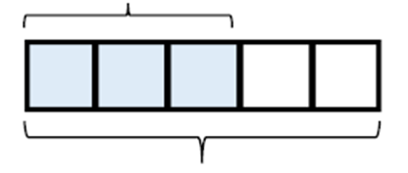
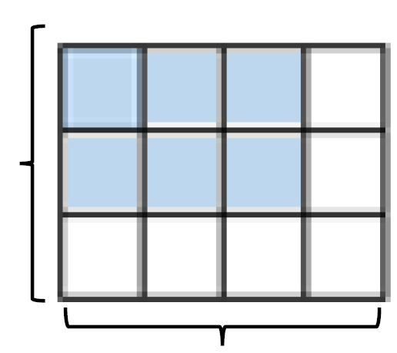

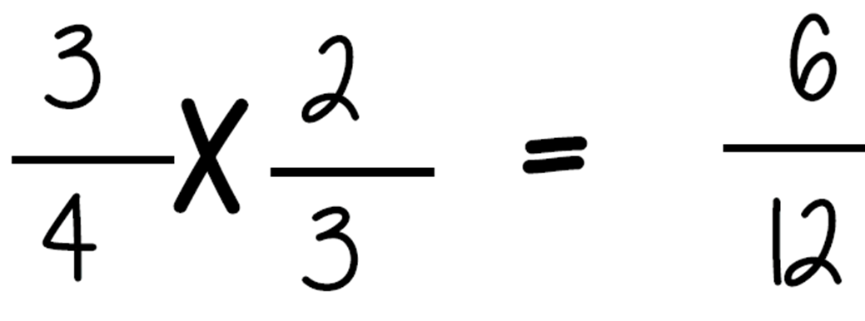
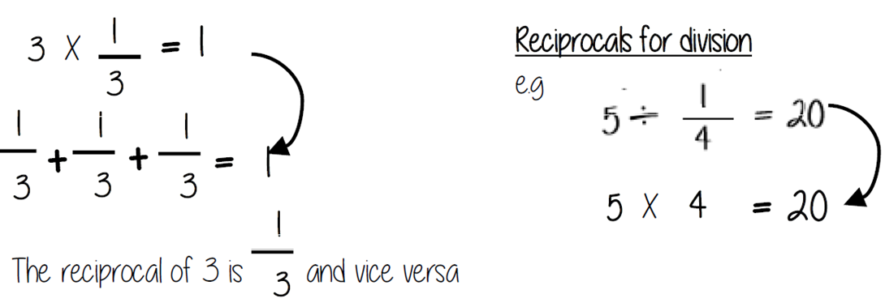
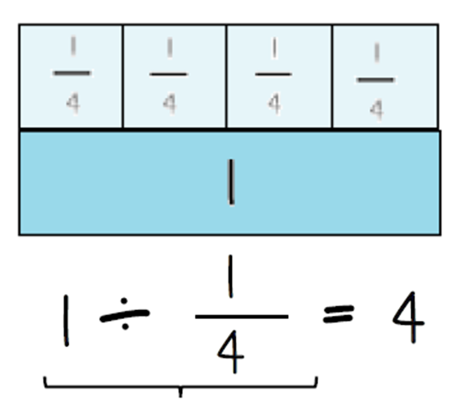
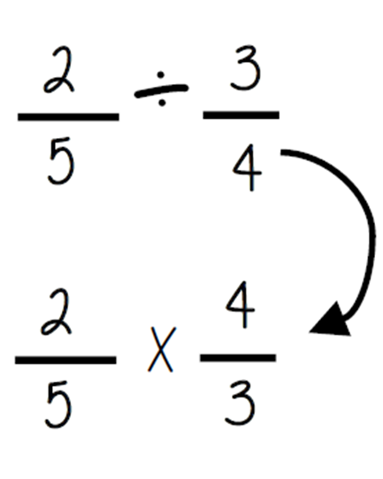

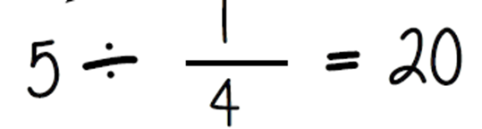
Year 8 – Multiply and Divide Fractions
Carry out any multiplication or division using fractions and integers.
Understand and use the reciprocal
Numerator : the number above the line on a fraction. The top number. Represents how many parts are taken
Denominator: the number below the line on a fraction. The number represent the total number of parts..
Unit Fraction: a fraction where the numerator is one and denominator a positive integer.
Non unit Fraction: a fraction where the numerator is larger than one.
Reciprocal:a pair of numbers that multiply together to give 1.
Representing a Fraction
hope
Representing a Fraction (Y6)
Repeated addition = multiplication by an integer (Y6)
Numerator
ALL PARTS of a fraction are of equal size
3
5
Denominator
Multiplying non-unit fractions
Quick Multiply
Parts Shaded
3
Total no of parts
4
The reciprocal When you multiply a number by its reciprocal the answer is always 1
Multiplying by a reciprocal gives the same outcome
Dividing an integer by a unit fraction
Dividing any fraction
There are 4 quarters in 1 whole. Therefore, there are 20 quarters in 5 wholes
Multiplying by a reciprocal gives the same outcome
How many quarters are in 1?

Slide 2
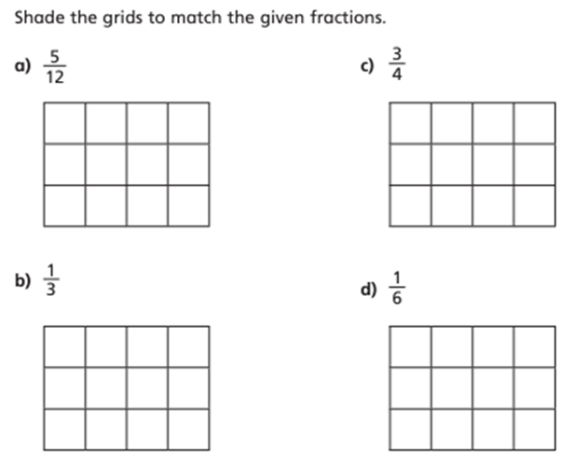
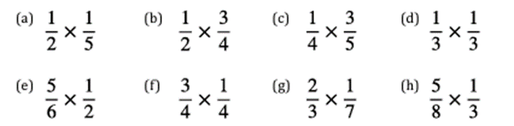
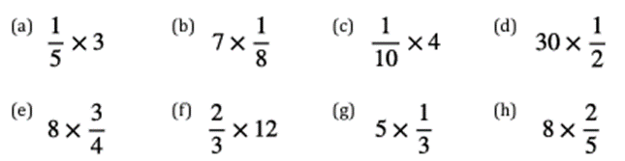
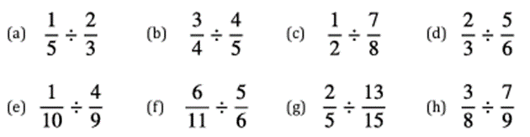
Year 8 – Multiply and Divide Fractions
Use cover, look, write, check to write the definitions
Numerator :
Denominator:
Unit Fraction:
Non unit Fraction:
Reciprocal:
Multiply any fraction
The reciprocal
Dividing any fraction

