Slide 1

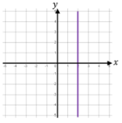
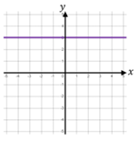
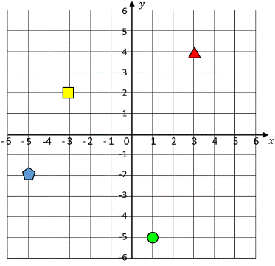

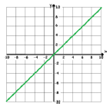



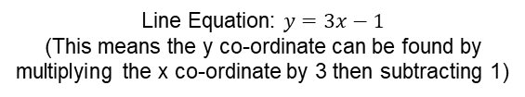



Year 8- Co ordinates and graphs
Label and identify lines parallel to the axes
Recognise and use basic straight lines
Identify positive and negative gradients
Link linear graphs to sequences
Plot y = mx + c graphs
Quadrant: four quarters of the coordinate plane.
Coordinate: a set of values that show an exact position.
Horizontal: a straight line from left to right (parallel to the x axis)
Vertical: a straight line from top to bottom (parallel to the y axis)
Origin: (0,0) on a graph. The point the two axes cross
Parallel: Lines that never meet
Gradient: The steepness of a line
Intercept: Where lines cross
Lines Parallel to the Axes
Position and Direction (Y6)
Algebraic Notation and Substitution (Y7)
All lines parallel to the y-axis take the form $x=a$
x = 2
All points on this line have an x co-ordinate of 2
(2,5), (2,0), (2,-3) etc.
Co-Ordinates in Four Quadrants
($x , y$)
Always position on the x-axis first
Position on the y-axis second
All lines parallel to the x-axis take the form $y=a$
(1, -5)
y = 3
All points on this line have a y co-ordinate of 3
(-4,3), (0,3), (2,3) etc.
From the origin we moved 1 square in the x axis and negative 5 in the y axis
Plot Lines in the form $y=mx+c$
Line Equation: $y=3x−1$
(This means the y co-ordinate can be found by multiplying the x co-ordinate by 3 then subtracting 1)
Recognise and Use the Line $y=x$
Generate the co-ordinates in a table
Co-Ordinates on this line:
(3,3)
(20,20)
(0,0)
(-5, -5) etc.
* we need a minimum of 2 co-ordinates but we can be more accurate by generating more
This means that the x co-ordinates and y co-ordinates on this line are always equal.
Plot the points and join with a ruler through the graph

Slide 2
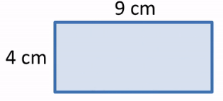
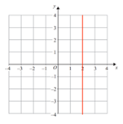
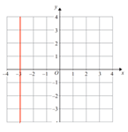
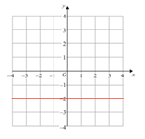
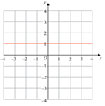

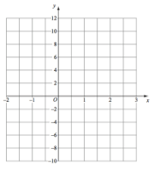
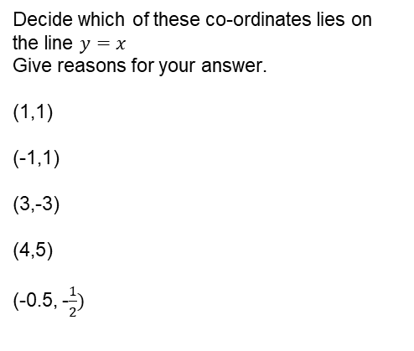
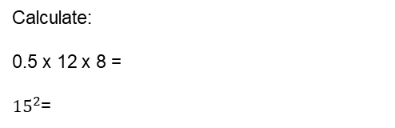



Year 8- Co ordinates and graphs
Find the area and perimeter of this shape:
Define the following key words:
Origin –
Parallel –
Co-Ordinate –
Calculate:
0.5 x 12 x 8 =
${15}^{2}$=
Lines Parallel to the Axes
Write down the equations of the following graphs.
Co-Ordinates in Four Quadrants
What are the four co-ordinates denoted by the shapes on this set of axes?
Triangle:
Square:
Circle:
Pentagon:
Plotting lines in the form $y=mx+c$
Generate co-ordinates for the line:
$$y=2x −4$$
Using the line $y=x$
Decide which of these co-ordinates lies on the line $y=x$
Give reasons for your answer.
(1,1)
(-1,1)
(3,-3)
(4,5)
(-0.5, -$\frac{1}{2})$
Plot these points on the graph below.

