Slide 1

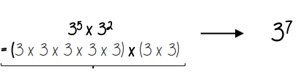
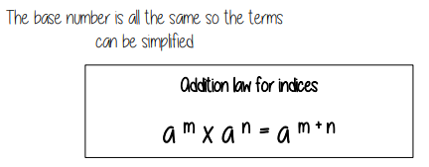
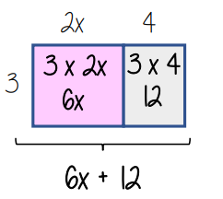

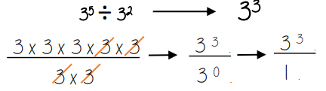
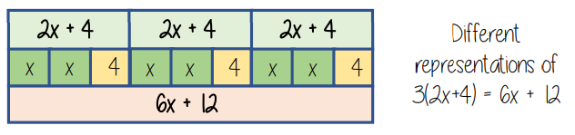
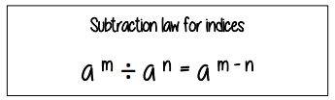
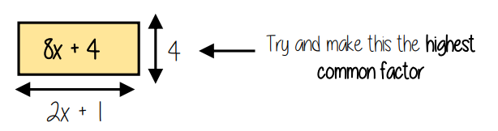
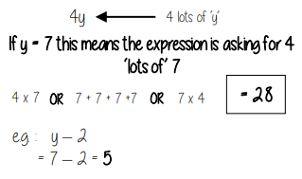


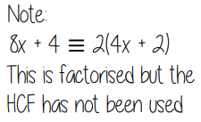
Year 8 – Algebra – Algebraic Manipulation
To be able to substitute into expressions
To be able to multiply and divide expressions with indices.
To be able to expand and factorise single brackets
Simplify: grouping and combining similar terms
Substitute: replace a variable with a numerical value
Term: a single number or variable
Like: variables that are the same are “like”
Highest Common Factor (HCF): the biggest factor
Coefficient: the number used to multiply a variable
Base: the number that gets multiplied by a power
Addition / Subtraction Laws with indices
Function Machines (Y7)
Expanding single brackets (Y8)
Expand a single bracket
Factorise into a single bracket
Substitute into expressions

Slide 2





















Year 8 – Algebra – Algebraic Manipulation
Define the following keywords:
Simplify
Substitute
Term
Work out the output when the input is 24
Work out the output when the input is 42
Work out the output when the input is 17
Addition / Subtraction Laws with indices
Write as a single power
Expand a single bracket
Expand the following brackets
Substitute into expressions
Factorise into a single bracket
Factorise:

