Slide 1

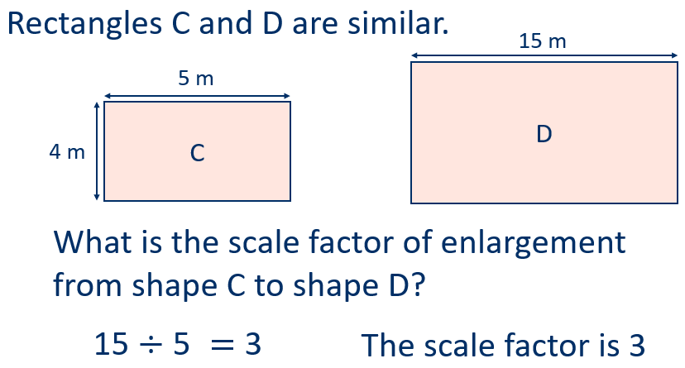
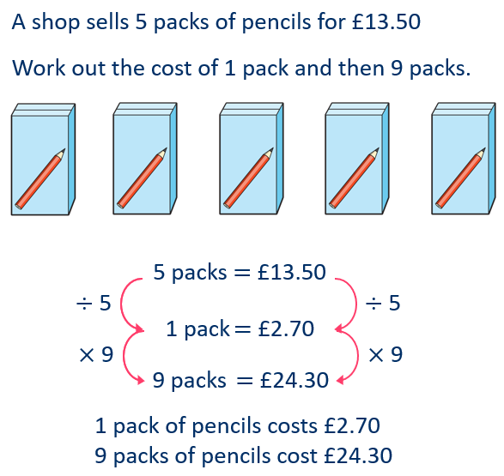
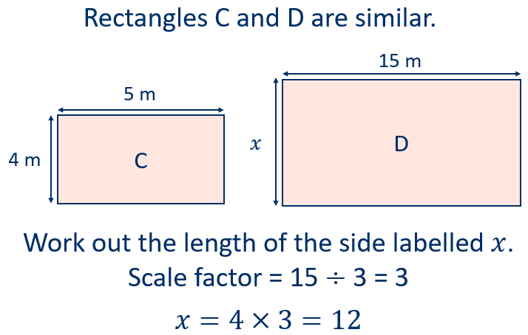
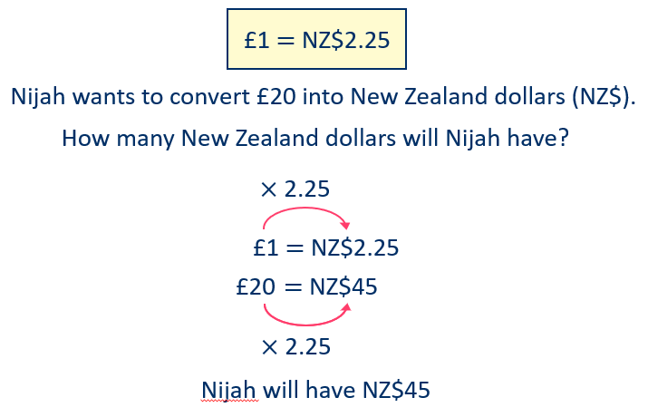
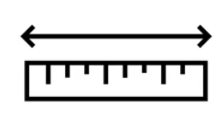
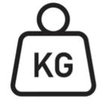

Year 8 – Proportion and Scale
Understand:
Direct Proportion.
Converting between currencies.
The relationship between similar shapes.
Converting metric units.
Direct proportion: describes a relationship between two quantities where the ratio between them remains constant, i.e they increase or decrease at the same rate
Metric units: The most common metric units include metres (kilometres, centimetres and millimetres) for length, grams (kilograms and milligrams) for mass, and litres (centilitres and millilitres) for volume.
Similar shapes: For two shapes to be similar, their corresponding angles must be equal, and their corresponding sides must be in proportion, meaning they have a constant ratio.
Similar shapes
Understand ratio
Use of ratio tables
Understand a linear relationship (Sequences Y7)
Direct Proportion
Convert metric units
Convert between currencies
Convert metric units
Length
1 kilometre = 1000 metres
1 metre = 100 centimetres
1 centimetre = 10 millimetres
Weight
1 kilogram = 1000 grams
Volume
1 litre = 1000 millilitres
1 litre = 10 centilitres

Slide 2
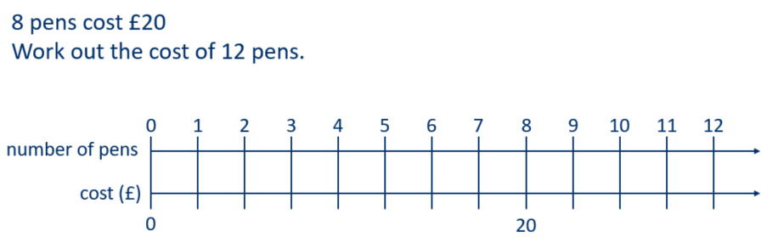
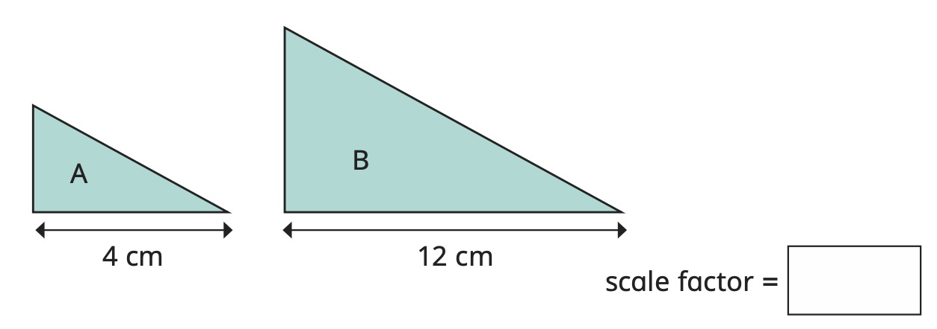
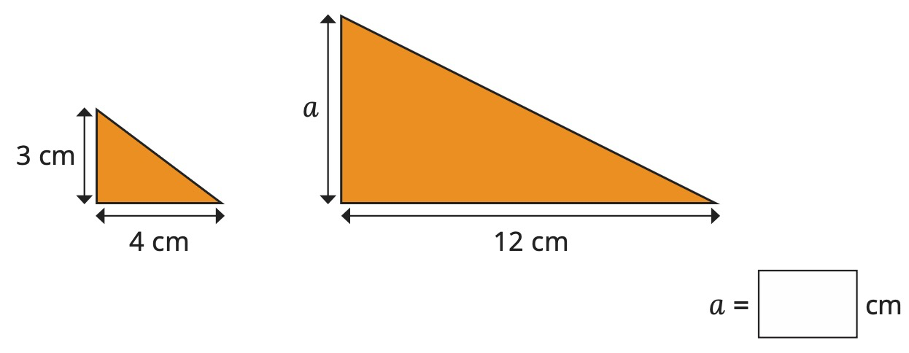
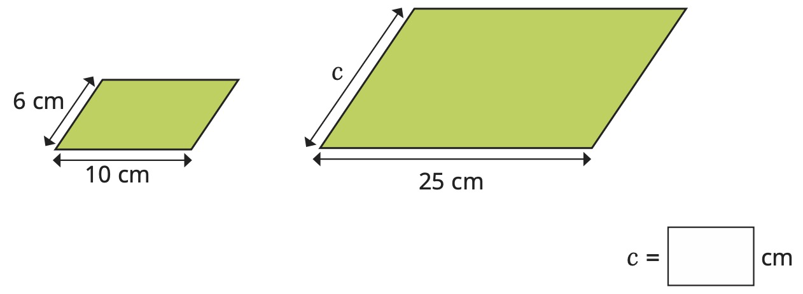
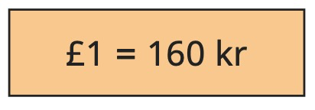
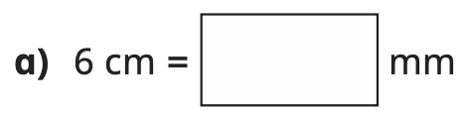
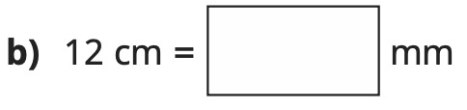
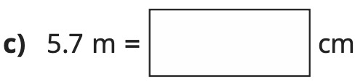
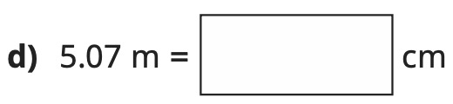
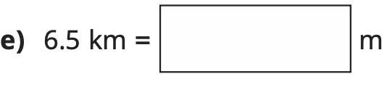
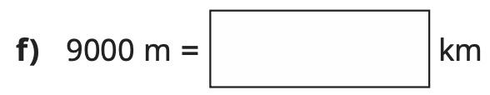
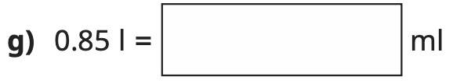
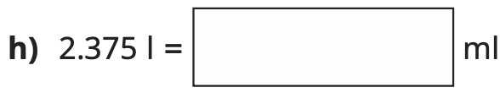
Year 8 – Proportion and Scale
Bob and Sally share £350 in the ratio 3:4. How much do they each receive?
Use the following ratio table to calculate the cost of 12 pens.
Define the following:
Direct proportion –
Similar shapes –
List the common metric units used for length, mass and volume.
Similar shapes
A 7cm square is enlarged by a scale factor of 3. What is the side length of the enlarged square?
Direct Proportion
5 bananas cost £1.20.
Work out the cost of:
10 bananas
25 bananas
1 banana
9 bananas
17 bananas
Convert between currencies
The currency of Iceland is the Icelandic króna (kr).
Convert the amounts into Icelandic Króna:
£5 b) £10
£15 d) £18
Convert the amounts into pounds:
1600 kr b) 320 kr
80 kr d) 40kr
Convert metric units
i) Write 8km in centimetres . . . . . . . .
j) Write 9m in millimetres . . . . . . . .

