Slide 1


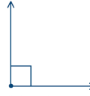
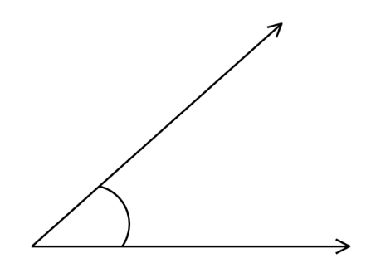
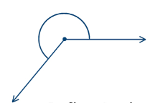
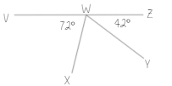


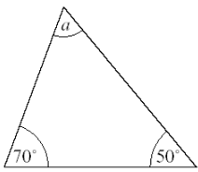

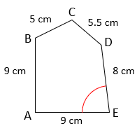
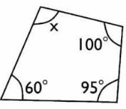
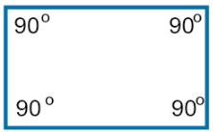
Year 7- Angles and polygons
Know the names and properties of 2-D shapes. Identify angles and lines using notation. Know the different types of angles. Angles on a straight-line sum to 180 & angles around a point sum to 360. Angles in a triangle sum to 180. Know angles in a quadrilateral sum to 360.
Sum: total, add all the interior angles together
Polygon: A 2D shape made with straight lines
Scalene triangle: a triangle with all different sides and angles
Isosceles triangle: a triangle with two angles the same size and two angles the same size
Right-angled triangle: a triangle with a right angle
Acute Angle – An angle less than 90º
Obtuse Angle – An angle greater than 90º and less than 180º
Reflex Angle – An angle greater than 180º and less than 360º
Names and properties of types of triangles and quadrilaterals. Names of polygons.
Angle facts relating to a full turn. Accurately use a protractor.
Types of angles
Obtuse angle-An angle greater than 90º and less than 180º
Angles on a straight line and round a point
Right angle is 90º .Usually marked as a square
Acute angle
Less than 90º
Adjacent angles that share a common point on a line add up to 180°
Reflex Angle – An angle greater than 180º and less than 360º
The sum of angles around a point is 360°
Angles in a triangle
WXY = 180-72-42 = 66º
Sum of interior angles in a triangle = 180°
Angle and line notation
Base angles
are equal
Hatch marks show sides are same length
180- 70-50 = 60º
180- 43 = 137
137 ÷ 2 = 68.5º
Angles in a quadrilateral
Sum of interior angles in a quadrilateral = 360º
Line segments are usually labelled as two letters at either end. So in the pentagon above line CD is equal to 5.5cm
We label angles as three letters which come from the line segments that form the angle. The angle marked above is angle AED as it is the angle between line segments AE and DE at E
360 – 100 – 60 – 95 = 105º
90 x 4 = 360º

