Slide 1

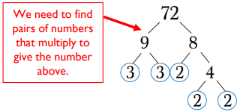

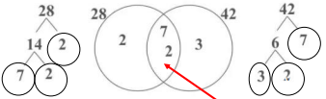
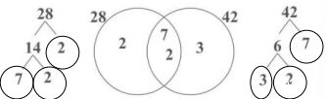
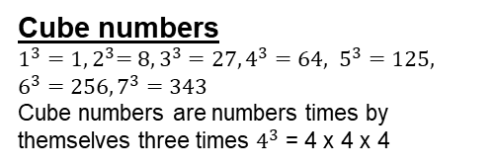
Year 7 – Properties of Number
Square numbers up to 12 squared
Cube numbers up to 7 cubed
How to find the lowest common multiple
How to find the highest common factor
Prime numbers
Prime number – A prime is a number that has only two factors which are 1 and itself
Multiple – A number in the given numbers times tables
Factor – A number that fits into another number exactly
Lowest Common Multiple – The smallest number that is in the times tables of two or more given numbers
Highest Common Factor – The biggest number that divides exactly into two or more given numbers
Product of prime factors
Otherwise known as Prime factorisation: This is when we split a number into its prime factors using a factor tree and circling the prime factors.
Times tables
Square Numbers
Cube numbers
$1^{3}{=1, 2}^{3}=8, 3^{3}=27, 4^{3}=64, 5^{3}=125, 6^{3}=256, 7^{3}=343$
Cube numbers are numbers times by themselves three times $4^{3}$ = 4 x 4 x 4
Prime numbers
This is a number that has exactly two factors
2, 3, 5, 7, 11, 13, 17, 19, 23, 29
This is the first 10 but not the only prime numbers
Multiples and Factors
Multiples
Multiples are in their times tables
Find the first 5 multiples of 9
They are 9, 18, 27, 36, 45.
Factors
All Factors come in pairs.
Write all the factors of 24
They are 1 x 24, 2 x 12, 3 x 8, 4 x 6.
Highest Common Factor
Find the highest common factors of 28 and 42.
Factors of 28 = 1 x 28, 2 x 14, 4 x 7
Factors of 42 = 1 x 42, 2 x 21, 3 x 14, 6 x 7
The highest number that appears in both is 14.
Lowest Common Multiple
Find the lowest common multiple of 28 and 42
First 5 multiples of 28 = 28, 56, 84, 112, 140
First 5 multiples of 42 = 42, 84, 126, 178, 220
The lowest number that appears in both is 84.
Multiply numbers in the centre together
7 x 2 = 14
Multiply all numbers in the Venn diagram together
7 x 3 x 2 x 2 = 84

Slide 2
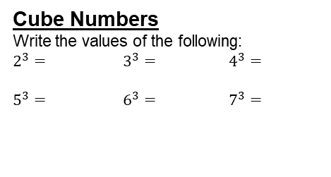
Year 7 – Properties of Number
Put
1.)
2.)
3.)
Define the key vocabulary
Directed number –
NN –
NN –
NN –
Cube Numbers
Write the values of the following:
$2^{3}=$ $3^{3}=$ $4^{3}=$
$5^{3}=$ $6^{3}=$ $7^{3}=$
Product of Prime numbers
Calculate the following:
Write the product of primes (With Prime factor trees)
72 96
Prime Numbers
Write the first 10 prime numbers:
Factors and Multiples
Multiples
Write the first 5 multiples of the following
13 = ________________
21 = ________________
16 = ________________
Factors
Write all the factors of the following
28 =_________________________
36 =_________________________
84 =_________________________
Highest Common Factor
Find the Highest Common Factor of the following numbers:
a.) 45 and 99
b.) 108 and 81
c.) 36 and 72
Lowest Common Multiple
Find the Lowest Common Multiple of the following numbers
a.) 12 and 18
b.) 9 and 4
c.) 18 and 24

