Slide 1


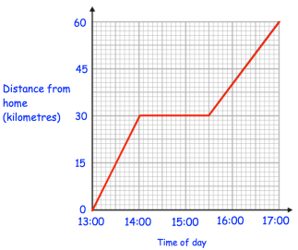

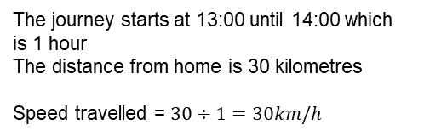
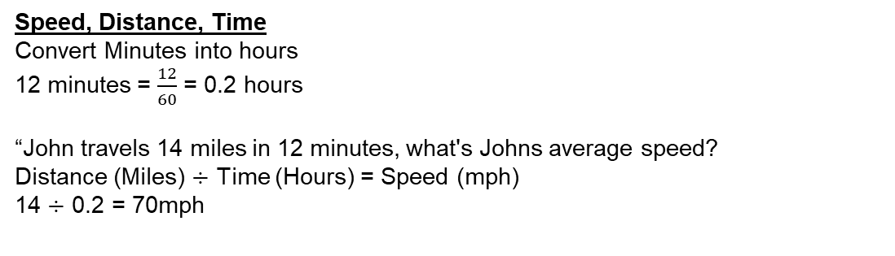
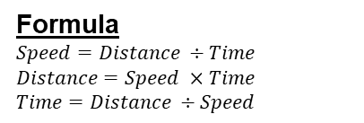
Year 7 – Speed, Distance & Time
Interpret Distance time graphs
Calculate speed, distance and time
Convert between units of time
Speed = How much distance is covered in a certain period of time
Distance – how far an object travels
Time - How long something takes
Average speed – The overall distance travelled divided by the overall time for a journey
Acceleration: How quickly speed increases or decreases
Convert between units of time
Seconds, Minutes, Hours
60 seconds = 1 minute
60 minutes = 1 hour
3600 seconds = 1 hour
Convert between units of time
Use correct units of speed
Days, Weeks, months Years
7 Days – 1 Week
365 Days = 1 Year
52 Weeks = 1 Year
12 Months = 1 Year
Tables and Timetables
Timetables are generally used for transportation
Carl needs to get to Milton for 10:20 which bus should he take? The 9:20 bus.
Distance time graphs
Problems with time and the calendar
When the line is flat the journey is stationary (Stopped)
a.) What day is 19th June? Sun
b.) What date is the 3rd Wednesday? 15th
c.) what day is the 6th July? Mon
The journey starts at 13:00 until 14:00 which is 1 hour
The distance from home is 30 kilometres
Speed travelled = $30÷1=30km/h$
Speed, Distance, Time
Convert Minutes into hours
12 minutes = $\frac{12}{60}$ = 0.2 hours
“John travels 14 miles in 12 minutes, what's Johns average speed?
Distance (Miles) $÷$ Time (Hours) = Speed (mph)
14 $÷$ 0.2 = 70mph
Formula
$Speed=Distance ÷Time$
$Distance=Speed ×Time$
$Time=Distance ÷Speed$

Slide 2
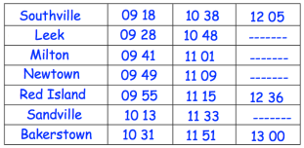
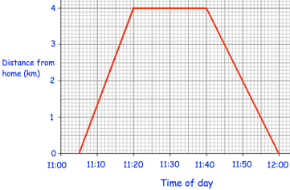
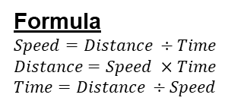
Year 7 – Speed, Distance & Time
Complete the following conversions
1.) 2.5 years = ___________ months
2.) 7 Weeks = ___________ days
3.) 98 days = ___________ weeks
4.) 3 hours = ___________ minutes
5.) 300 seconds = __________ minutes
6.) 7 minutes - ___________ seconds
Define the key vocabulary
Speed –
Distance –
Time –
Average Speed –
Problems with time and the calander
Calculate the following:
a.) James goes to a meeting that lasts 1 hour and 50 minutes. The meeting ends at 1:45, when did the meeting start?
b.) A movie begins at 6:10pm and ends at 9:05pm. How long did the movie last?
c.) Olivia does her maths, French and history homework, it takes her 3 hours. 70 minutes on her history homework, 15 minutes less on her maths homework. How long did she spend on her French homework?
d.) A train leaves Cardiff at 11:45am, it takes 39 minutes to reach Bristol. When does it leave Bristol (24 hour clock time)
Tables and TimeTables
Calculate the following:
1.) a bus leaves Southville at 10 38
a.) What time should the bus arrive at Newtown
b.) How long will the journey take?
c.) James arrives at Milton at 09 29, he wants the next bus to Red Island. How long will it take?
Distance time graphs
Calculate the following:
a.) How long did It take Laura to cycle to the post office?
b.) How long did she stay at the post office?
c.) How long does it take to cycle back?
Formula
$Speed=Distance ÷Time$
$Distance=Speed ×Time$
$Time=Distance ÷Speed$
Speed Distance time
a.) Jenny drives 153 miles in 3 hours. What was Jenny’s average speed?
b.) Paul cycles 48 km in at a speed of 6km/h. How long does this take?
c.) A rubber band travels 12m/s and is in the air for 3 seconds. How far does the rubber band travel?
d.) Francesca travels 10 miles in 30 minutes. What was Francesca’s average speed in mph?

