Slide 1










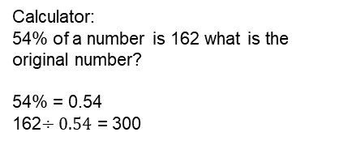


Year 7 – Fractions and percentages of amounts
Fraction of an amount
Percentage of an amount
Percentage increase/Decrease
Fractions to find a whole
Fraction – Number with a numerator and denominator
Numerator – Top number in a fraction that indicates the number of equal parts out of a whole
Denominator – Bottom number in a fraction that indicates the number of equal parts a whole has been divided into
Percentage – Expressing a part of a whole as a number out of 100
Equivalent Fraction – fraction that represents the same value as another fraction
Fraction of an amount.
Equivalent fractions
Multiply fractions
Percentage of an amount
Multiply by numerator
$\frac{2}{3}$ of 18
Divide by Denominator
18 $÷$ 3 = 6
6 x 2 = 12
18
Percentage increase and Decrease
Increase £200 by 20%
Calculator Non-Calculator
Decrease £400 by 25%
Calculator Non-Calculator
6
6
6
Use a fraction to find the whole.
100% + 20% = 120%
120% $÷$ 100 = 1.2
200 x 1.2 = £240
200 $÷$ 10 = 20 ← (10%)
20 x 2 = 40 ← (20%
200 + 40 = 240
$\frac{2}{3}$ of ? = 18
18 $÷$ 2 = 9
9 x 3 = 27
18
100% - 25% = 75%
75% $÷$ 100 = 0.75
400 x 0.75 = £300
400 $÷$ 10 = 40 ← (10%)
40 $÷$ 2 = 20 ← (5%)
400 – (40 +40 + 20) = 300
9
9
9
= 27
Percentage of an amount (Non-Calculator)
Percentage of an amount (Calculator)
When we have a calculator we can use a multiplier
Use a percentage to find a whole
Non-Calculator:
30% of a number is 15 what is the original number?
30% = 15
10% = 5
100% = 5 x 10 = 50
Calculator:
54% of a number is 162 what is the original number?
54% = 0.54
162$÷0.54$ = 300

Slide 2
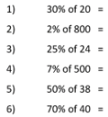

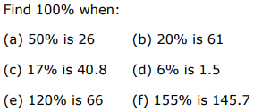
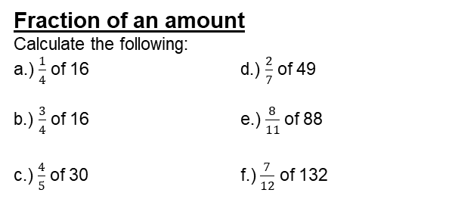
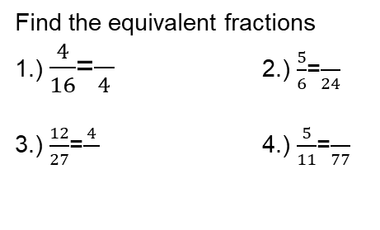
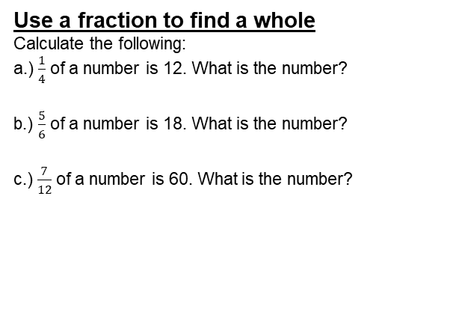
Year 7 – Fractions and percentages of amounts
Find the equivalent fractions
1.) $\frac{4}{16}$=$\frac{}{4}$ 2.) $\frac{5}{6}$=$\frac{}{24}$
3.) $\frac{12}{27}$=$\frac{4}{}$ 4.) $\frac{5}{11}$=$\frac{}{77}$
Define the key vocabulary
Numerator –
Denominator –
Percentage –
Equivalent Fraction –
Percentage increase
Calculate the following:
a.) Increase 400 by 20%
b.) Increase 95 by 40%
c.) Increase 350 by 15%
Percentage Decrease
Calculate the following:
a.) Decrease 400 by 20%
b.) Decrease 95 by 40%
c.) Decrease 350 by 15%
Fraction of an amount
Calculate the following:
a.) $\frac{1}{4}$ of 16 d.) $\frac{2}{7}$ of 49
b.) $\frac{3}{4}$ of 16 e.) $\frac{8}{11}$ of 88
c.) $\frac{4}{5}$ of 30 f.) $\frac{7}{12}$ of 132
Use a fraction to find a whole
Calculate the following:
a.) $\frac{1}{4}$ of a number is 12. What is the number?
b.) $\frac{5}{6}$ of a number is 18. What is the number?
c.) $\frac{7}{12}$ of a number is 60. What is the number?
Percentage of an amount (Non-Calculator)
Calculate the following:
Percentage of an amount (Calculator)
Calculate the following:
Use a percentage to find a whole
1.) A bike shop was having a 25% off sale and I purchased a bike for £120. How much was the bike originally

