Slide 1


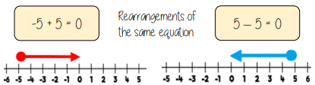
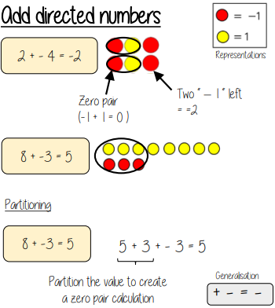
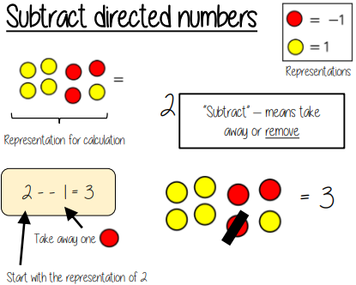
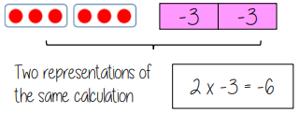
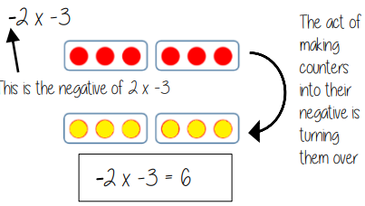
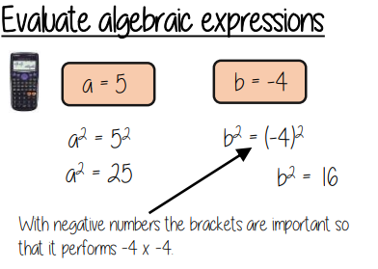
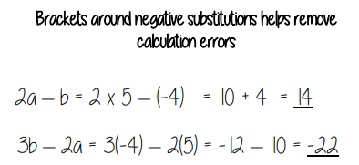


Year 7 – Directed Number
Add and subtract negative numbers
Order negative numbers
Multiply and divide negative numbers
Directed number – Number that has a positive or negative sign.
Negative number – a number less than zero
Ascending order – ordered from smallest to greatest
Descending order – ordered from greatest to smallest
Less than – Smaller than another amount
Greater than – More than another amount
Cross Zero – Move from positive to negative or vice versa.
Zero Pair – Two numbers or algebraic terms that sum to zero
Directed numbers on number lines.
Negative numbers (Addition and Subtraction
Value of negative numbers
Add Directed numbers
Multiply Directed Numbers
Divide Directed Numbers
$−6÷2$ = -3
$−6÷−2$ = 3
Flip the counters
Evaluate Algebraic expressions

Slide 2

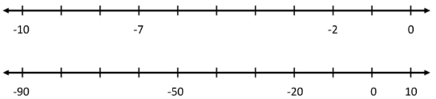
Year 7 – Directed number
Define the key vocabulary
Directed number –
Negative number –
Less than –
Greater than –
Put the following in ascending order
1.) -4, -2,. -6, -9, -3
2.) -0.5, - 40, - 500, -7, -0.045
3.) -2.7, -2.4, -2.3, -2.9, -3
Add Directed number
Calculate the following:
Subtract Directed number
Calculate the following:
Multiply Directed number
Calculate the following:
Divide Directed number
Calculate the following:
Directed number on number lines

