Slide 1

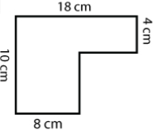
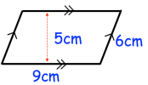
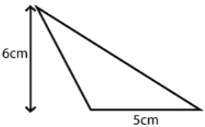
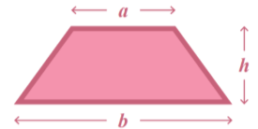
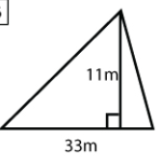
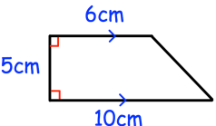
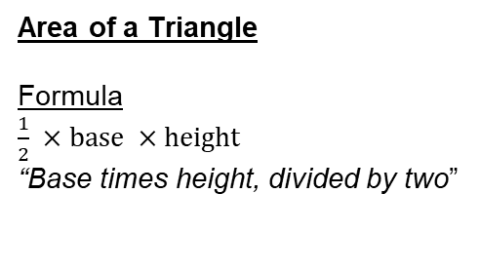



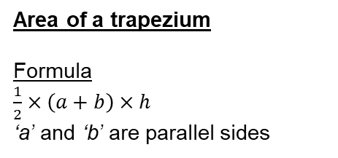
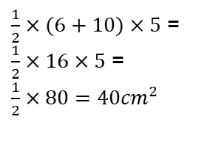
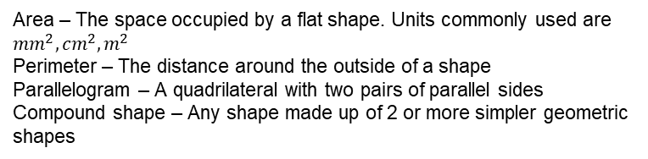
Year 7 – Perimeter and Area
To be able to calculate the area of a triangle, Rectangle, Parallelogram etc.
To be able to find the perimeter of shapes
To solve problems involving perimeter and area
Area – The space occupied by a flat shape. Units commonly used are ${mm}^{2},{cm}^{2},m^{2}$
Perimeter – The distance around the outside of a shape
Parallelogram – A quadrilateral with two pairs of parallel sides
Compound shape – Any shape made up of 2 or more simpler geometric shapes
Metric Conversions.
Convert 1.2m into mm
1.2m = 120cm
120cm = 1200mm
Conversions between metric units
Formula for area of a rectangle and triangle
10mm = 1cm
100cm = 1m
1000m = 1km
x100
x10
Perimeter of a polygon
Area of rectangles and parallelograms
Formula
Base x Perpendicular Height
18cm – 8cm = 10cm
NOT perpendicular height
10cm – 4cm = 6cm
Perimeter is the distance around the outside of the shape
Perimeter = 18 + 10 + 8 + 6 + 10 + 4 = 56cm
Area = 5 x 9 = 45${cm}^{2}$
Ensure that ‘squared’ is used
Area of a Triangle
Formula
$\frac{1}{2} ×base ×height$
“Base times height, divided by two”
Area of a trapezium
Formula
$\frac{1}{2}×\left(a+b\right)×h$
‘a’ and ‘b’ are parallel sides
$$\frac{1}{2}×6×5=15{cm}^{2}$$
$\frac{1}{2}×(6+10)×5$ =
$\frac{1}{2}×16×5$ =
$\frac{1}{2}×80={40cm}^{2}$
$$\frac{1}{2}×11×33=181.5m^{2}$$

Slide 2
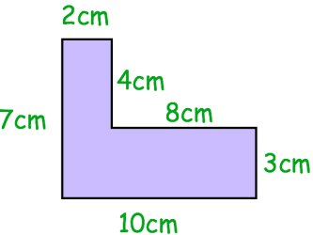
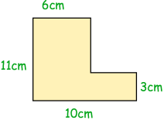

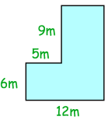

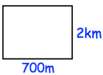
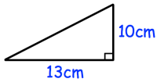
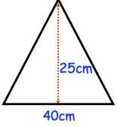
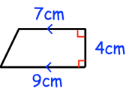
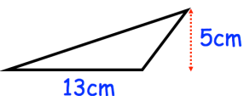
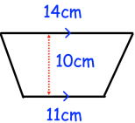
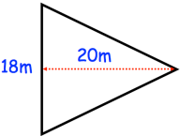
Year 7 – Perimeter and Area
Define the key vocabulary
Directed number –
Negative number –
Less than –
Greater than –
Finish the sentences
1.) There are ____mm in 1cm
2.) There are ____cm in 1m
3.) There are ____m in 1m
The formula for the area of a rectangle is:
Metric Conversions
Calculate the following:
1.) Convert 4km into m
2.) Convert 17m into cm
3.) Convert 35cm into mm
4.) Convert 120mm into cm
5.) Convert 3200cm into m
6.) Convert 27000m into km
Perimeter of a polygon
Calculate the perimeter of the following:
1.)
2.)
3.)
Area of a rectangle and parallelogram
Calculate the area of the following:
1.)
2.)
3.)
Area of a Triangle
Calculate the area of the following:
1.)
2.)
3.)
4.)
Area of a Trapezium
Calculate the area of the following:
1.)
2.)

