Slide 1

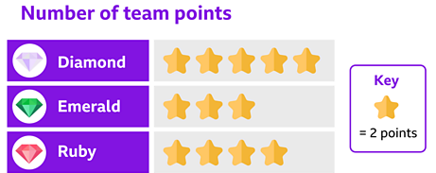
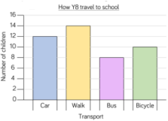
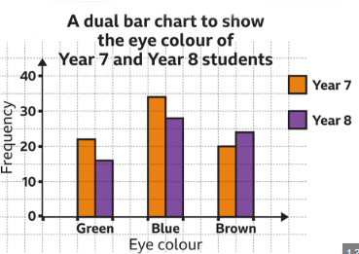
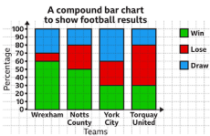
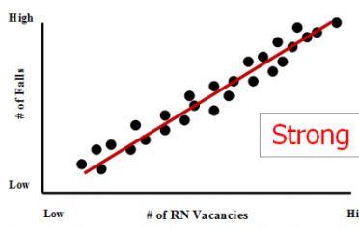
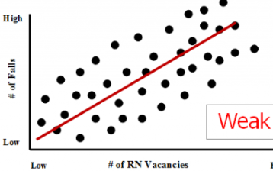
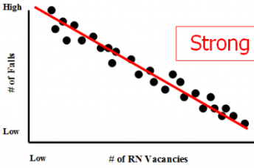
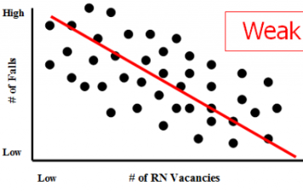
Year 7 – Graphing Data
Be able to read and create pictograms.
Be able to read and create bar charts.
Be able to draw a line of best fit and describe a correlation.
Correlation – A connection between two different variables
Discrete Data – Countable data that can be categorised
Continuous Data – Data that is measured and can take any value
Frequency – the number of times a data value occurs
Sampling – The group of things you use to check your hypothesis
Spread – the distance/ how spread out/ variation of data
Primary Data – Data that you collect yourself
Secondary Data – Data that is sourced from elsewhere e.g. the internet
Pictograms
Pictograms are where a symbol represents a amount.
Look below, half a star would represent 1 point, a full star would represent 2.
Plotting Coordinates
Averages
Bar Charts
Normal Bar Charts Dual Bar Charts Composite Bar Charts
Commonly used when there is only one variable like “How do you get to school”
Commonly used when there is two variables like “What is your eye colour and year group?”
Commonly used when there is two variables with multiple potential answers.
Scatter graphs
A scatter diagram typically looks at two sets of data one set represents the y-axis and the other set represents the x-axis
Line of Best Fit
A straight line that is drawn directly through the diagram as close to as many of the points on the graph as possible.
This is used to interpret the diagram, asking questions such as “Which way is the line going?” “Are the points on the graph close together?” This helps determine “Positive or Negative” and “Weak or Strong”
Correlation
Positive
Strong Weak
Negative
Strong Weak

Slide 2
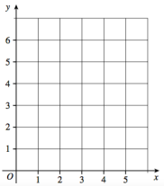

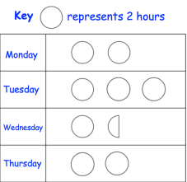
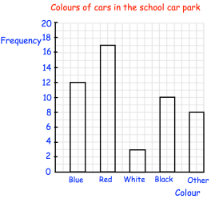
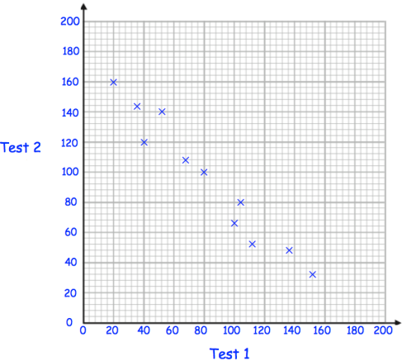
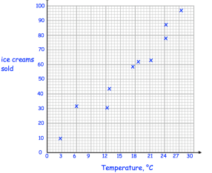
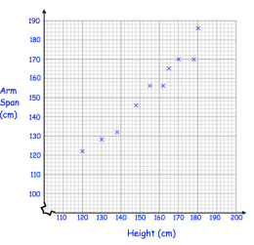
Year 7 – Graphing Data
Plot these coordinates
Define the following key terms:
Continuous Data –
Discrete Data –
Frequency –
Bar Charts
Pictograms
1.) How many hours are represented on Wednesday and Thursday?
2.) How many hours are represented overall?
3.) in total the amount of hours including Friday that should be represented is 24. Show what Friday should look like.
1.) What is the most common colour of car?
2.) How many Cars were blue?
3.) What is the difference between the blue and black cars?
4.) How many cars were there in total?
5.) What is the mean amount of cars?
6.) What is the range of cars (Largest – smallest)
Scatter Graphs
1a.) What are the three ways we can describe the correlation of a scatter graph?
1b.) What is the name of the line drawn to be able to see correlation in a scatter graph?
2.) Draw the line of best fit for each of the graphs
a.)
b.)
c.)

