Slide 1

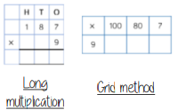

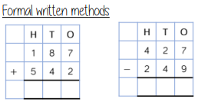
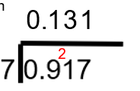
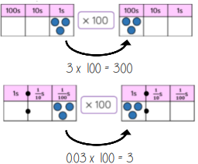
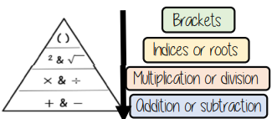
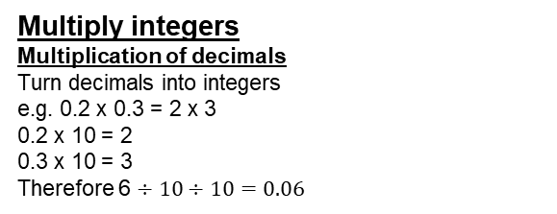
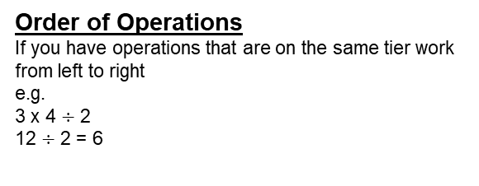
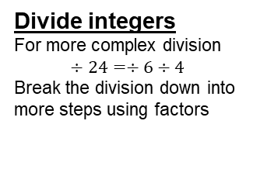
Year 7 – Four Operations
Times Tables
Place value
BIDMAS
Powers of 10
Divisor: The number we divide by
Commutative – Changing the order of operations does not change the result (x and +)
Place value – Value of a digit depending on its place in a number
Place holder – We use 0 as a place holder to show that there are none of a particular place in a number
Multiply integers
Multiplication of decimals
Turn decimals into integers
e.g. 0.2 x 0.3 = 2 x 3
0.2 x 10 = 2
0.3 x 10 = 3
Therefore 6 $÷10÷10=0.06$
Place value of decimals
Multiplying by powers of ten
Add and subtract integers
Add and subtract integers
Remember the place value for each column. You may need to move 10 ones to the ones column to be able to subtract.
Divide integers
For more complex division
$$÷24=÷6÷4$$
Break the division down into more steps using factors
Divide decimals by integers
The place holder in division methods is essential
Ensure that any amount left over is carried to the next number during short division
Multiply by 10, 100, 1000
Every 10 means that the place value of the number increases. When multiplying by 100 the number moves 2 place value
Order of Operations
If you have operations that are on the same tier work from left to right
e.g.
3 x 4 $÷$ 2
12 $÷$ 2 = 6

Slide 2




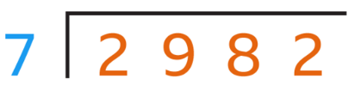









Year 7 – Four Operations
Prior Knowledge
1.) Write the value of the 8 in:
a.) 0.823
b.) 0.018
c.) 0.982
2.) Write the value of the 2 in:
a.) 0.342
b.) 0.21
c.) 0.121
Define the following key terms:
Divisor -
Commutative -
Place Value –
Place holder -
Multiply integers
a.) b.) c.)
Add and subtract integers
Find the answer to the following
a.) 12 + 19 f.) 476 + 352
b.) 24 + 37 g.) 798 + 342
c.) 68 + 92 h.) 1028 + 86
d.) 96 + 37 i.) 1476 + 265
e.) 112 + 87 j.) 2056 + 1972
Divide integers
a.) b.)
Divide decimals by integers
a.) d.)
b.) e.)
c.) f.)
Multiply by 10, 100, 1000
Find the answer to the following
a.) 12 x 10 g.) 0.98 x 10
b.) 12 x 100 h.) 0.98 x 100
c.) 12 x 1000 I.) 0.98 x 1000
d.) 2.4 x 10 j.) 12.1 x 10
e.) 2.4 x 100 k.) 12.1 x 100
f.) 2.4 x 1000 l.) 12.1 x 1000
Order of Operations
Find the answer to the following
a.) e.)
b.) f.)
c.) g.)
d.) h.)

