Slide 1


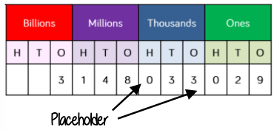


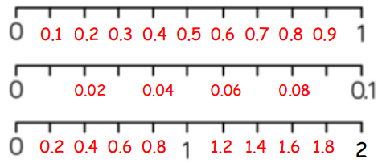
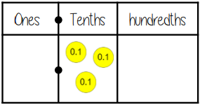
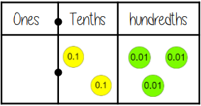

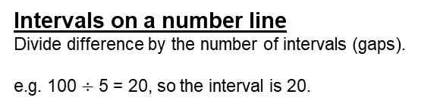
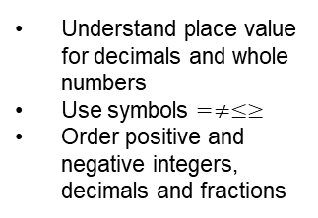
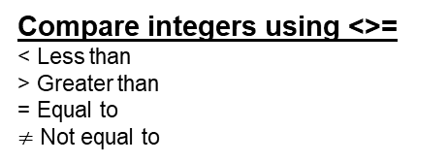
Year 7 – Place Value, Ordering and rounding
Understand place value for decimals and whole numbers
Use symbols $=≠≤≥$
Order positive and negative integers, decimals and fractions
Approximate: Estimate a number, amount or total.
Integer: A whole number that is positive or negative.
Interval: Between two points or values.
Median: Middle value found by putting data in order.
Negative: A number less than zero.
Place Value: Value of a digit depending of its place in a number.
Range: The difference between the largest and smallest numbers
Significant figure: A digit that gives meaning to a number usually the digit most on the left
Round to powers of ten
If the number is half way between we ‘Round up’
Place Value
Equal Division
Understanding of decimals
Inequality signs
Integer place value
Three Billion, One hundred and forty eight million, thirty three thousand and twenty nine
1 Billion 1,000,000,000
1 Million 1,000,000
Intervals on a number line
Divide difference by the number of intervals (gaps).
e.g. 100 $÷$ 5 = 20, so the interval is 20.
Decimal Intervals on a number line
One whole split into 10 parts makes tenths = 0.1
One tenth split into 10 parts makes hundredths = 0.01
Compare integers using <>=
< Less than
> Greater than
= Equal to
$≠$ Not equal to
Comparing Decimals
Which is the largest of 0.3 and 0.23?
0.3>0.23 “There are more counters in the furthest column to the left”
Comparing the values both with the same number of decimal places is another way to compare the number of tenths and hundredths

Slide 2

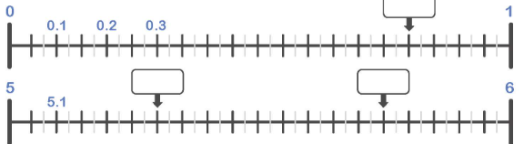
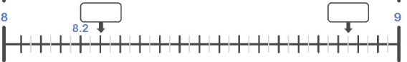
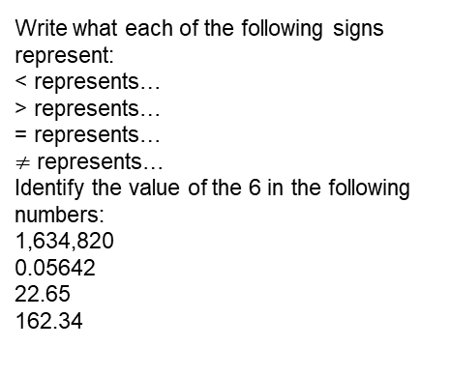
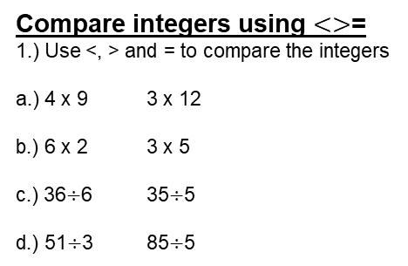
Year 7 – Place Value, Ordering and rounding
Write what each of the following signs represent:
< represents…
> represents…
= represents…
$≠$ represents…
Identify the value of the 6 in the following numbers:
1,634,820
0.05642
22.65
162.34
Define the following keywords:
Integer:
Interval:
Place Value:
Significant figure:
Negative:
Rounding to powers of 10
Round the following numbers to the nearest 100 and 1000
a.) 1525
b.) 1475
c.) 1501
Integer place value
1.) Write the value of the 8 in:
a.) 12830
b.) 9821
c.) 0.982
2.) Write the value of the 2 in:
a.) 0.342
b.) 12830
c.) 9821
Intervals on a number line
Decimal intervals on a number line
Compare integers using $<>$=
1.) Use <, > and = to compare the integers
a.) 4 x 9 3 x 12
b.) 6 x 2 3 x 5
c.) 36$÷$6 35$÷$5
d.) 51$÷$3 85$÷$5
Compare decimals using <>=
1.) Use <, > and = to compare the integers
a.) 0.814 0.84 e.) 1.4 11.2
b.) 0.18 0.6 f.) 101.92 100.23
c.) 0.73 0.99 g.) -12.23 -12.01
d.) 0.01 0.001 h.) -0.21 -0.2

