Slide 1

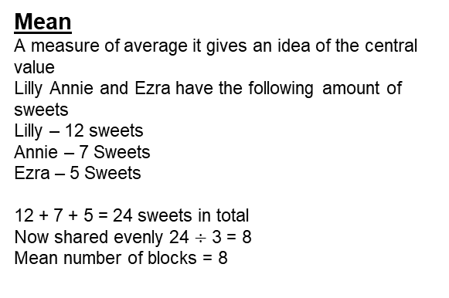
Year 7 – Averages, Rounding and Estimation
Powers of 10
Know what mean, median, range and mode are
Four Operations
Mode: The number that occurs the most in data
Median: Found by putting values in order and finding the middle value
Mean: the sum total divided by the amount of numbers in the data.
Range: difference between the largest and smallest numbers
Significant figure: a digit that gives meaning to a number. The non-zero number furthest to the left
Rounding to powers of 10
Rounding integers
Mean
Mode and Range
Mode Range
The number that occurs the most.
‘Find the mode of the following numbers’
1 2 3 3 3 4 4 6 7
3 appears more times than the rest
Mode = 3
Difference between the largest and smallest.
‘Find the range of the following numbers’
3 9 8 12
12 – 3 = 9
Range = 9
Round to significant figures
1 Significant Figure
Round the first non-zero number
‘Round 27 to 1 significant figure’ = 30
2 7
2 Significant Figure
Round the second non-zero number
‘Round 234 to 1 significant figure’ = 230
23 4
First non-zero number
If number is below 5 round down if the number is above 5 round up
Mean
A measure of average it gives an idea of the central value
Lilly Annie and Ezra have the following amount of sweets
Lilly – 12 sweets
Annie – 7 Sweets
Ezra – 5 Sweets
12 + 7 + 5 = 24 sweets in total
Now shared evenly 24 $÷$ 3 = 8
Mean number of blocks = 8
second non-zero number
If number is below 5 round down if the number is above 5 round up
Estimation
Estimations are useful – especially when using fractions and decimals to check if your solution is possible]
Most estimations round to 1 sig fig.
210 + 899 < 1200
This is true because when estimated the answer is much lower than 1200
200 + 900 = 1100
Median
The middle value after the values are put in order
Example 1
Find the median of the following numbers.
4 3 9 8 12
Put in numerical order → 3, 4, 8, 9, 12
Example 2
Find the median of the following numbers.
15, 16, 14, 18, 19, 20 → 14, 15, 16, 18, 19, 20
There are 2 middle numbers so find the midpoint
16--------17--------18 Median = 17

Slide 2


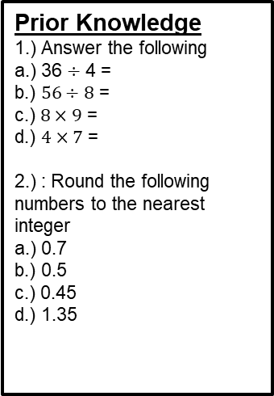
Year 7 – Averages, rounding and estimation
Prior Knowledge
1.) Answer the following
a.) 36 $÷$ 4 =
b.) $56÷8$ =
c.) $8×9$ =
d.) $4×7$ =
2.) : Round the following numbers to the nearest integer
a.) 0.7
b.) 0.5
c.) 0.45
d.) 1.35
Define the following key terms:
Mean –
Median –
Mode –
Range –
Mode – Work out the mode of the following
Round to Significant figures
1.) Round to 1 significant figure
a.) 1.9 d.) 98
b.) 27 e.) 54
c.) 93 f.) 135
2.) Round to 2 significant figures
a.) 1.27 d.) 1356
b.) 43.8 e.) 923.7
c.) 906 f.) 23.49
Range
1.) Work out the range of the following
Mean
1.) Work out the mean of the following
2.) Find the mean of the following
Estimation
1.)
a.) 12 x 10 d.) 0.98 x 3.2
b.) e.)
c.) 13 x 19 f.)
Median
1.) Work out the median of the following
2.) Find the median of the following

