Slide 1

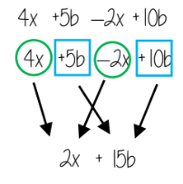
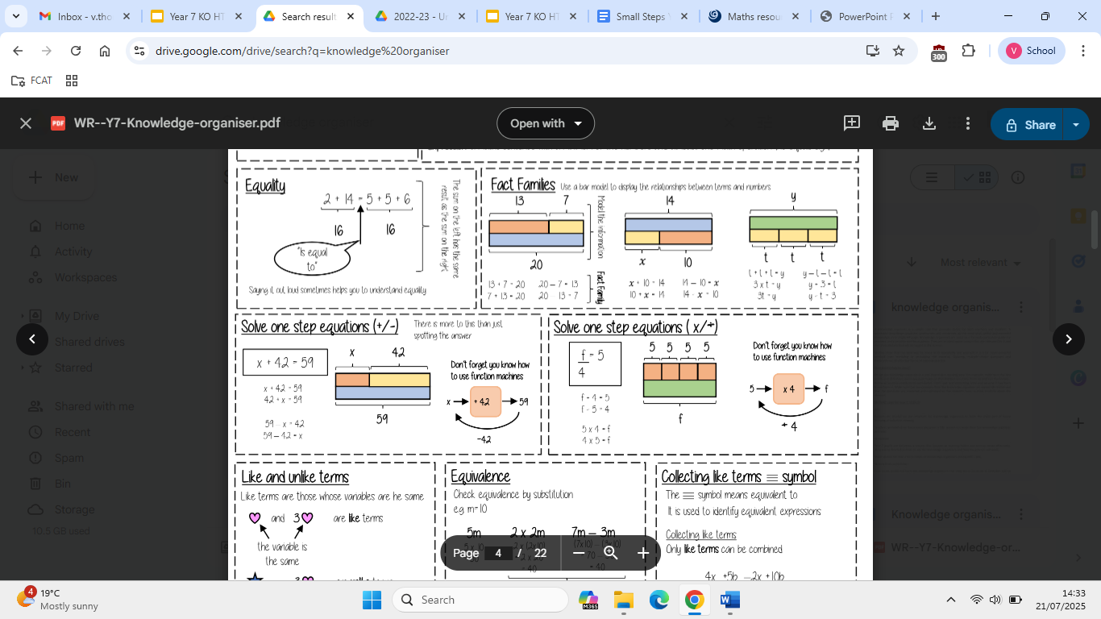
Year 7 – Algebra – Expressions & Equations
Know inverse operations. Know correct algebraic notation e.g. 4 x b = 4b. Recognise like and unlike terms.
Know when terms can be collected.
Equation: a mathematical statement where one side is equal to the other side
Solve: to find a solution
Term: a single number or variable
Like: variables that are the same are ‘like’
Inverse: opposite effect of
Collecting Like Terms
Only like terms can be combined.
x + x + x = 3x
2t + 5t = 7t
11e - 5e = 6e
a + a + b + b + b = 2a + 3b
4x + 5b - 2x + 10b
4x - 2x = 2x
5b + 10b = 15b
2x + 15b
Function Machines
Bar Modelling
Inverse Operations
Algebraic Notation
Like and Unlike Terms
Like terms are those whose variables are the same.
Like terms:
y, 4y
5, -2
h², 4h²
ab, 10ba (notice here ab and ba are commutative operations, so are still like terms)
Unlike terms:
7x, y
ab, 10a
-2t, -2
2x², 2c²
Solving 1-step equations (x/÷)
Solving 1-step equations (+/-)

Slide 2
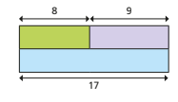
Year 7 – Algebra – Expressions & Equations
The inverse of subtraction is…
The inverse of multiplication is…
What does 5t mean?
What does the bar model represent?
Define the following keywords:
Equation:
Solve:
Term:
Like:
Inverse:
Collecting Like Terms
Simplify these expressions so they only have one term:
7𝑎 + 2𝑎 =
3𝑎 + 4𝑎 + 5𝑎 =
10𝑏 − 3𝑏 + 5𝑏 =
6𝑥² + 5𝑥² =
2𝑎𝑏 + 6𝑎𝑏 − 3𝑎𝑏 =
Like and Unlike Terms
Tick which pairs are like terms:
3h and 5h
2k and 7hk
b² and 4b²
3e and 3e²
d and 246d
Solving 1-step equations (+/-)
Solve the following equations:
g + 59 = 81
18.8 + b = 27
73.1 = e + 51
243.2 = 108 + k
70 - s = 28
p - 201 = 423.9
Solving 1-step equations (x/÷)
Draw a bar model to represent 3b = 39
Solve the following equations:
4a = 32
2p = 17
8 = 20b
9 = m
15

