Slide 1

Year 7 – Algebraic Notation and Substitution
Know inverse operations.
Know correct algebraic notation e.g. 4 x b = 4b
Know how to identify square and square root on a calculator.
Know the meaning of variable, term and expression.
Function: mathematical relationship between an input and output, written as a rule
Input: number, term or expression that goes into a function and results in an output
Output: number, term or expression that results from a function being applied to an input
Inverse: opposite effect of
Substitution: replace letters with numerical values
Expression: collection of terms involving variables and numbers
Substitution into expressions - 1 step
Example 1
4y means 4 lots of ‘y’
If y = 7, this means the expression is asking for 4 lots of 7.
4 x 7 = 28
Example 2
y - 2 means y subtract 2
If y = 7, this means the expression is asking for 7 subtract 2.
7 - 2 = 5
Function Machines
Bar Modelling
Inverse Operations
Function Machine - 1 step
A 1-step function machine has only one operation (rule) applied to the input.
Input → [Operation] → Output
Finding the Output
Machine: Add 5 Input: 7
7 → +5 → 12
Machine: Multiply by a Input: 4
4 → x a → 4a
To find the input from the output. Use the inverse operation.
Substitution into expressions - 2 step
Example
Expression: 2x+5
If, x=4
Substitute: 2×4+5
Step 1 (Multiplication): 8+5
Step 2 (Addition): 13
Function Machine - 2 step
Input → [Operation 1] → [Operation 2] → Output
Finding the Output
Machine: Multiply by 2, add 3 Input: 4
4 → x 2 → + 3 → 11
Machine: Multiply by 5, subtract 3 Input: b
b → x 5 → - 3 → 5b - 3
8

Slide 2
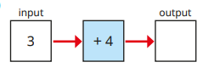
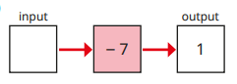
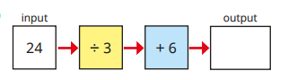
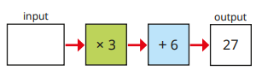
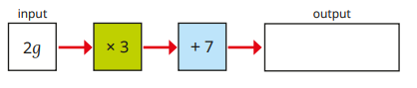
Year 7 – Algebra – Algebraic Notation and Substitution
The inverse of addition is…
The inverse of division is…
The inverse of squaring is…
Complete the calculation
8 + = 15
5 x = 65
Define the following keywords:
Function
Input
Output
Inverse
Substitution
Expression
Substitution into expressions - 1 step
If x=8, what is the value of x+5?
If y=15, what is the value of y−7?
If a=6, what is the value of 3a?
If b=20, what is the value of b?
4
If c=9, what is the value of c²?
Function Machine - 1 step
Function Machine - 2 step
Substitution into expressions - 2 step
If m=5, what is the value of 3m−4?
If p=7, what is the value of 2(p+1)

