Slide 1

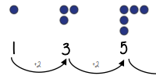
Year 7- Sequences
Sequence: list of items in a given order, usually following a rule
Term: number/object that relates to a specific position in a sequence Rule: description to generate terms in a sequence
Linear: sequence with a common difference between consecutive terms
Non-Linear: sequence with no common difference between consecutive terms
Position: where a number or diagram is located in a sequence
Consecutive: following one after another without any gaps eg. 1, 2, 3
Know the difference between linear and non-linear sequences.
Know how to identify a Fibonacci sequence.
Linear Sequences- sequence with a common difference between consecutive terms
Recognising patterns
Number facts
Linear Sequences 7, 11, 15, 19…
How do I know this is a linear sequence?
It increases by adding 4 to each term.
How many terms do I need to make this conclusion?
At least 4 terms – two terms only shows one difference not if this difference is constant. (a common difference).
How do I continue the sequence?
You continue to repeat difference for each consecutive term.
Non Linear Sequences
1, 2, 4, 8, 16 …
How do I know this is a non-linear sequence?
It increases by multiplying the previous term by 2. – this is a geometric sequence because the constant is multiply by 2
How many terms do I need to make this conclusion?
At least 4 terms – two terms only shows one difference not if this difference is constant. (a common difference).
Sequences (Patterns and Diagrams)
How do I work out the term-to-term rule?
Count the number of circles in each pattern and record as a number then work out the difference between the numbers.
How do I work out the next term?
Continue the number sequence then draw that number of circles.
Does the pattern/diagram always involve a circle?
The pattern or diagram could be made up on any shape. The most common are circles or lines to represent match sticks.
Fibonacci Sequence
A Fibonacci sequence is where you add the two previous terms together to get the next term.
1, 1, 2, 3, 5, 8, 13, 21, 34, 55, 89, 144…
1+1 = 2
1+2 = 3
2+3 = 5
3 + 5 = 8
5+8 = 13
8+13 = 21
13+21 = 34

Slide 2
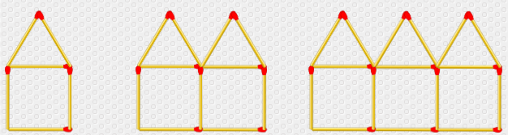
Year 7- Sequences
Find the difference between the following sets of numbers:
7 and 11
2 and 13
31 and 38
72 and 81
Fill in the blanks
6 + _ = 9 12 - _ = 5 7+_ = 39
Define the following:
Sequence
Term
Rule
Linear
Non-Linear
Position
Consecutive
Linear sequences
Write the next three terms and the rule.
7,10,13…
10,8,6…
14,18,22…
-6,-4,-2…
Non Linear Sequences
Find the next term in
each geometric sequence
2, 10, 50…
5, 15, 45, 135…
200, 50…
Fibonacci Sequence
The first two terms of a Fibonacci sequence are 1 and 1
The term-to-term rule is: To find the next term, add the two previous terms together.
Write the first seven terms of the sequence.
Seqeunces (Patterns and Diagrams)
How many matchsticks are in each diagram?
What are the matchsticks increasing by each time?
How many matchsticks would be in the next two diagrams?
Can you draw the next two diagrams?

